Slide 1

成長電影院
第八節
Miss K Miss M

Slide 2
小組規則
準時出席
尊重他人
安靜坐好
用心觀看
專心聆聽
積極參與
帶手冊及完成小任務

Slide 3

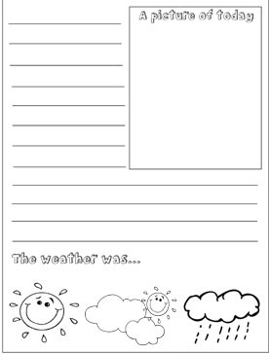
分享時間：上一節小任務
我的日記
請在一週內寫至少 4 天日記，紀錄你的每天
Notes:
HWK: Diary

Slide 4

Compassion

Slide 5

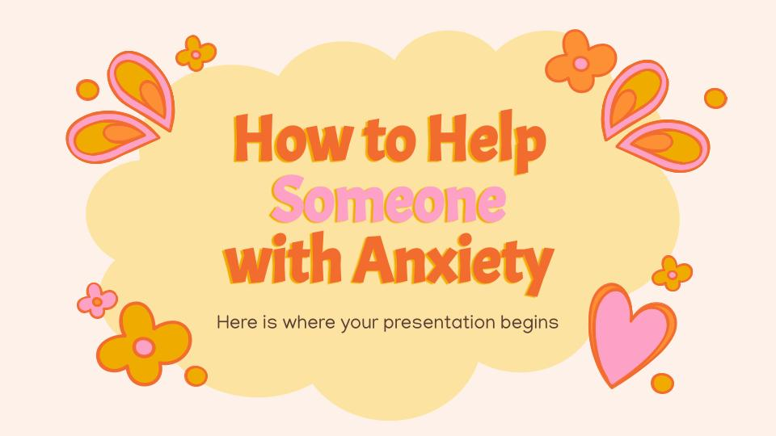
MOVIE TIME
公主日記
The Princess Diaries (2001)
Notes:
Summary: Part 2 (56:00-end)
Joe reminds Clarisse that Mia is still both a teenager and her granddaughter, suggesting that the queen reacted too harshly. After making amends with Lilly, Mia finally stands up to Lana for bullying a schoolmate. Mia invites both Lilly and Michael to the ball but Michael declines. After Clarisse apologizes to Mia for scolding her, she states that Mia must publicly renounce the throne at the ball. Terrified by the prospect, Mia plans to run away until she discovers a touching letter from her late father. When they finally arrive, Mia, still wet and untidy from the rain, accepts her role as Princess of Genovia. After changing into a gown, Mia accompanies Clarisse into the ballroom where Michael, who has accepted Mia's apology. In the final scene, Mia is shown traveling to Genovia in a private plane with her pet cat Fat Louie, and writes in her diary that she plans to relocate to Genovia with her mother.
-1:06:47 MIA + Queen have fun and settled the traffic accident
-1:13:10 Lily’s show (Mia missed it)
1:20:52-1:23:50 Lily got mad at Mia and they made up
1:31:05 Grandma told Mia she has faith in her but Mia doesn’t want to disappoint
1:50:03 END OF MOVIE

Slide 6
成長電影院
回顧一下這8節課堂，分享一樣最令你深刻的活動/學到什麼。
Notes:
目的：讓同學反思這八節課堂裏有什麼得著

Slide 7
10分鐘
休息時間
Notes:
10 minute break

Slide 8
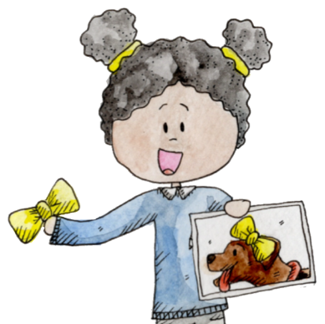
Show and Tell
給演講同學一個鼓勵🥰
問演講同學一條問題🙋🏻
Notes:
目的：讓同學們練習專心聆聽及欣賞他人，給其他人鼓勵和支持（聆聽部分）；讓同學們練習演講，並增強自信心（演講部分）

Slide 9

C - Curiosity 好奇
O - Openness 開放
A - Acceptance 接受
L - Love 自愛

Slide 10
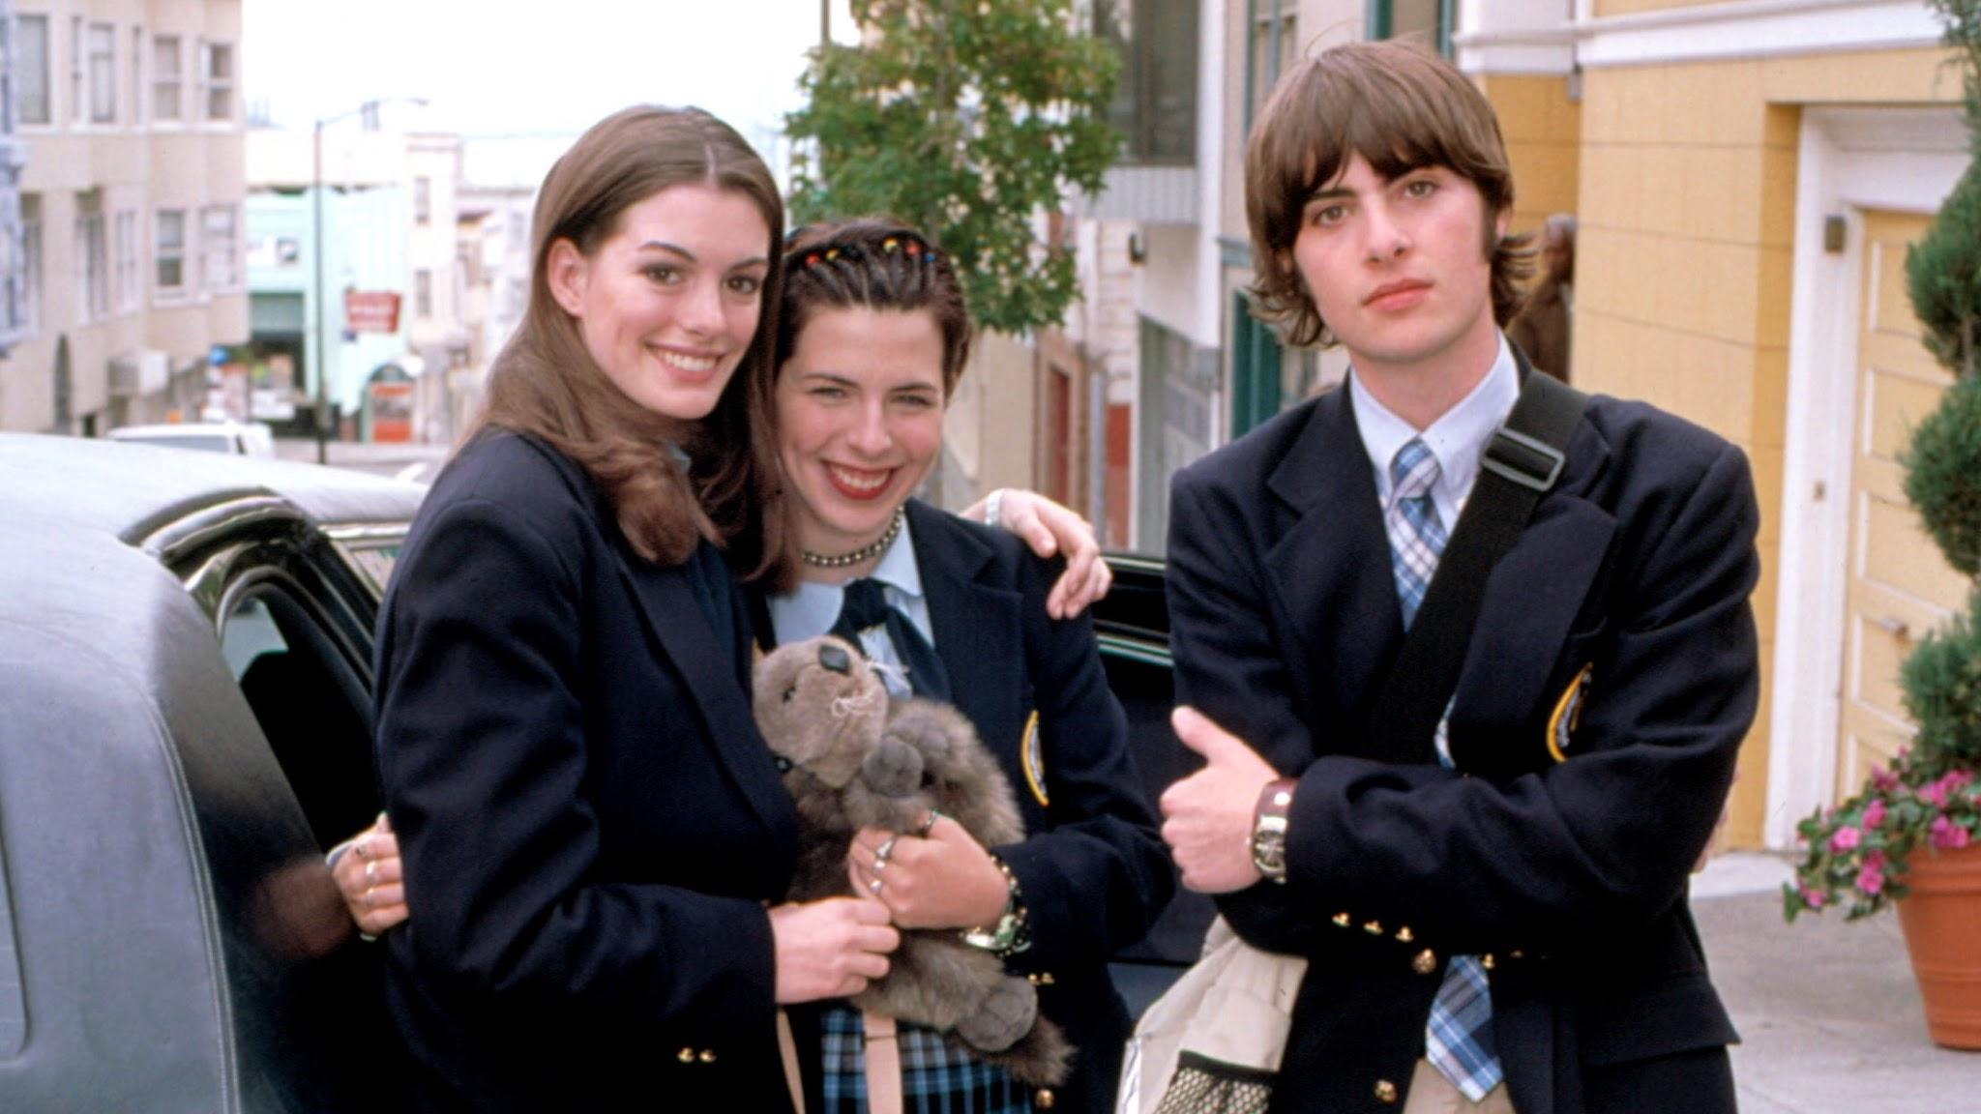
No one can make you feel inferior without your consent.
在未經你同意之下，沒有人可以讓你覺得自卑。
Notes:
No one can quit being who they are, not even a princess.
沒有人可以放棄做自己，即使是公主也不行
Courage is not the absence of fear but rather the judgment that something else is more important than fear. The brave may not live forever but the cautious do not live at all.
勇敢並不是「不畏懼」，而是分辨到有其他比畏懼更重要的事。勇敢的人也許無法活很久，但謹慎的人卻不會真正地活過。

Slide 11


今天是最後一節了！

