Slide 1

成長電影院
第七節
Miss K Miss M

Slide 2
小組規則
準時出席
尊重他人
安靜坐好
用心觀看
專心聆聽
積極參與
帶手冊及完成小任務

Slide 3

分享時間：上一節小任務
當你生氣時，你會希望朋友怎樣安慰你呢？
Notes:
HWK: 當你生氣時，你會希望朋友怎樣安慰你呢？

Slide 4

Compassion

Slide 5

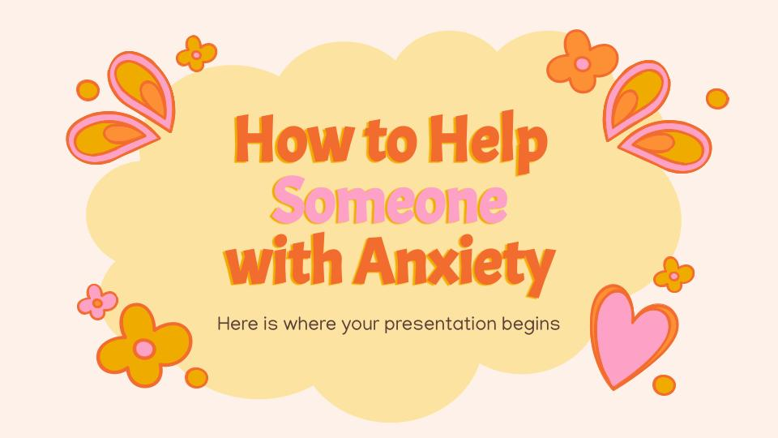
MOVIE TIME
公主日記
The Princess Diaries (2001)
Notes:
Summary: (00:00-55:00)
Mia Thermopolis is a student at Grove High School residing with her single mother. Unpopular among her peers, Mia suffers from a fear of public speaking and is often teased by her classmate Lana Thomas. Mia's only friends are social outcast Lilly Moscovitz and Lilly’s older brother, Michael. Mia learns from her estranged paternal grandmother, Clarisse, that she is sole heir to the kingdom of Genovia. Clarisse is determined to groom Mia into a refined princess. Mia initially refuses until her mother convinces her to attend her grandmother's "princess lessons".
Mia receives a glamorous makeover and a limousine chauffeured by Joe. Mia's transformation causes her schoolmates to treat her differently, while her increasingly hectic schedule strains her relationship with Lilly. To appease her best friend, Mia tells Lilly the truth and swears her to secrecy. However, the public soon learns that Mia is a princess and the paparazzi begins to pursue her relentlessly. Although Mia embarrasses herself at her first state dinner, the queen admits that she found her clumsiness endearing and suggests that they spend quality time together, canceling their lessons for the following afternoon.
18:00 till Mia got told she’s a princess and she confronted her mother
35:10 till Mia learned to do the Spanish dance
Start from 36:07-42:25 Mia’s makeover + Lily taunting Mia on her change + Joe comforts Mia
-45:30 Lily helping Mia out with bullies
46:37-47:12 Destressing with paintball
-52:38 Mia’s identity was exposed at school + Lily asked Mia to be in her show + Mia feels insecure and unconfident
From this onwards —> Geneva dinner

Slide 6
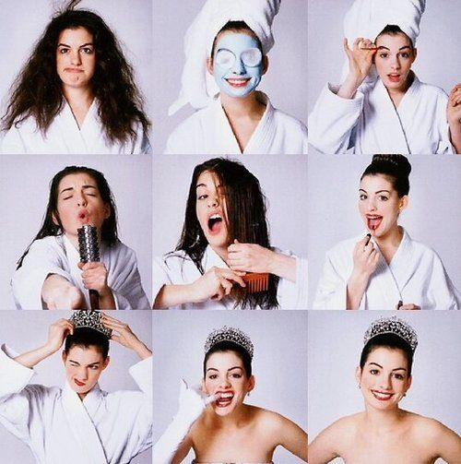
Compassion for self 善待自己
接受自己與眾不同的一面，包容自己的不足，減少自我批評

Slide 7
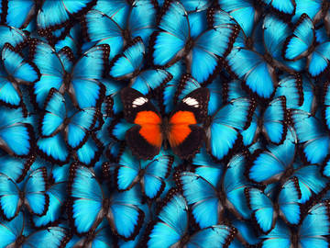
Individual Quirks 個人特別之處
興趣
外觀
性格
說話方式
情緒
思想模式
Notes:
目的：讓同學發掘自己的個人特別之處，不要 label 好與壞；讓同學發現其他人也有自己的個人之處，沒有兩個人是完全相同的

Slide 8
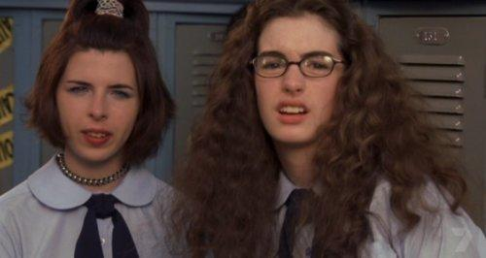
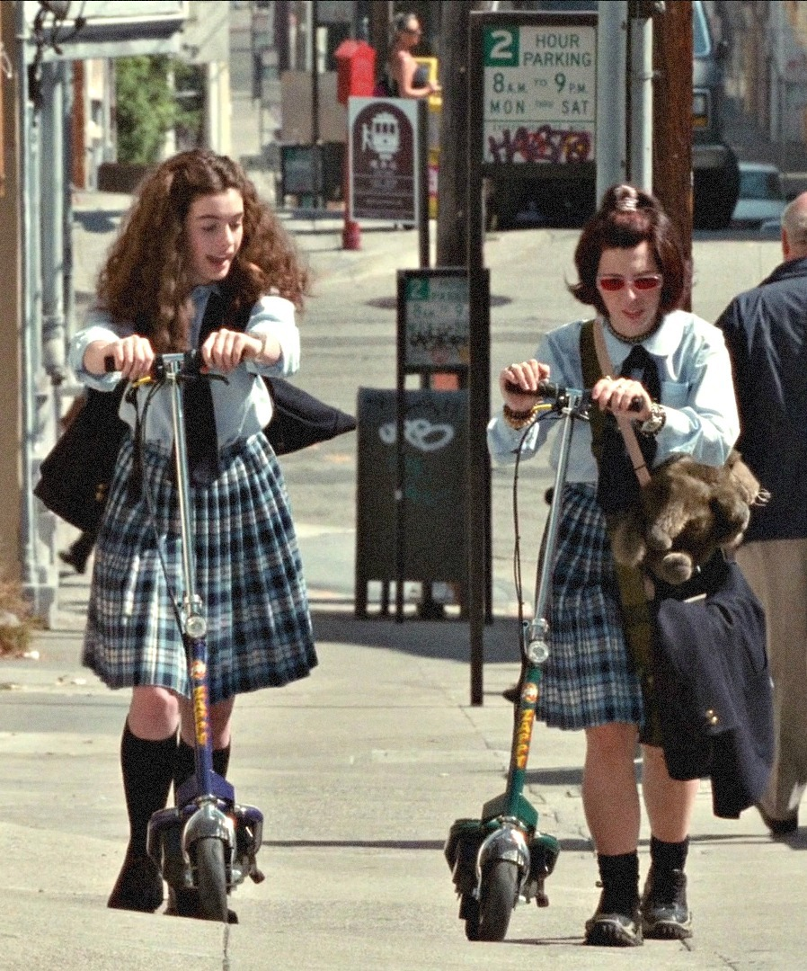
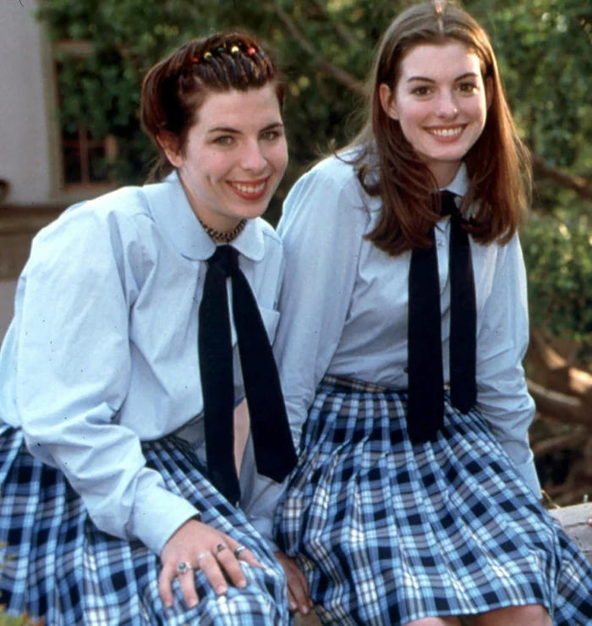
Friendship Analysis 友誼分析
Notes:
目的：讓同學反思什麼是好的友誼？
Q: What makes a good friendship?
-e.g., compassion
Trust/honesty
Ability to apologize and forgive
Support for one another
Similar interests
Willing to make time for you

Slide 10
10分鐘
休息時間
Notes:
10 minute break

Slide 11
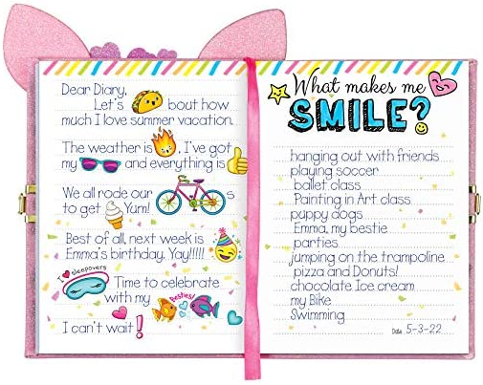
Dear diary日記
心情
日期
文字
文字
事情
地點
畫畫
人物
Notes:
Discuss on different triggers and sensations they have when they experience different emotions (can use animal or any analogies) → Miss K & Miss M can also share their own experiences

Slide 12
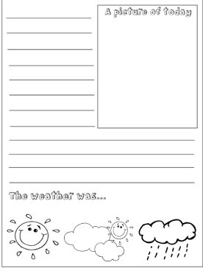
「我的日記小任務」：
我的日記
請在一週內寫至少 4 天日記，紀錄你的每天
Notes:
HWK: Diary

Slide 13
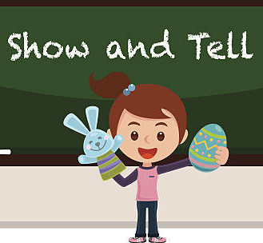
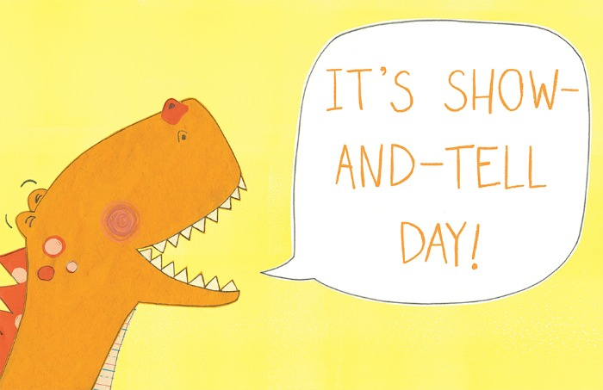
下堂預告 - Show and Tell!
請帶備一樣物件/相片，下堂跟同學們分享！

Slide 14
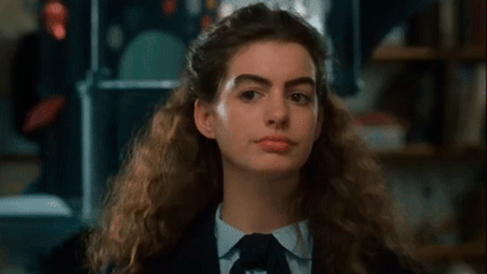
下一節：X月X日
xx:xx - xx:xx
記得完成小任務呀！

