Slide 1

成長電影院
第五節
Miss K Miss M

Slide 2
小組規則
準時出席
尊重他人
安靜坐好
用心觀看
專心聆聽
積極參與
帶手冊及完成小任務

Slide 3

分享時間：上一節小任務
請寫/畫出如何走出舒適圈。
Notes:
HWK: 請寫/畫出如何走出舒適圈。

Slide 4

Social support

Slide 5

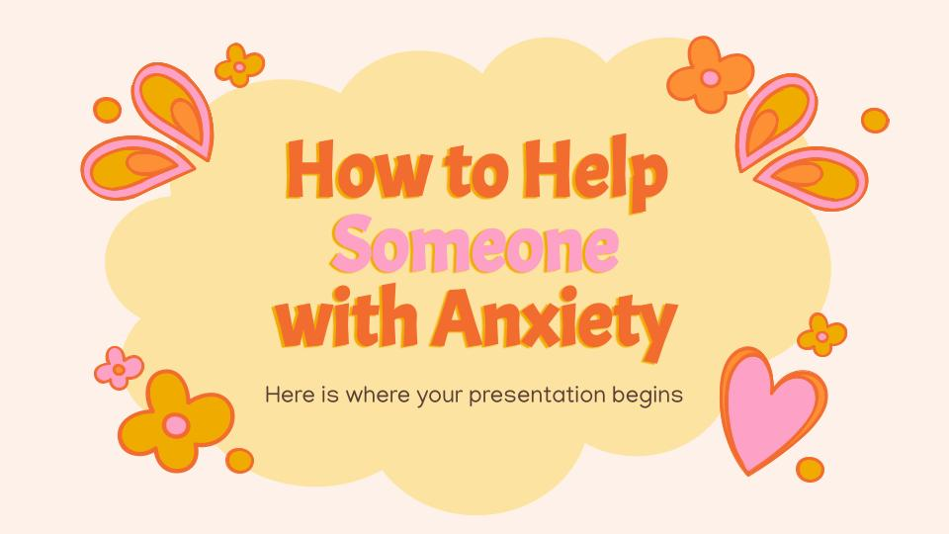
MOVIE TIME
魔髮精靈
Trolls (2016)
Notes:
Watch Theme 1 Trolls (00:00 - 49:44) - just after Branch told everyone singing killed his grandma
Theme 2 Trolls (49:45 - 1:11;57 - finish)

Slide 6
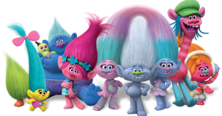
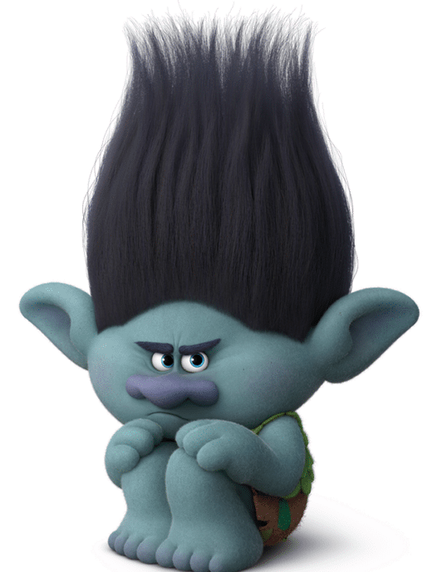
Social support 社交支援

Slide 7
Games that require teamwork
Describe and Draw
收買佬
The blindfold walk
Character analysis - Poppy/Branch
Notes:
Blindfold Walk
This is a fun game that can be played with all ages and groups. To do it, you’ll need a blindfold, several obstacles (chair, stool, table), open space to move in, and some musical instruments.
The group members work in pairs: a leader and a follower. The follower is blindfolded, and the leader guides them. The rest of the group makes noise with the instruments to guide the follower.
There should be no talking in this game. A different instrument sound will indicate a different way to walk (left, right, backward, or straight ahead). Adding a timing element to the task makes it even more exciting to see which couple finishes quicker.
As the couples have to work together, this game also promotes cooperation, active listening, problem solving, and trust in social interactions
https://positivepsychology.com/social-skills-groups/

Slide 8
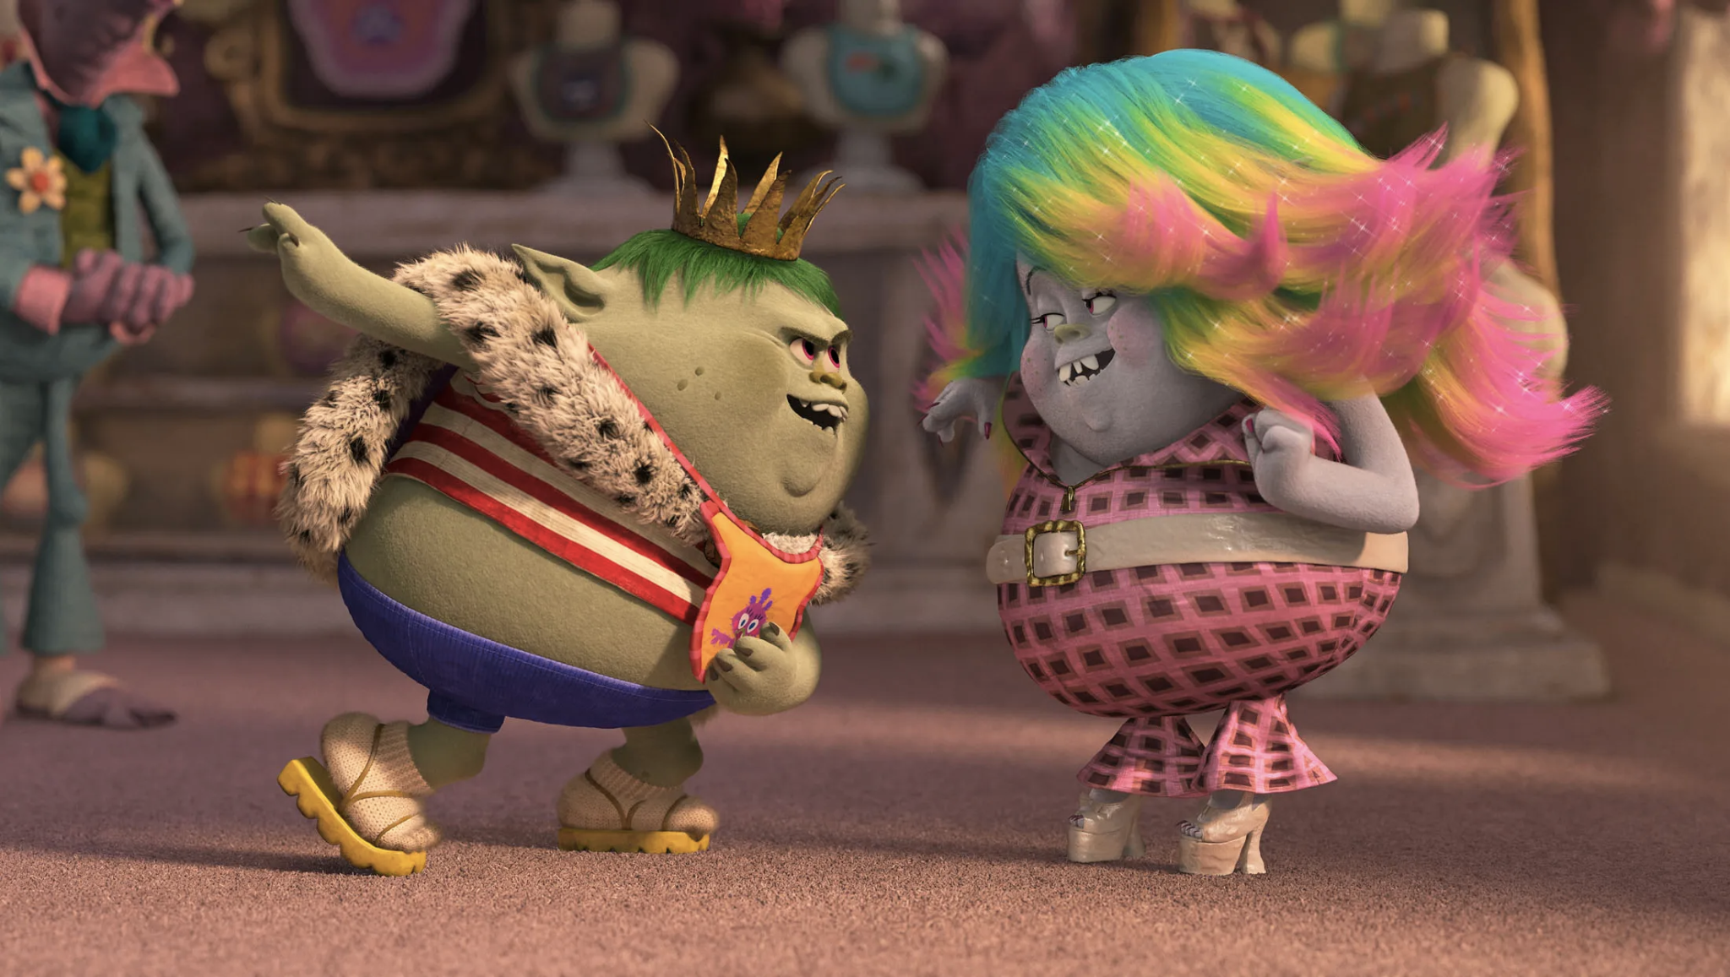
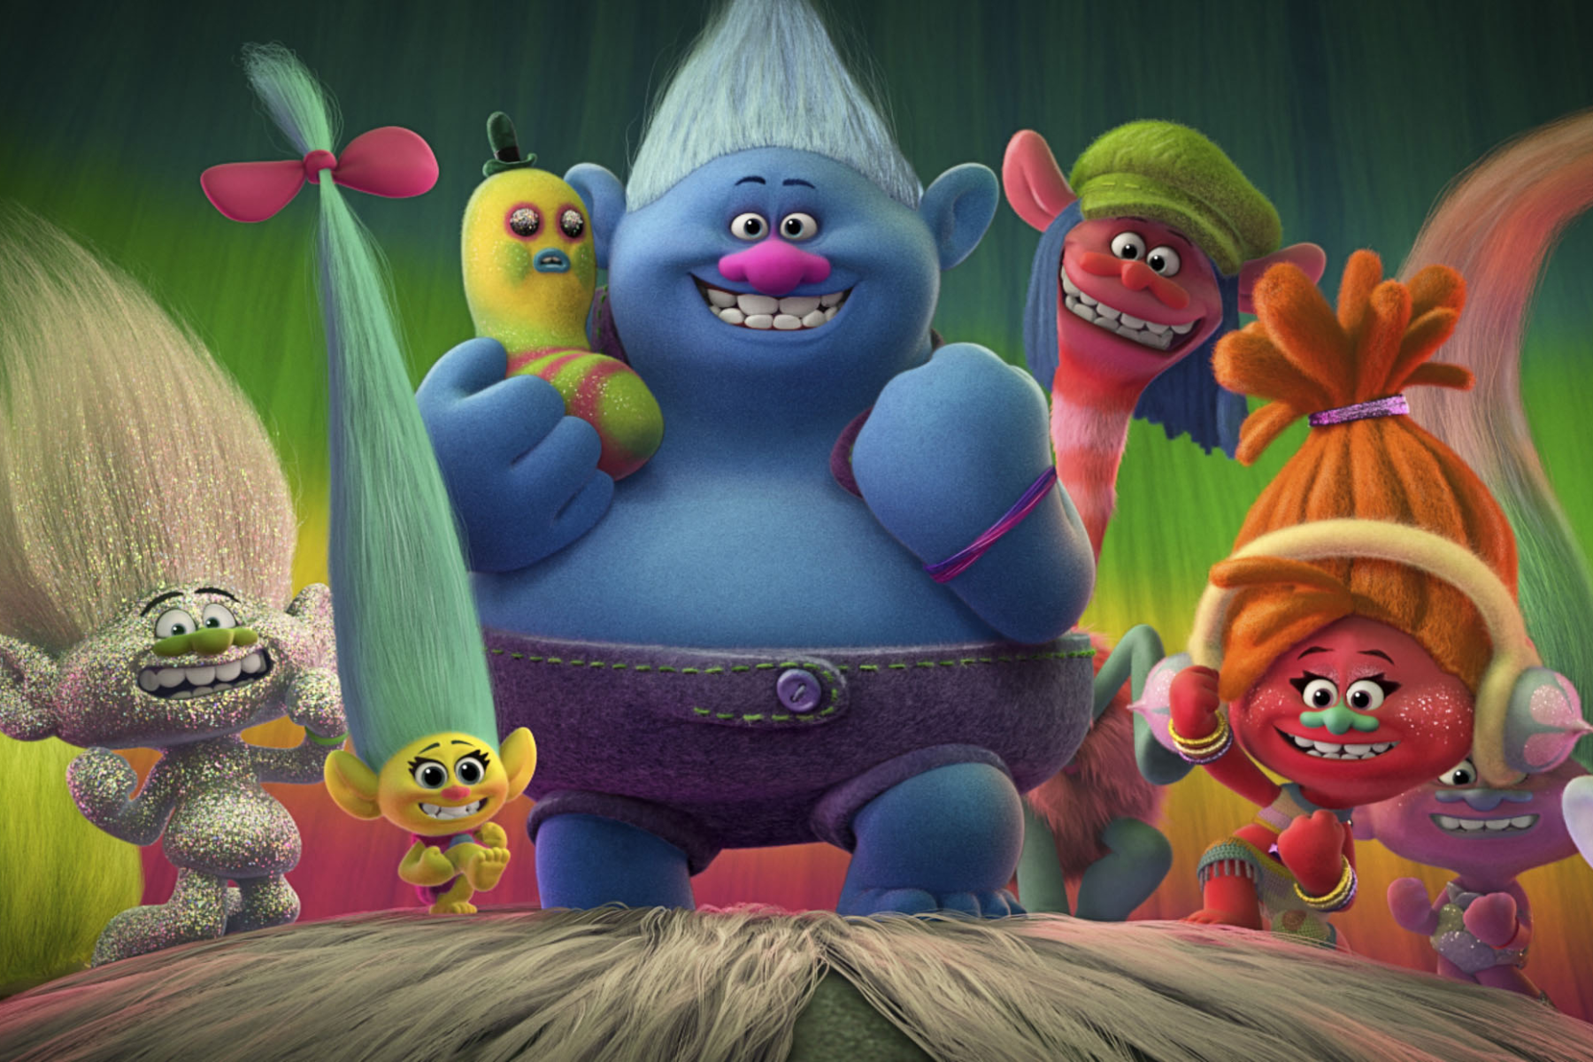
你對朋友有什麼期望呢？
給予鼓勵
給我們進步的動力
令我們感覺被接納
需要時提供支援和幫助

Slide 10
10分鐘
休息時間
Notes:
10 minute break

Slide 11
當我們感到焦慮時....
呼吸急促
面紅
小動作變多(磨牙，搣手指)
肚痛
出手汗
心跳加快
Notes:
Discuss on different triggers and sensations they have when they experience different emotions (can use animal or any analogies) → Miss K & Miss M can also share their own experiences

Slide 12
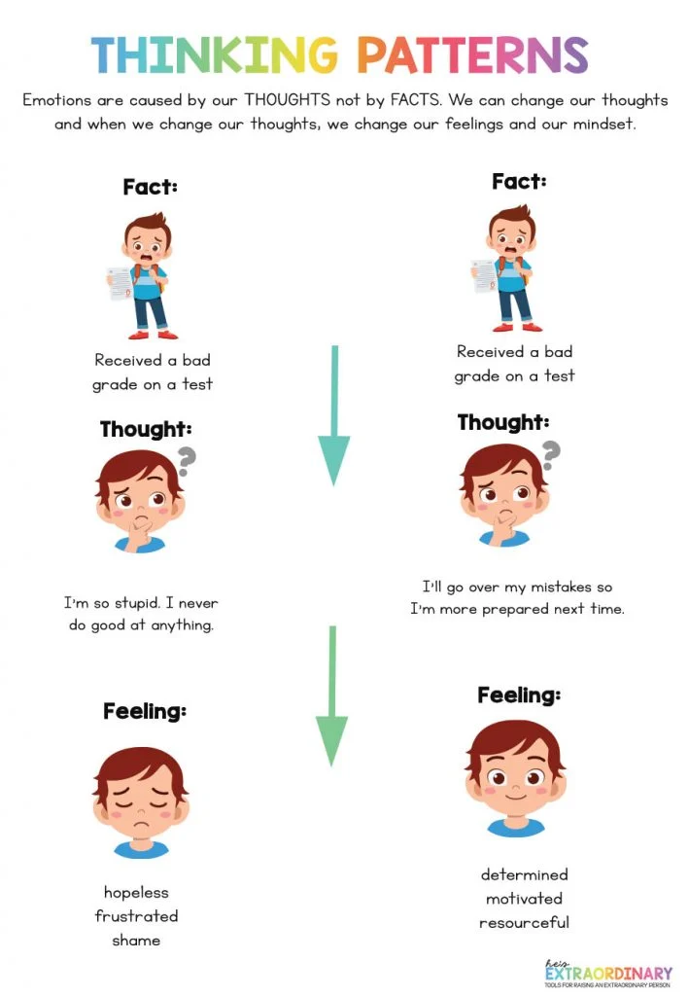
F.T.F.
情緒想法換轉
考試不合格
考試不合格
我真的太蠢了，我什麼都做不到
我會更加留意答錯的題目，為下次考試做好準備！
絕望
失望
慚愧
有決心
有動力
平靜

Slide 13
「F.T.F. 情緒想法換轉小任務」：
請換轉並改寫左邊的思考模式和感受
在課堂上答錯問題
在課堂上答錯問題
在課堂上答錯問題
同學肯定在取笑我，覺得我很愚蠢
？
傷心
失望
慚愧
？
Notes:
HWK: 請換轉並改寫左邊的思考模式和感受

Slide 14
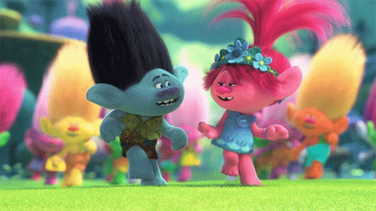
下一節：X月X日
xx:xx - xx:xx
記得完成小任務呀！

