Slide 1

成長電影院
第四節
Miss K Miss M

Slide 2
小組規則
準時出席
尊重他人
安靜坐好
用心觀看
專心聆聽
積極參與
帶手冊及完成小任務

Slide 3

「畫畫小任務」：
請把情緒寫在適當的位置上：
焦慮 / 開心 / 驚慌 / 滿足 / 擔心 / 興奮 / 好奇 / 熱情 / 放鬆
危險圈
伸展圈/學習區
舒適圈
Notes:
HWK: 分辨在舒適圈，伸展圈，危險圈會遇到什麼情緒

Slide 4

Comfort Zone

Slide 5
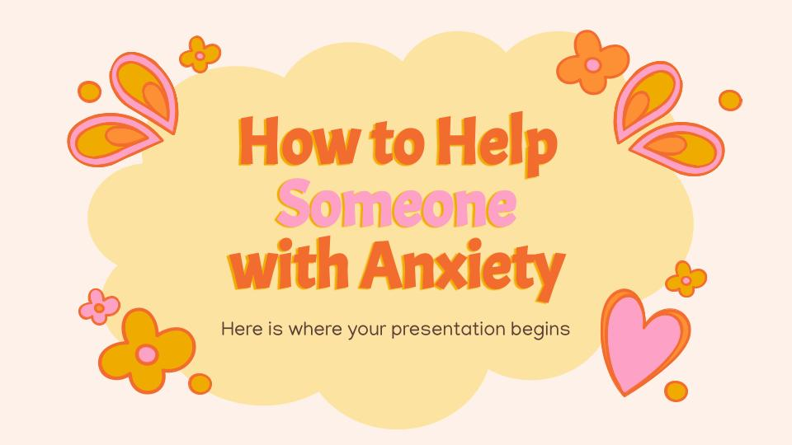
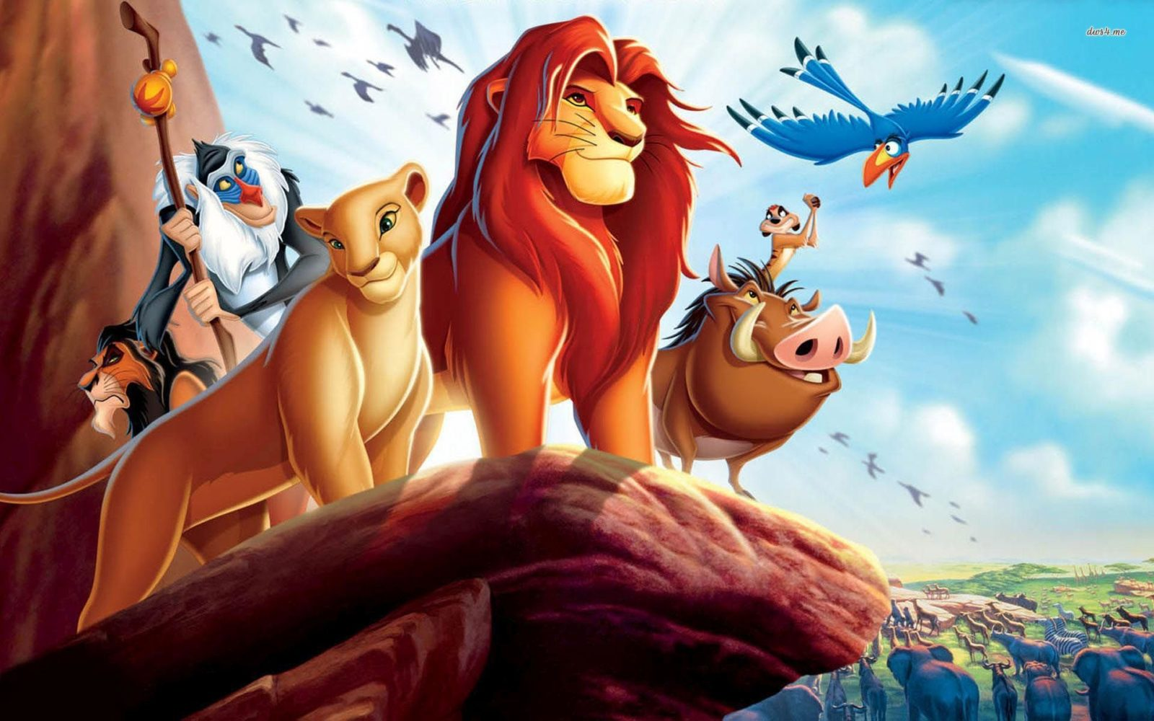
MOVIE TIME
獅子王
The Lion King (1994)
Notes:
Part 2 40:00 - 1:24:00
Timon and Pumbaa, a meerkat and warthog, rescue Simba, who has collapsed in a desert. Simba grows up with his two new friends in their oasis, living a carefree life under the motto "hakuna matata" ("no worries" in Swahili). Nala and Simba reunite and she urges him to return home. Still feeling guilty over Mufasa's death, Simba refuses and storms off. He encounters Rafiki, who tells him that Mufasa's spirit lives on in Simba. Realizing that he can no longer run from his past, Simba decides to return to the Pride Lands.
Aided by his friends, Simba sneaks past the hyenas at Pride Rock and confronts Scar. Scar begs for mercy and attempts to blame his crimes on the hyenas; Simba spares his life but orders him to leave the Pride Lands forever. The hyenas, who have overheard Scar's intention of betraying them, angrily maul him to death. Simba reclaims leadership and Nala becomes his queen. With the Pride Lands restored, Rafiki presents Simba and Nala's newborn cub to the assembled animals, continuing the circle of life.

Slide 6
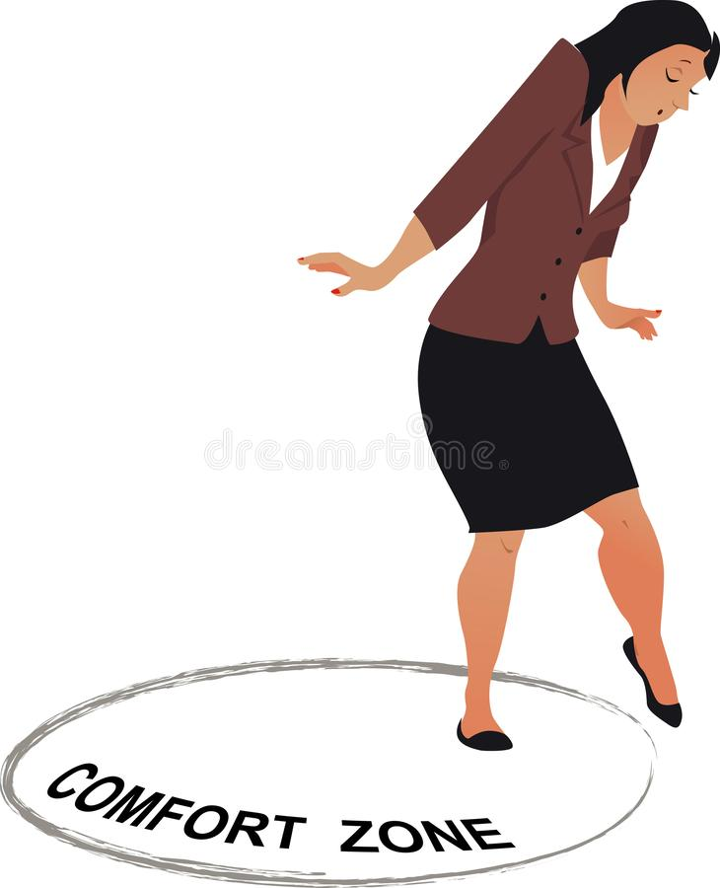
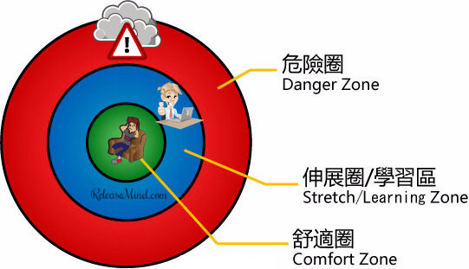
舒適圈遊戲
Notes:
目的：讓同學明白舒適圈和自己日常生活的關連
Miss K 將會講出的不同的情境，同學們需要判斷自己在不同的情境上是處於舒適圈/伸展圈/危險圈。
Introduce students on danger zone, stretch zone and comfort zone
https://hk.releasemind.com/post/167662983553/custom-plan-of-get-out-of-comfort-zone-1-personality-ana/
另一種學說，把踏出舒適圈的概念劃分為 3 個層次，如上圖。走出舒適圈的理念就是擴展個人的知識、技能、人脈、經驗，從而獲取更大的成就。這一個理想的層次，稱為「伸展區」或者「學習區」。學習新事物的過程會產生精神壓力和腦的負擔，適度的壓力有助人成長，但過度的學習就會像考試前夕用功的學生一樣，腦痛、胃痛等毛病百出，這種狀態稱為「危險區」。如果你確定你是在危險區，譬喻過度勞累、失眠、焦慮、憂鬱的話，情況就如站足於懸崖峭壁。你再踏出一步就可能會墮落懸崖，受到致命性的傷害。
當你忘記要休息和保養身體的時間，走回舒適圈也是跳出「小圈子」的想法

Slide 7

遊戲玩法
Miss K 將會講出的不同的情境，同學們需要判斷自己在不同的情境上是處於舒適圈/伸展圈/危險圈。
Notes:
Comfort zone bullseye game:同學們需要判斷自己在不同的情境上是處於舒適圈/伸展圈/危險圈

Slide 8
10分鐘
休息時間
Notes:
10 minute break

Slide 9
Comfort Zone的重要性

Slide 10
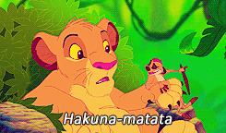
Hakuna Matata
哈庫那馬他他（斯瓦希里語：Hakuna Matata）一詞，源於斯瓦西里語，意思是「不用擔心」或「没有問題」。
Notes:
By, embracing the Hakuna Matata philosophy, Simba got comfortable in a life that meant “no worries, for the rest of his days. A problem-free, philosophy” which is an utopia, for we know that real life does not resemble nor adhere to this philosophy.

Slide 11
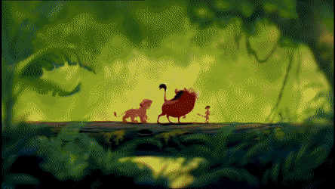
“Hakuna Matata” 這個哲理有什麼好處和壞處呢？
Notes:
目的：讓同學反思完全沒有焦慮或壓力的好處和壞處

Slide 12
辛巴是如何走出自己的舒適圈？
Notes:
目的：透過電影角色學習如何走出舒適圈

Slide 13
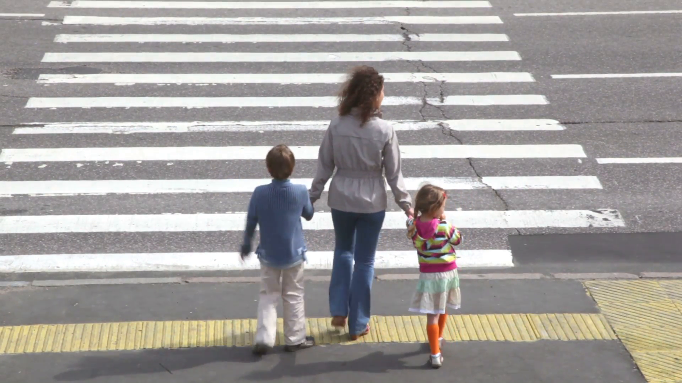
焦慮 - 面對危機和壓力時的本能反應
因為太焦慮、緊張導致不能過馬路 😖
太多
提醒我們過馬路前先留意路面情況 🚥 🚗
適量
完全不理會路面情況，衝出馬路 💥
太少
例子：過馬路
Notes:
目的：讓同學認識焦慮，並學會與這個情緒共存

Slide 14
「畫畫小任務」：
請寫/畫出如何走出舒適圈。
Notes:
HWK: 請寫/畫出如何走出舒適圈。

Slide 15
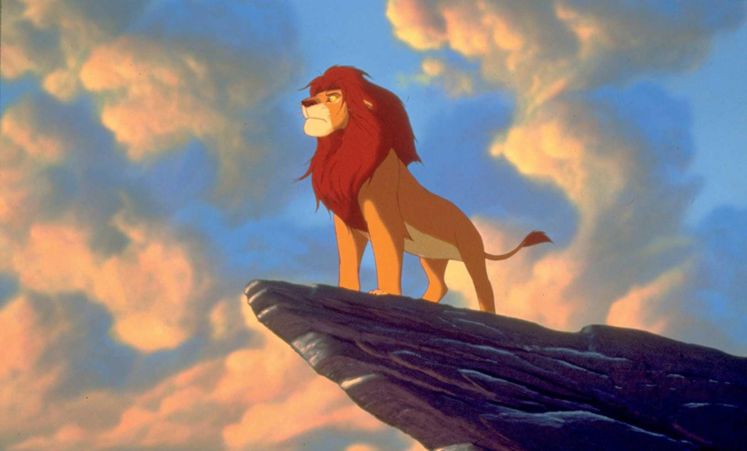
Ah yes, the past can hurt. But, you can either run from it or learn from it. 過去的傷痛會留下印記，但是你可以選擇逃避它，或是從中學習。

Slide 16

下一節：X月X日
xx:xx - xx:xx
記得完成小任務呀！

