Slide 1

成長電影院
第三節
Miss K Miss M

Slide 2
小組規則
準時出席
尊重他人
安靜坐好
用心觀看
專心聆聽
積極參與
帶手冊及完成小任務

Slide 3

分享時間：上一節小任務
請寫/畫出你最近一次情緒起伏的經歷。
Notes:
HWK: 請寫/畫出你最近一次情緒起伏的經歷。

Slide 4

Comfort Zone

Slide 5
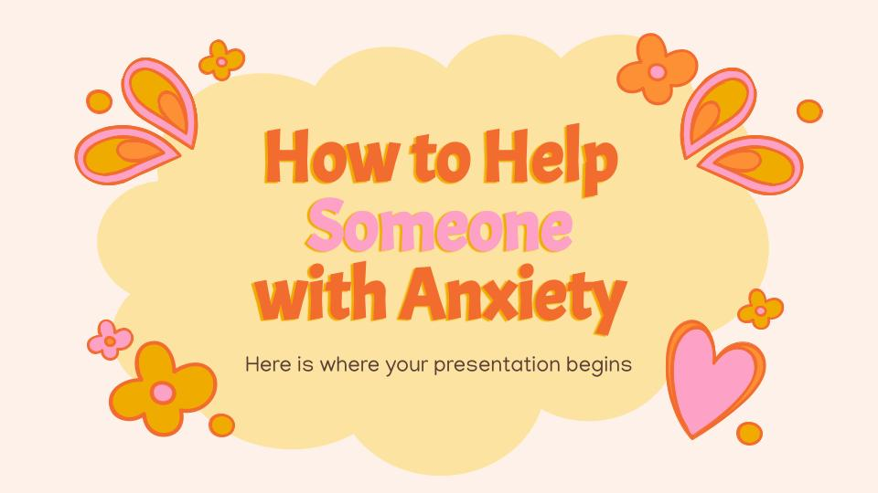
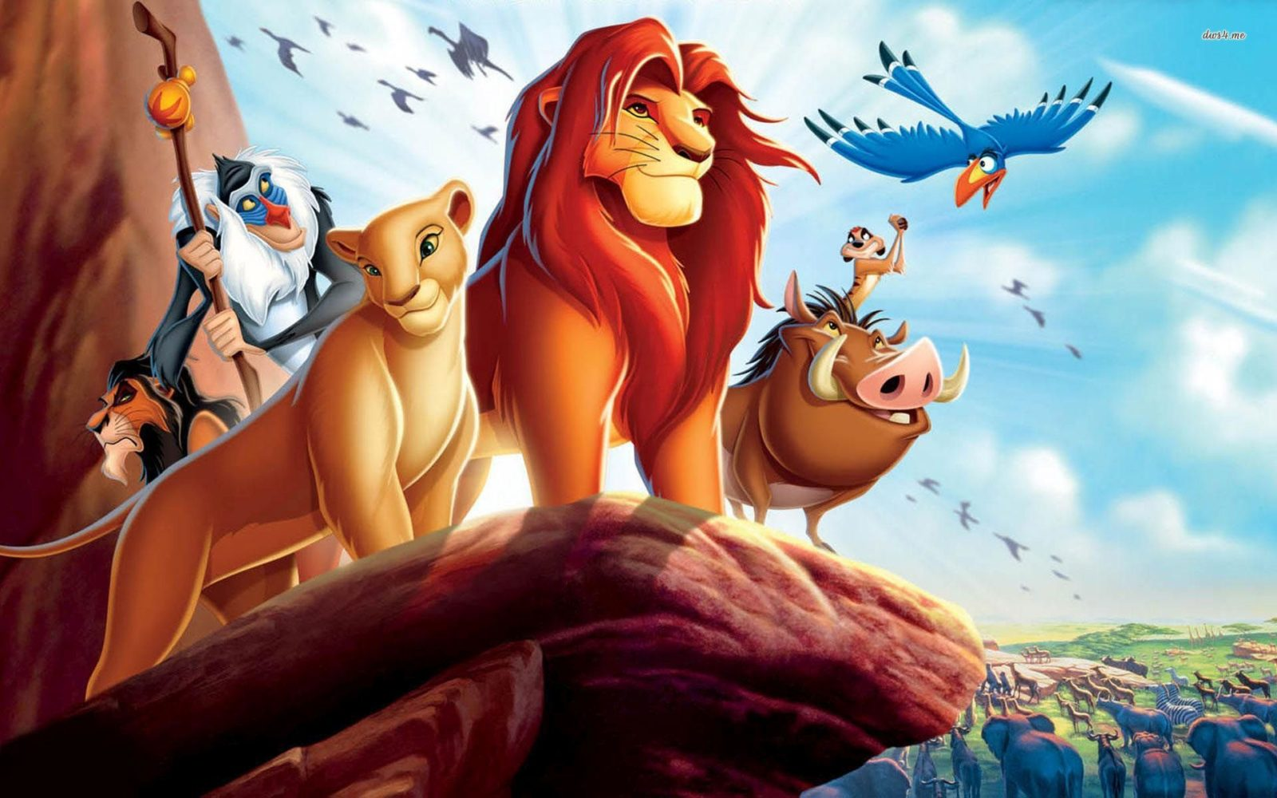
MOVIE TIME
獅子王
The Lion King (1994)
Notes:
0:00 - 40:05
In Africa, a lion rules over the other animals as king. King Mufasa showed off his newborn cub. The animals cheer and then bow to the new future king. Scar is envious of his brother's position as king and is disgruntled at the fact that he will never be king. Mufasa tells Simba he's forbidden from ever going to the dark side. Out in the plains, Mufasa tells Simba that there is a balance to all life which eventually comes full circle; the Circle of Life. Simba meets up with his friend Nala and tells her about a cool place he has found. Soon after, the hyenas came and attempted to attack Simba and Nala. A real roar is let out as Mufasa attacks the hyenas before they run off. Back in the Pride Lands, Mufasa tells Simba he's only brave when he has to be.
Scar tricks Simba and Mufasa, which ended up costing Mufasa’s life. Scar announces that both Simba and Mufasa have perished and assumes the role as king. A horde of hyenas arrives to live alongside Scar at Pride Rock. Rafiki watches sullenly from a distance and smears the image he had once created of Simba.

Slide 6
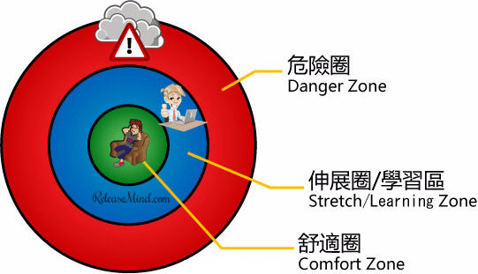
Comfort Zone 舒適圈
Notes:
Introduce students on danger zone, stretch zone and comfort zone
https://hk.releasemind.com/post/167662983553/custom-plan-of-get-out-of-comfort-zone-1-personality-ana/
另一種學說，把踏出舒適圈的概念劃分為 3 個層次，如上圖。走出舒適圈的理念就是擴展個人的知識、技能、人脈、經驗，從而獲取更大的成就。這一個理想的層次，稱為「伸展區」或者「學習區」。學習新事物的過程會產生精神壓力和腦的負擔，適度的壓力有助人成長，但過度的學習就會像考試前夕用功的學生一樣，腦痛、胃痛等毛病百出，這種狀態稱為「危險區」。如果你確定你是在危險區，譬喻過度勞累、失眠、焦慮、憂鬱的話，情況就如站足於懸崖峭壁。你再踏出一步就可能會墮落懸崖，受到致命性的傷害。
當你忘記要休息和保養身體的時間，走回舒適圈也是跳出「小圈子」的想法

Slide 7
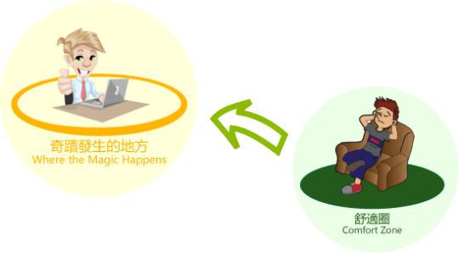
只有到舒適圈外才會找到俗話說「奇蹟發生的地方 (Where the magic happens)」，人就會成長和改進。
Notes:
莫林斯基博士喜歡用兩個圓圈去形容什麼是踏出舒適圈，只有到舒適圈外才會找到俗話說「奇蹟發生的地方 (Where the magic happens)」，人就會成長和改進。

Slide 8
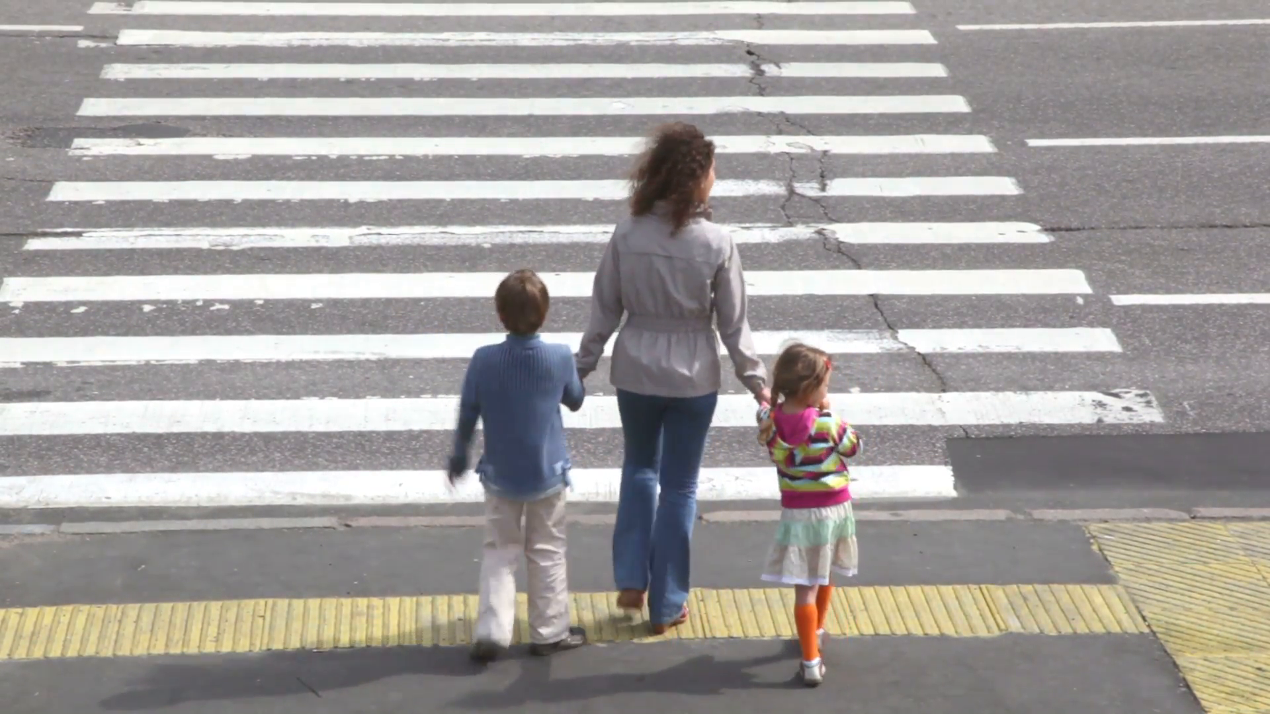
焦慮 - 面對危機和壓力時的本能反應
因為太焦慮、緊張導致不能過馬路 😖
太多
提醒我們過馬路前先留意路面情況 🚥 🚗
適量
完全不理會路面情況，衝出馬路 💥
太少
例子：過馬路

Slide 10
10分鐘
休息時間
Notes:
10 minute break

Slide 11
當我們感到焦慮時....
呼吸急促
面紅
小動作變多(磨牙，搣手指)
肚痛
出手汗
心跳加快
Notes:
Discuss on different triggers and sensations they have when they experience different emotions (can use animal or any analogies) → Miss K & Miss M can also share their own experiences

Slide 12
「畫畫小任務」：
請把情緒寫在適當的位置上：
焦慮 / 開心 / 驚慌 / 滿足 / 擔心 / 興奮 / 好奇 / 熱情 / 放鬆
危險圈
伸展圈/學習區
舒適圈
Notes:
HWK: 分辨在舒適圈，伸展圈，危險圈會遇到什麼情緒

Slide 13
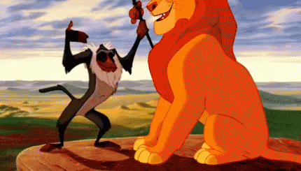
下一節：X月X日
xx:xx - xx:xx
記得完成小任務呀！

