Slide 1
成長電影院
第二節
Miss K Miss M

Slide 2
小組規則
準時出席
尊重他人
安靜坐好
用心觀看
專心聆聽
積極參與
帶手冊及完成小任務

Slide 3
分享時間：上一節小任務
你會用什麼動物來形容自己呢？請畫出來並說明原因。
我（ ）
Notes:
HW
你會用什麼動物來形容自己呢？請畫出來並說明原因。

Slide 4
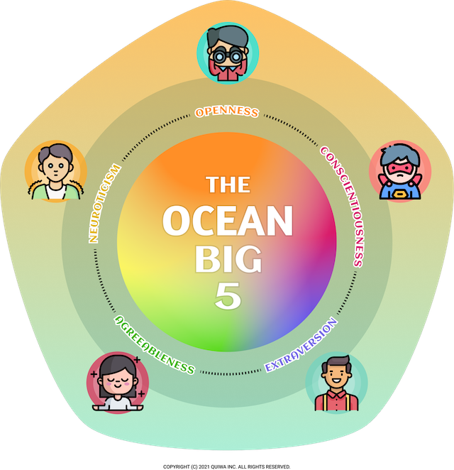
Personality
性格特質

Slide 5
Big5 大五人格測試
Openness (開放性) 好奇 VS 謹慎 | O
Conscientiousness (盡責性) 有組織 VS 粗心 | C
Extraversion (外向性) 外向 VS 內向 | E
Agreeableness (親和性) 有同情心 VS 理性 | A
Neuroticism (情緒不穩定性) 緊張 VS 自信 | N
Notes:
Introduce BIG 5 Personality (O.C.E.A.N.) https://meetype.com/bigfive-test
（創造性/好奇 或 一致/謹慎）
盡責性（高效/有組織 或 奢侈/粗心）
外向性（外向/精力充沛 或 孤獨/內向）
親和性（友好/富有同情心 或 批判/理性）
神經質（敏感/緊張 或 彈性/自信

Slide 6
問卷結果開估
請把你的名字寫在另一個顏色的post-it上
請把新的post-it貼在適當位置
你的問卷結果如妳所料嗎？
Notes:
目的：承接上一節的活動，讓同學比較她們自我認知的性格和測驗結果，希望從中更了解自己
開估 on their personality test result
Compare results (perception vs reality)

Slide 7
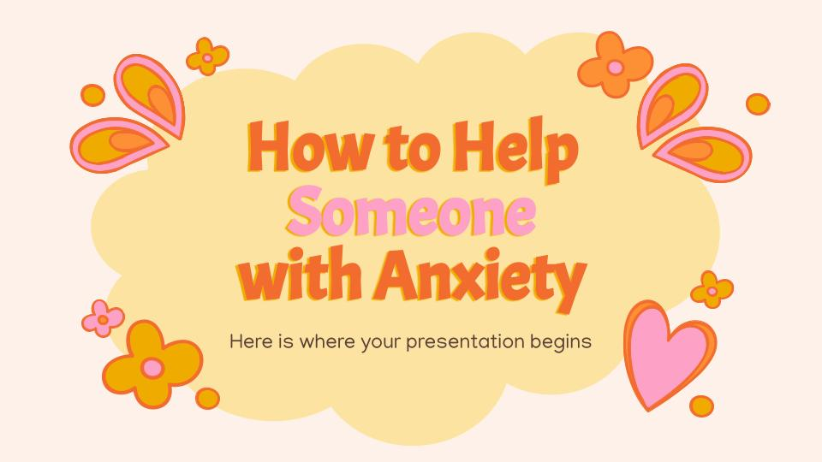
MOVIE TIME
熊抱青春記
Turning Red (2022)
Notes:
Part 2 39:21 - 01:28:41
The girls secretly raise money for the tickets at school, exploiting the popularity of Mei's red panda form, while lying to Ming. Ming discovers Mei's activities and accuses her friends of corrupting and taking advantage of her. Ashamed and afraid to stand up to her mother, Mei fails to come to her friends' defense.
During the ritual, as Mei's red panda form is about to be sealed, she decides to keep her powers and abandons the ritual to attend the concert. Her friends forgive her for her actions at the party, and they discover Tyler is also a 4*Town fan. However, during her escape from the temple, Mei inadvertently damaged her mother's talisman; an enraged Ming transforms into a kaiju-sized red panda and disrupts the concert, intending to take back Mei by force.
Mei reconciles with Ming and helps her mend her bond with Wu, whom Ming accidentally scarred in anger at some point years ago before sealing her red panda form. The other women conceal their red pandas in new talismans, but Mei decides to keep hers, and Ming accepts that she is finding her own path.

Slide 8
10分鐘
休息時間
Notes:
10 minute break

Slide 9
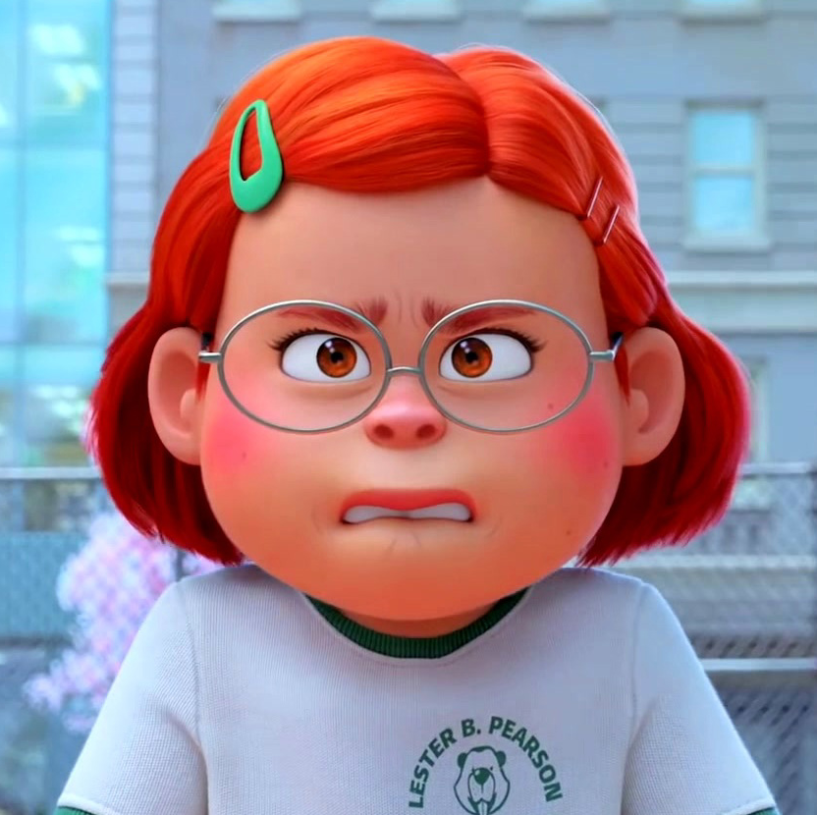
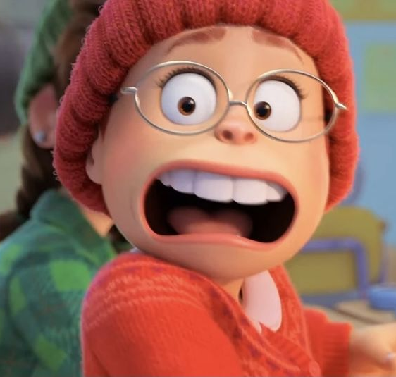
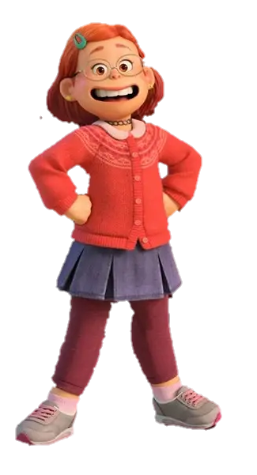
當我們有情緒起伏時
可以做什麼？
跟信任的人傾訴
深呼吸，透大氣
接受自己有情緒
先照顧好自己
想一些美好的事/人
做一些可令自己放鬆的事
Notes:
目的：用電影角色做提示，讓學生想想可以令自己平復心情的方法

Slide 10
S - Stop 停一停
T - Take a breath 深呼吸
O - Observe 觀察自己的情緒和需要
P - Proceed 繼續行動
Stop Method

Slide 11
「畫畫小任務」：
請寫/畫出你最近一次情緒起伏的經歷。
Notes:
HWK: 請寫/畫出你最近一次情緒起伏的經歷。

Slide 12
People have all kinds of sides to them. And some sides are messy. The point isn’t to push the bad stuff away. It’s to make room for it, live with it. 我們每個人都有好和混亂面。關鍵不是把壞東西推開，而是為它騰出空間，與它一起生活。

Slide 13
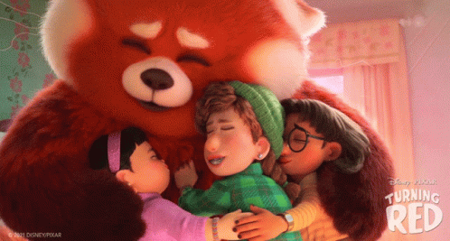
下一節：X月X日
xx:xx - xx:xx
記得完成小任務呀！

