Slide 1

成長電影院
第一節
Miss K Miss M
Notes:
Prepare:
-OCEAN questionnaire
-OCEAN Spectrum
-Comfort Zone Bullseye
-Paper
-Comic strip
-Diary (in the handbook)

Slide 2
小組規則
準時出席
尊重他人
安靜坐好
用心觀看
專心聆聽
積極參與
帶手冊及完成小任務

Slide 3
自我介紹
我的名字
希望別人如何稱呼我
就讀班別

Slide 4
互相認識遊戲
2 Truths and 1 Lie
遊戲規則：
說出三個有關你的個人經歷或喜好，其中兩個是真實的，一個是假的。
例如：你喜歡的運動，食物，動物，經歷, etc.
其他玩家可以向這個人問問題，找到更多的細節。小組一起投票判斷哪一個是謊言。
Notes:
目的：透過遊戲訓練同學的聆聽能力和以有趣的方法人認識新朋友

Slide 5
互相認識遊戲
2 Truths and 1 Lie
Miss K
我的名字是Kay
我有一個雙胞胎妹妹
我很害怕昆蟲
究竟那一句是謊言呢？

Slide 6
互相認識遊戲
2 Truths and 1 Lie
Miss M
我家有兩隻很可愛的貓
我有一個哥哥
我會說4種語言
究竟那一句是謊言呢？

Slide 7
到你們了！
2 truths and 1 lie
1.
2.
3.

Slide 8
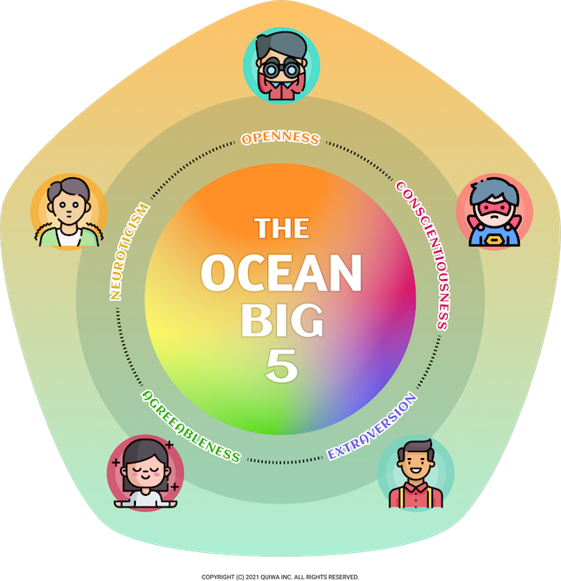
Personality
性格特質

Slide 9
Big5 大五人格測試
Openness (開放性) 好奇 VS 謹慎 | O
Conscientiousness (盡責性) 有組織 VS 粗心 | C
Extraversion (外向性) 外向 VS 內向 | E
Agreeableness (親和性) 有同情心 VS 理性 | A
Neuroticism (情緒不穩定性) 緊張 VS 自信 | N
Notes:
Introduce BIG 5 Personality (O.C.E.A.N.) https://meetype.com/bigfive-test
（創造性/好奇 或 一致/謹慎）
盡責性（高效/有組織 或 奢侈/粗心）
外向性（外向/精力充沛 或 孤獨/內向）
親和性（友好/富有同情心 或 批判/理性）
神經質（敏感/緊張 或 彈性/自信

Slide 10

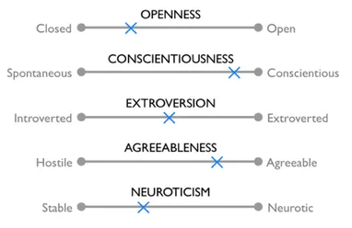
請把你的名字寫在post-it上
請把post-it貼在適當位置
活動：猜猜自己的性格
Notes:
目的：讓同學猜猜自己的性格，看看他們了解自己多少
Ask students to guess which personality trait they score the highest percentage of https://www.thenewslens.com/article/93049
Stick their name onto our A4 paper with all the personality traits

Slide 11
活動二
請用25分鐘時間完成問卷
Let's find out our personalities
Notes:
Ask them to complete the Big 5 Personality questionnaire (~25minutes)

Slide 12
10分鐘
休息時間
Notes:
10 minute break

Slide 13
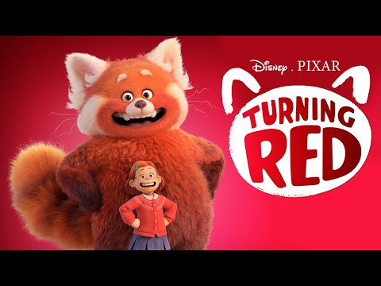
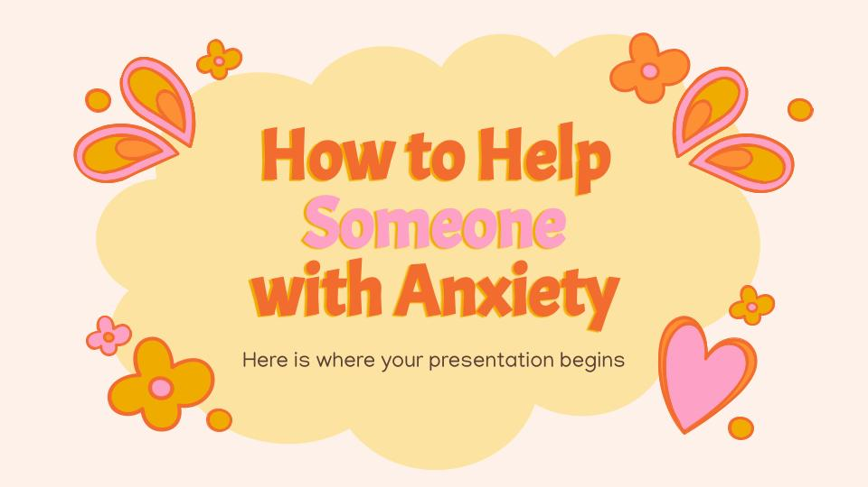
MOVIE TIME
熊抱青春記
Turning Red (2022)
Notes:
Part 1 0:00 - 39:21
Meilin "Mei" is a 13-year-old Chinese-Canadian girl living in Toronto. She helps take care of the family's temple dedicated to their ancestor and works to make her strict, overprotective mother Ming proud. Mei hides her personal interests from Ming, such as the fact that she and her best friends Miriam, Priya, and Abby are fans of the boy band 4*Town.
Mei has transformed into a large red panda after being overwhelmed by some circumstances in her life. She hides from her parents and discovers that she only transforms when she is in a state of high emotion. Ming finds out when she further embarrasses Mei at school, causing Mei to transform and run home.
Ming and Jin, Mei's father, explain that their ancestor was granted this transformation to protect her daughters, and every female family member since then has also transformed when they came of age. Mei's friends discover her transformation but take a liking to it, and Mei finds that concentrating on them helps control the red panda within her. Ming allows Mei to resume her normal life but refuses to let Mei attend 4*Town's upcoming concert.

Slide 14

「畫畫小任務」：
你會用什麼動物來形容自己呢？請畫出來並說明原因。
我（ ）
Notes:
HW

Slide 15
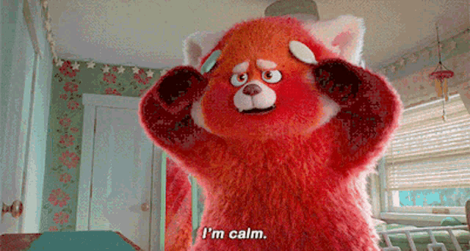
下一節：X月X日
xx:xx - xx:xx
記得完成小任務呀！

