Slide 1
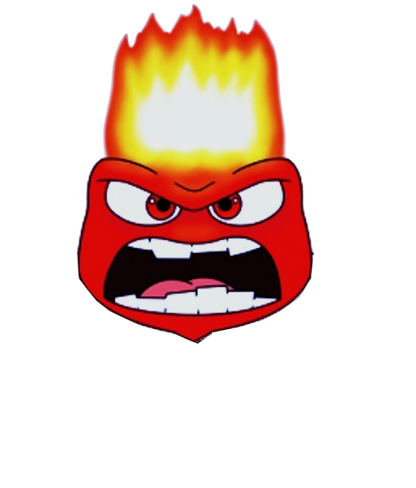
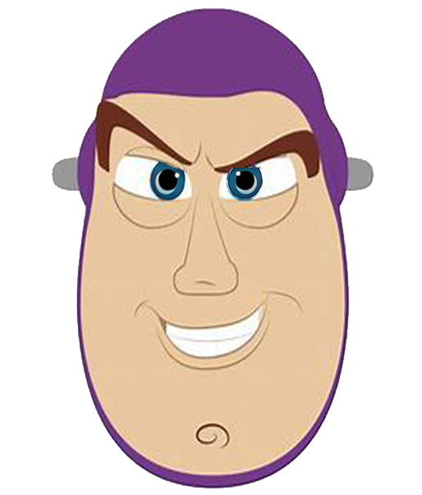
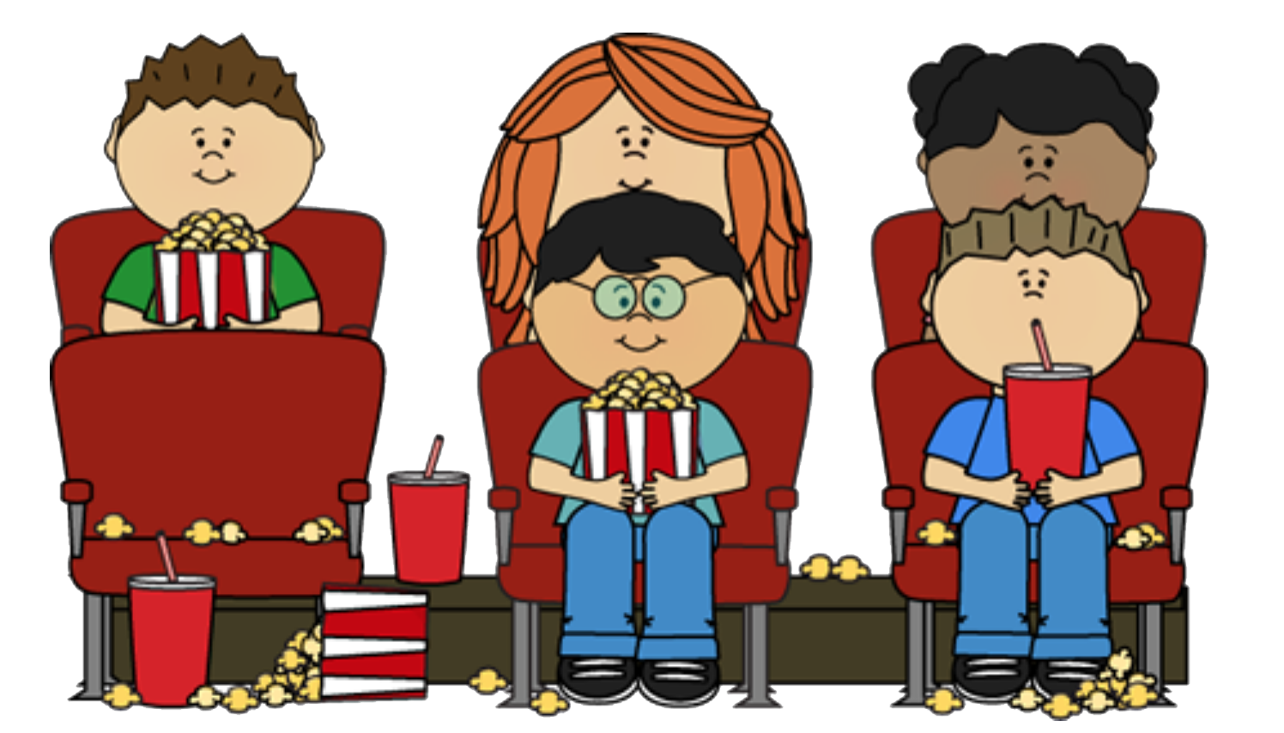
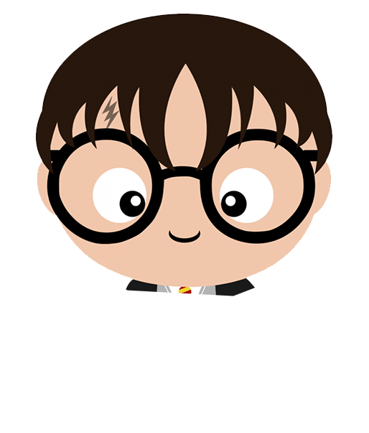
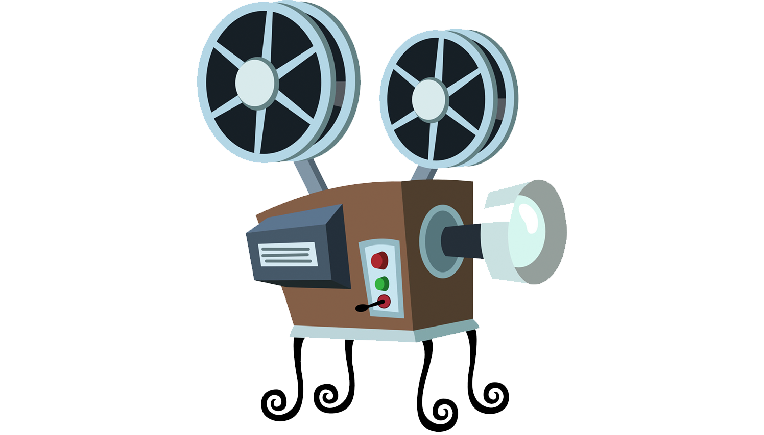
成長電影院
第三節
Notes:
Wonder - Wonder is a relatively recent movie that can help nurture young minds with concepts such as empathy, compassion and respect for others. This movie is an adaptation of R.J. Palacio’s award-winning novel “Wonder,” It is about a fifth-grader who has a genetic facial difference, a child who wants to feel accepted for who he is from the inside. A feel good movie that shows how the protagonist lovingly and bravely accepts who he is and doesn’t let things that he can’t change about himself, alter his joy.

Slide 2
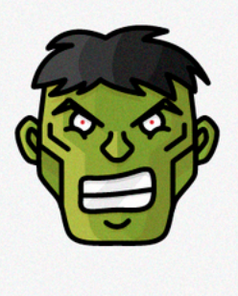
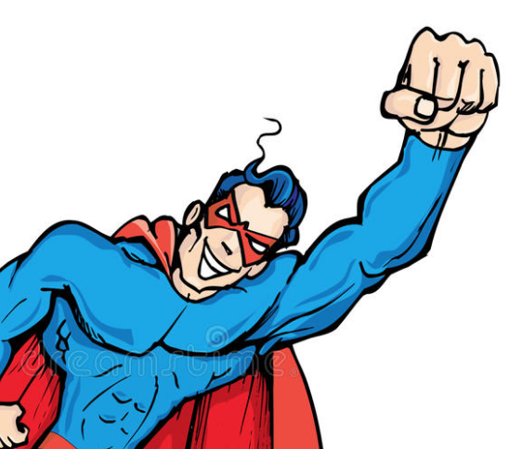
齊想想： 小組小規則
互相尊重
準時出席
用心觀看
專心聆聽
遵守秩序
積極參與
每節帶備此手冊及完成小任務

Slide 3
今日活動內容
主題： 用善意對待別人
🎬播放 ：奇蹟男孩
電影心得分享
猜猜我是誰 - 畫畫篇總部控制心
總結 ， 課外小任務

Slide 4
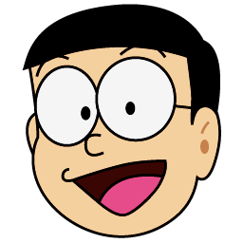

Slide 5
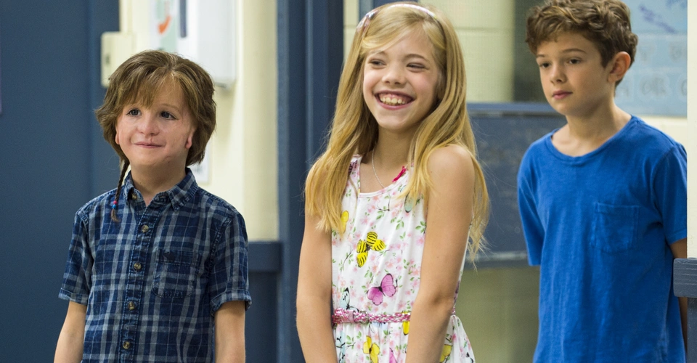
請一齊完成工作紙
Notes:
Pre-questionnaire: 學生看了以上圖片後，判斷這三個角色的性格 (first impression)，並將他們的偏見寫在工作紙上
Purpose: we would like to know student’s judgments of others based on their appearances and also let students compare their first impression of the characters and after they actually watch the move and know more about them.

Slide 6
🎬電影時間
Notes:
Video Clip: part 1 + Auggie and Jack (13:04)
Instructions for students: pay attention to Auggie and his interactions with others
Summary
Part 1: Auggie’s first day of school and in class and how he was verbally bullied by Julian.
Auggie and Jack: Auggie’s talent in science and how he grew close and befriended Jack in school
Purpose: introduction of the characters in the movie and let students know observe the interactions Auggie has with others.

Slide 7
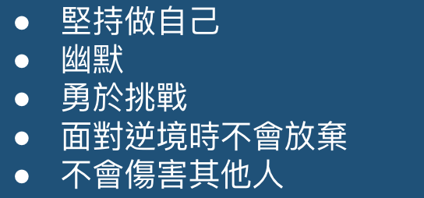
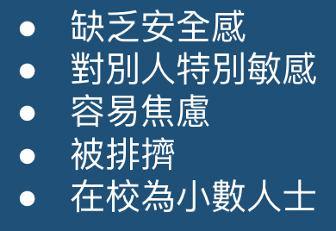
請找出Auggie和被欺凌者的共同特徵。
 | 不同的地方（異） | 相同的地方（同）
Auggie
被欺凌者
Notes:
Students were also asked to discuss about the topic of bullying and how they perceive Auggie’s character and the similarities and differences between Auggie’s response and characteristics to that with other bully victims’.
Students were also asked if they have experience with bullying
意行：he said he was bullied by his sister at home, when asked for concrete example, he said he was falsely accused of things he didn’t do at home or his sister would fight him for toys
加佑 & 宇軒：never been bullied before but they said they have bullied others. 加佑 specifically said scolding others makes him feel very happy just like eating sushi
迪浩 & 家亨：both said they have either been bullied or witnessed someone being bulled

Slide 8
🎬電影時間2
Notes:
Video Clip: Halloween + Auggie and Summer
Instructions for students: pay attention to Auggie and his interactions with others
Summary
Halloween: Auggie dressed up as Scream for Halloween and he was very excited for school. However, as everyone was dressed up, Jack didn’t notice when Auggie went into the classroom when he told Julian and his friends how he only hung out with Auggie because the principal told him so and if he looked like Auggie he would kill himself. Heartbroken, Auggie ran home and did not want to see or talk to anyone. His sister end up cheering him up and let Auggie know that she also had trouble with friends in school and that they would now be each other’s best friends. Auggie felt better and went trick or treating with his sister.
Auggie and Summer: Upset Auggie returned to school after the Halloween ordeal. He was visibly angry at Jack though Jack clearly didn’t know why. Their other classmate, Summer, wanted to make friends with Auggie because she wanted nice friends for a change. She fully accepted Auggie and Auggie was hesitant and had prejudice of his own that Summer only approached him because she was asked by the principal to, but later became inseparable with her and apologized for accusing her.
Purpose: let students see the character development of Auggie specifically. How his support system (e.g. family members and Summer) helped cheer him up and how he himself as the victim, would also have prejudice of his own because he was upset and lost trust from people around him.

Slide 9
討論時間：為什麼Auggie會和Jack不和呢？你認為他們發生了什麼事？
Notes:
Theory of mind: we asked students what happened between Auggie and Jack. They were able to pick up on the fact that Auggie was upset with Jack because Jack said very hurtful things against Auggie behind his back. However, Jack doesn’t know that Auggie was present when he said the mean things and therefore, did not know why Auggie was mad at him.

Slide 10
🎬電影時間3
Notes:
Video Clip: Jack knows why + Mindcraft + Julian says sorry + Camp 2
Instructions for students: pay attention to other characters and how their personalities change and develop
Summary
Jack knows why: Audience took on Jack’s perspective and knew how he felt deep down. Jack initially was unwilling to befriend Auggie upon principal’s request but he felt pity for Auggie therefore agreed to help Auggie. Upon knowing more about Auggie, he started to really want to become his friend. He didn’t know why Auggie got mad at him and therefore asked Summer for hint. Summer told him “Scarface” and he understood why Auggie was so upset with him.
Mindcraft: Auggie realized how hard it is to make good friends and therefore used Mindcraft to reach out to Jack. Jack apologized to Auggie on the gaming platform and they become friends again.
Julian says sorry: Julian continued to bully Auggie at school so much so that he was called to meet the principal along with his parents. The principal was extremely upset at his behaviours while his mother dodged all the blames for him. He was suspended from the annual school camping trip and the principal told him that “Auggie couldn’t change the way he looks, so maybe we should change the way we see”. Julian apologized to the principal and felt sorry that he was mean to Auggie the whole time.
Camp 2: Jack and Auggie were bullied by 7th graders from another school. His other schoolmates who used to bully him (Amos and his friends) stood up for Auggie and Jack and they fought against the bullies for him. They all became friends and Amos also cheered on Auggie for being brave and stood up for himself against the bullies.
Purpose: bring up the topic of change in people. We’re all capable of changing ourselves and the way we see others. We are all bound to make mistakes in life and hurt others but the importance is being able to be aware of our wrongdoings and how we impact others. Being able to apologize and admit that’re wrong is what makes us stronger and help us make friends and build relationships. Being kind to others is always the way to achieve bigger things.

Slide 11
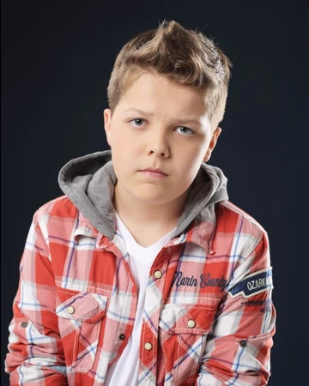
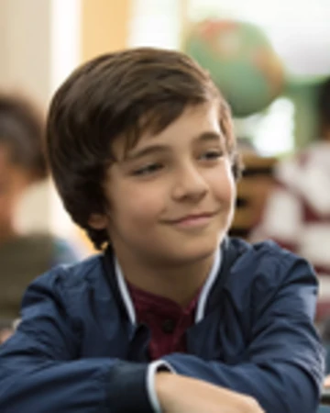
猜猜我是誰 - 畫畫篇
Notes:
Game:
Students were allocated a character each from the above (i.e. Auggie, Amos, Julian, Summer and Jack). They have to think of an animal that best represent their character (it could be anything from the appearances to their personality traits) and draw it out on a piece of paper. Then they’ll each have time to present their drawing and other students will have to guess which character they were allocated with.
Purpose: a fun way for students to practice examining and analyzing a person as well as describing them. Also for other students to practice active listening and assessing people’s characters.

Slide 12
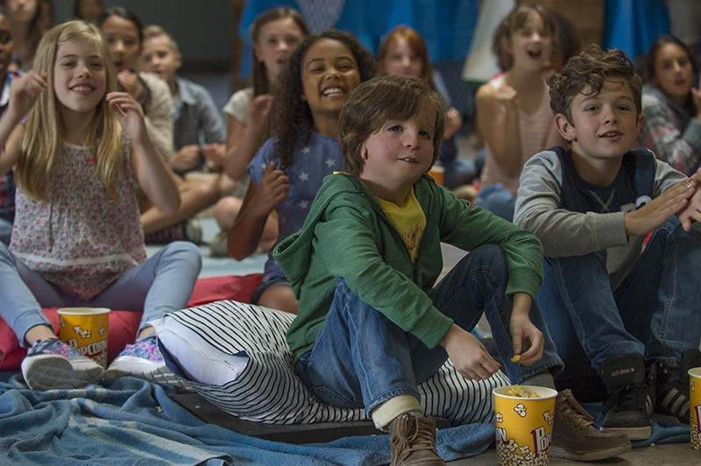
🎬分享心得
Notes:
Remarks: we didn’t have enough time to play the 猜猜我是誰 – 畫畫篇 game but it would be beneficial to the students to have a review session to share how they felt when they played in that game and if they had any difficulties in choosing the animal or guessing their friend’s characters.

Slide 13
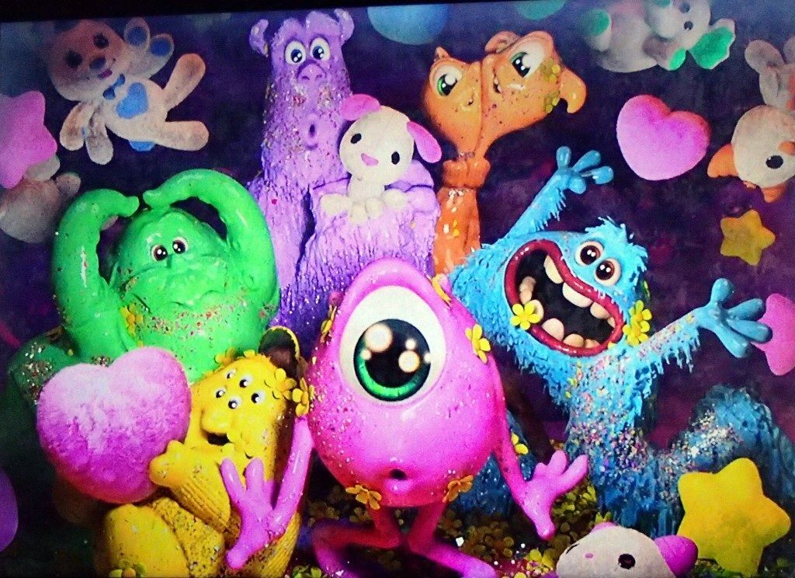
5分鐘小休時間
Break Time!

Slide 14
今日學什麼
我們的一舉一動，都會對別人產生影響。或許不是造成立即或直接的影響，但假使心存惡意，就會有人受到傷害；如果心存善意，則會有人獲益。不論是否被人注意到，選擇權其實都在我們手上。我們必須選擇在這個世界上，自己想成為什麼樣的人。
你無法改變別人的長相，單我們可以改變看人的方式。

Slide 15
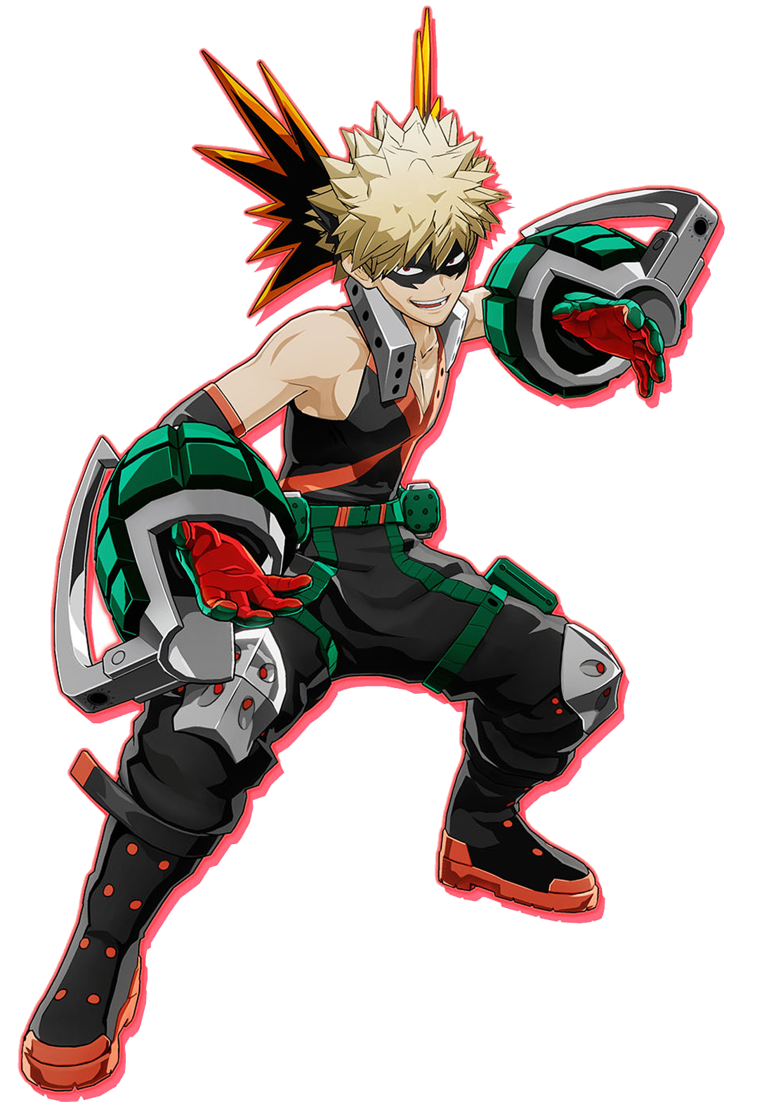
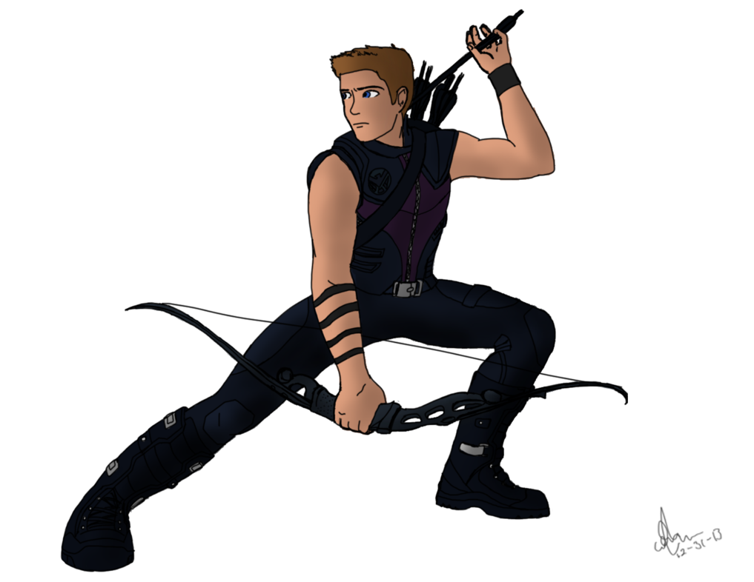
What makes a Hero?
Listen (聽話)
Attentive (留心)
Organised (組織能力)
Creative (創作力)
Flexible (思維靈活)
In control (掌控)
Communicate (溝通)

Slide 16
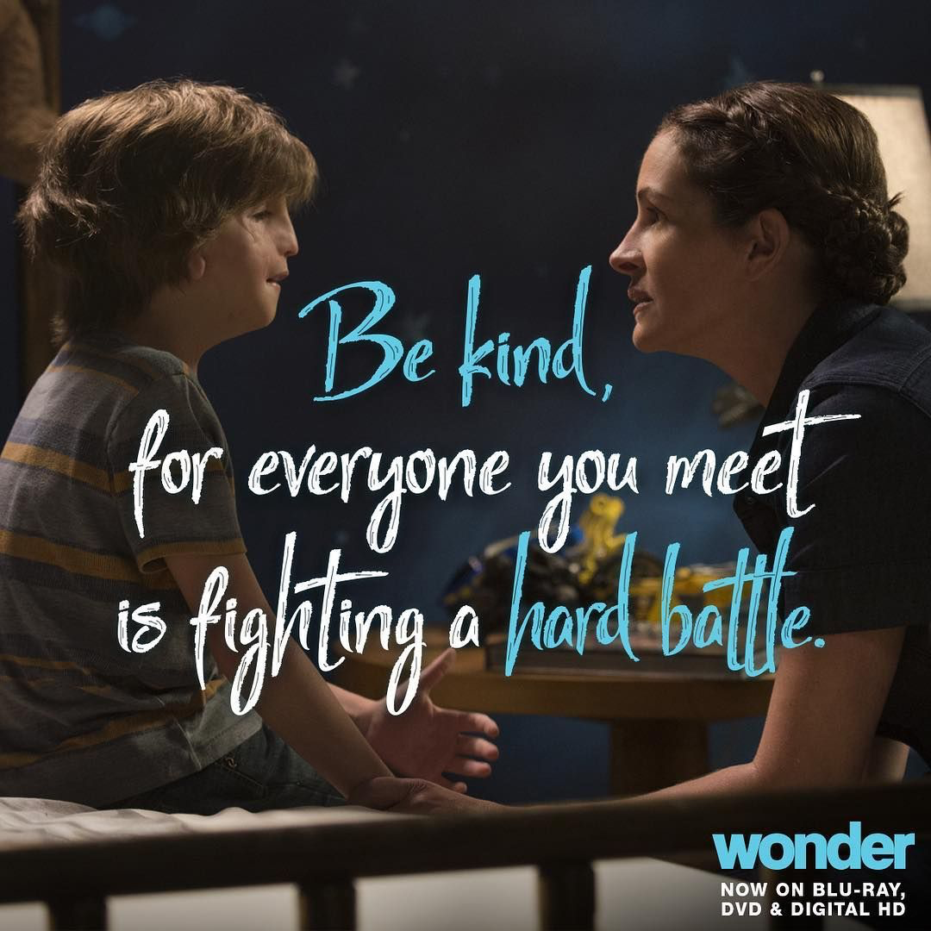
🎬總結時間
要善意對待別人，因為你所遇到的每個人，都正在為自己的人生奮鬥。

Slide 17
大家都有優點和缺點，差別在於我們能不能接受並學習改善自己和欣賞他人。朋友之間要懂得互相扶持、互相幫助，每個人都在發揮自己的長處。
Notes:
我們也應該珍惜友情、相信自己、努力發光發熱的樂觀傾向

Slide 18
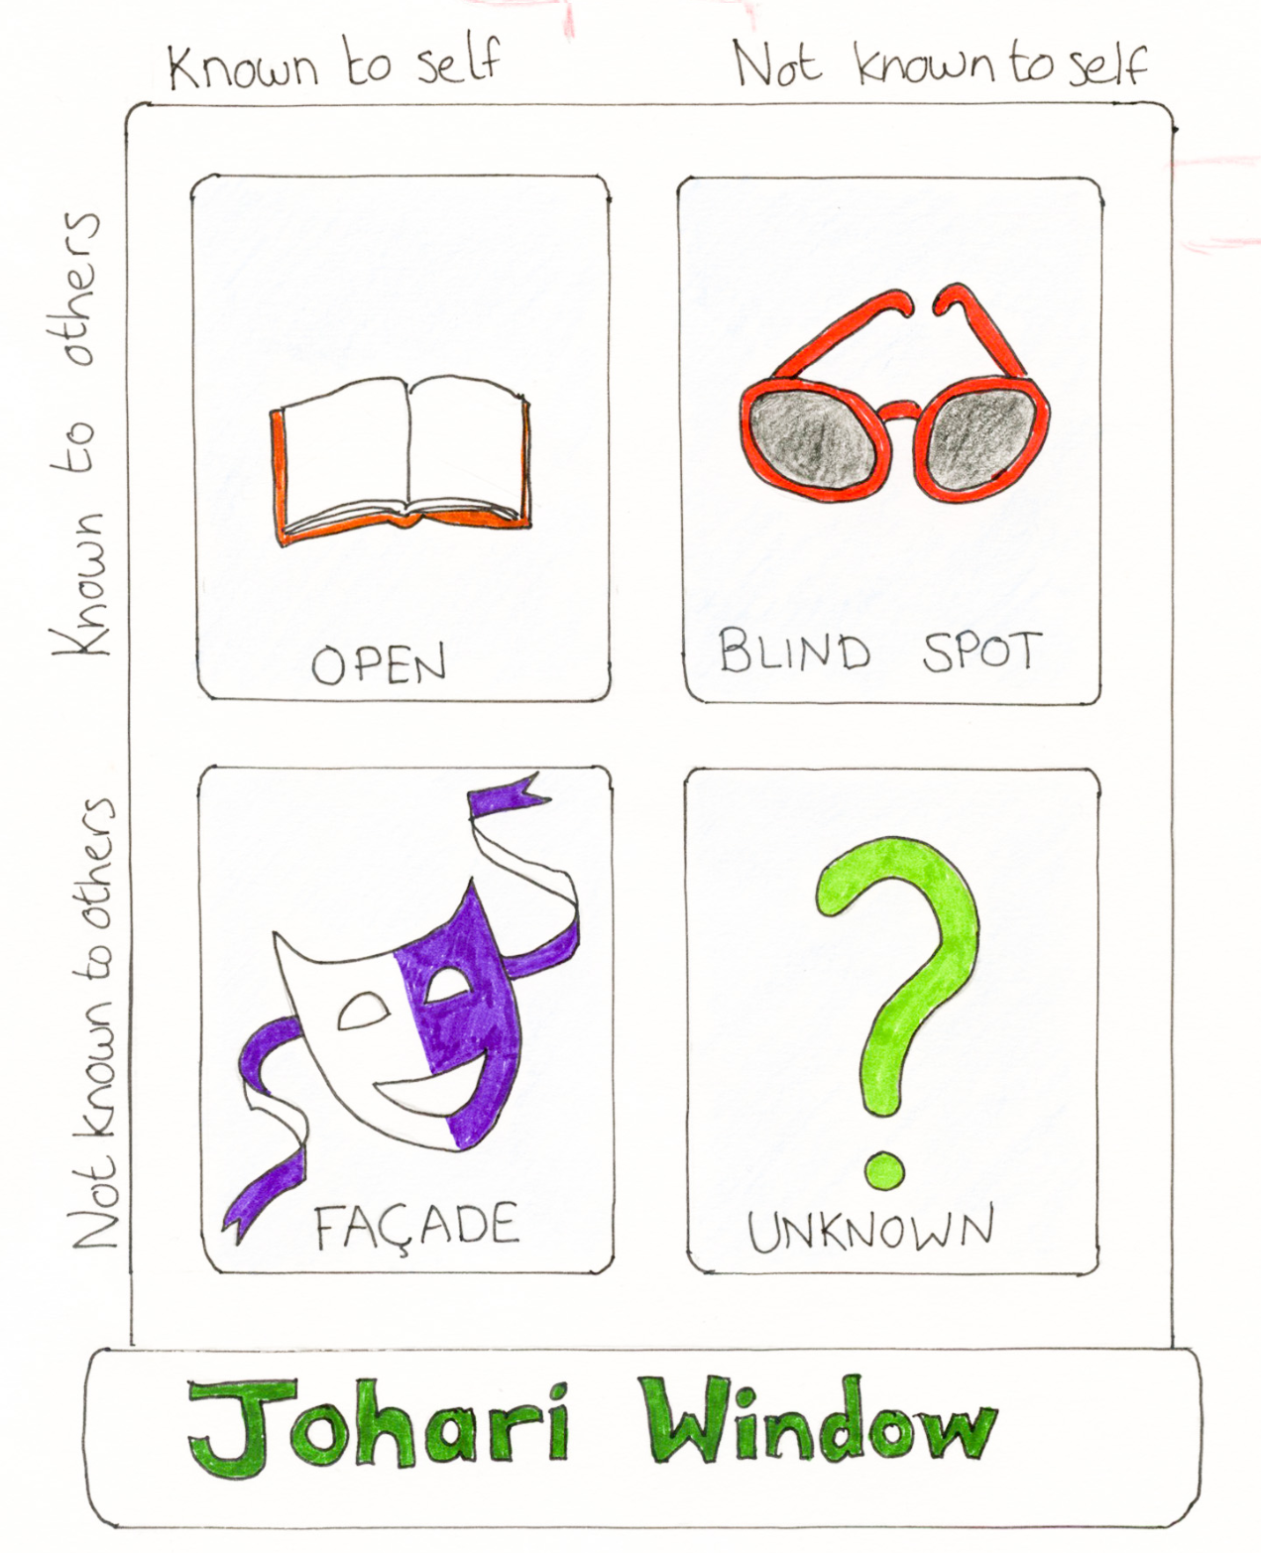
發揮想像力 ：
創做你們獨一無二的
總部控制中心
開放我
盲目我
隱藏我
未知我
周哈里窗🪟🪟

Slide 19
請一起完成工作紙
Notes:
Post-questionnaire：學生看完電影後，重新判斷這三個角色的性格，並將他們的偏見寫在工作紙上
Purpose: we would like to know student’s judgments of others changed after knowing them better (through watching the movie clips) and also let students compare their first impression of the characters. We would like students to know that impressions of others can change. It is inevitable and very easy for us to form judgments of others based on multiple factors such as their appearance, the way they speak, their gestures, etc. However, everyone has their own story and if we give time to get to know them better, we might be pleasantly surprised by them and our impressions of them could easily also change.
Remarks: An interesting conversation sparked when we addressed the characters in this movie. 加佑 suggested for Auggie to do plastic surgery and asked why isn’t he fixing his face. Miss K then explained to 加佑 that due to the limited amount of time we had in the session, we actually didn’t show the beginning of the movie which addressed Auggie’s surgeries. In fact, Auggie has had 27 surgeries done, not to change his appearance, but actually to help him see with his eyes, hear with his ears, breathe more smoothly and properly with his nose as well as eat, chew and swallow with his mouth. He has had surgeries done just to do the most basic things that we usually take for granted. Miss K also brought up that therefore when we see classmates at school who might look or act different from others (e.g. speak slowly, needed more time to process questions or walk awkwardly), we should try and understand their story before judging them. They might be struggling because of their pre-existing conditions and those are something that they cannot change and therefore like the principal of Auggie, we should “change the way we see” and be kind to others.

Slide 20
下星期六 10:00am 見

