Slide 1
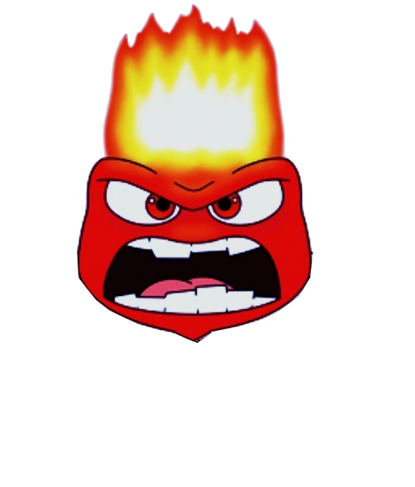
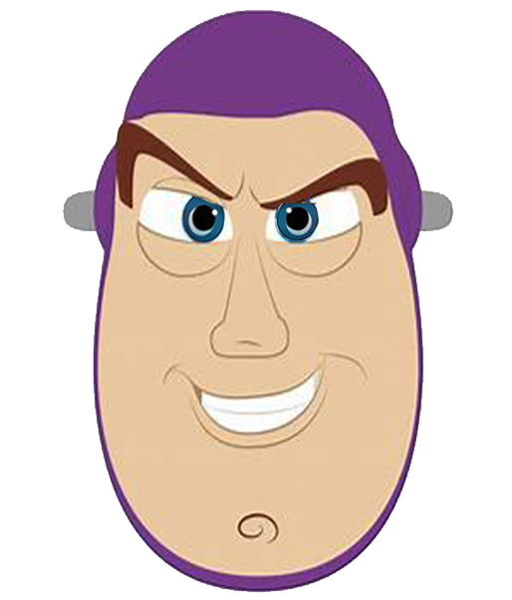
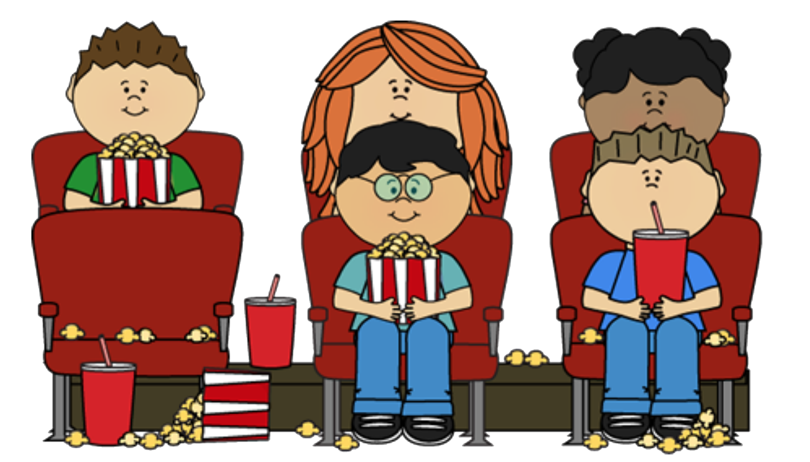
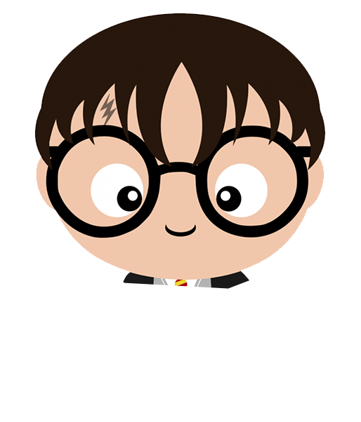
成長電影院
第二節

Slide 2
齊想想： 小組小規則
互相尊重
準時出席
用心觀看
專心聆聽
遵守秩序
積極參與
每節帶備此手冊及完成小任務

Slide 3
今日活動內容
主題： 發掘個人長處及短處，團體合作
🎬播放 ：怪獸大學
團體比賽
電影心得分享總部控制中心
總結 ， 課外小任務

Slide 4
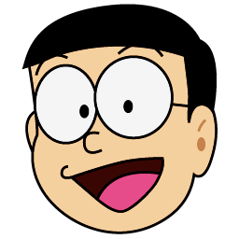

Slide 5
請填妥選擇題，並於答案☑️
Notes:
Pre-session questionnaire

Slide 6
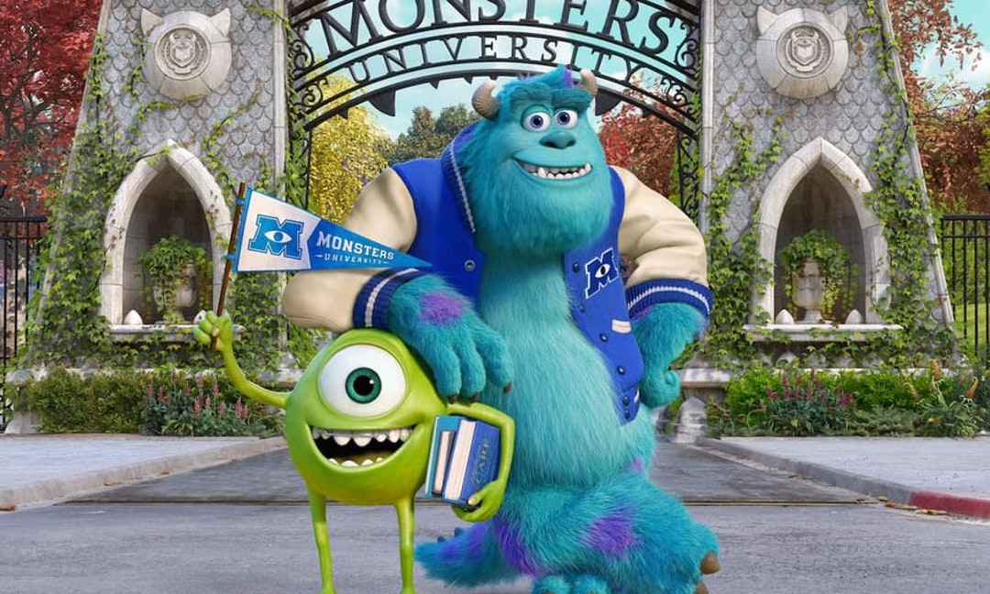
Notes:
We gave students the background of the story
米高·「大眼仔」·華素基小學念書時隨班級一起來到怪獸公司參觀，該公司是怪物城市中最盈利，也是最知名的驚嚇公司。米高從這以後就夢想着能夠成為一名「驚嚇專員」，半夜三更潛入人類世界嚇唬小孩，以便取得他們的尖叫聲來作為怪物世界的能量來源。11年後，米高來到怪獸大學就讀，報名驚嚇專業，他再驚嚇學院認識了一個藍色、毛茸茸的龐大怪物占士「毛毛」。
獨眼怪大眼仔天生長得不恐怖，想靠後天補強而努力學習，而毛毛則仗着自己家族的驚嚇天賦而表現得很懶散，似乎有恃無恐，大眼仔對此很不以為然，而毛毛則認為大眼仔由於先天上的限制，因此無論如何努力都不可能成為優秀的驚嚇專員。兩怪都試圖加入大學中的兄弟會與姐妹會，但只有毛毛得以進入勁嚇會（Roar Omega Roar）。之後的一次考試時，大眼仔和毛毛之間的競爭導致斯克薄院長將兩怪都逐出了驚嚇系，勁嚇會也因此取消了毛毛的成員資格。不甘心的米高決心要證明自己，於是報名參加驚嚇遊戲，但該遊戲只限兄弟會與姐妹會團體參加，而大眼仔現場決定加入的啱Key會（Oozma Kappa）加上他後也還差一名成員才夠資格。這時毛毛也報名要求參加，大眼仔雖然萬分不願，但最終迫於形勢只能接受。

Slide 7
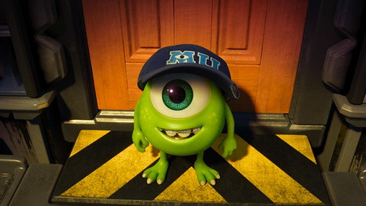
角色介紹
米高 華素基

Slide 8
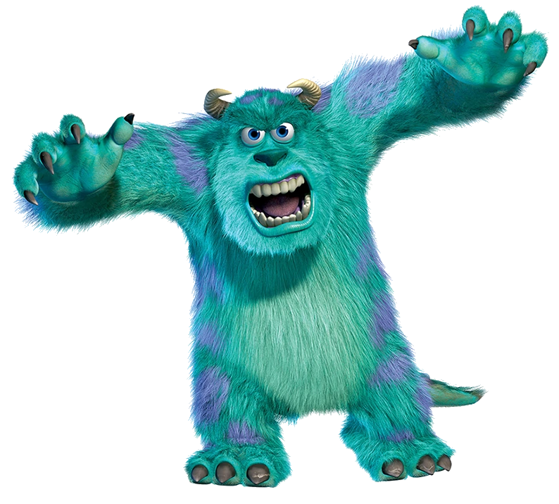
角色介紹
毛毛 (蘇利文)

Slide 9
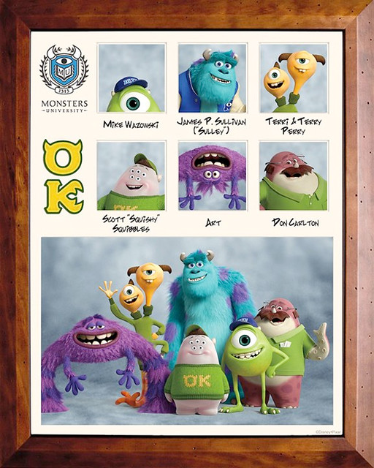
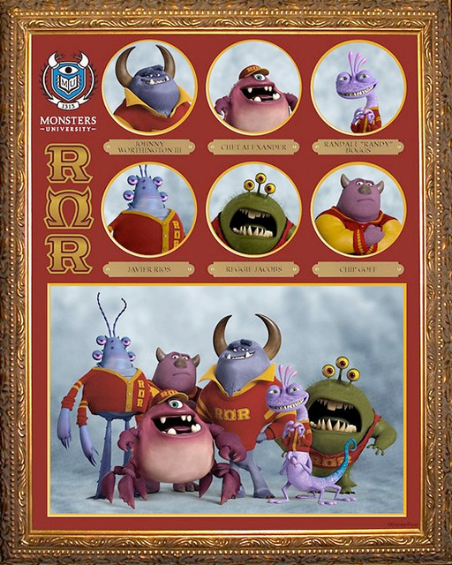
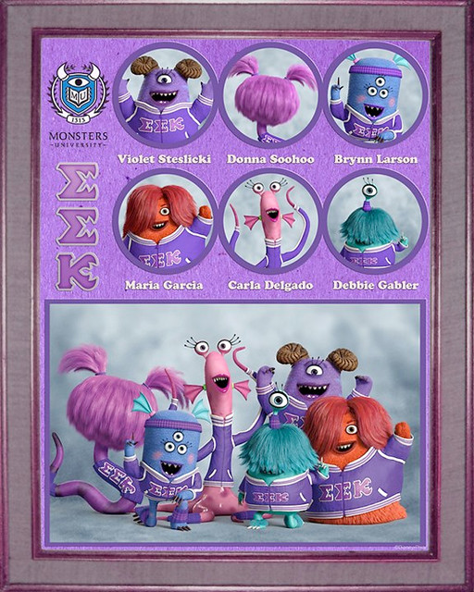
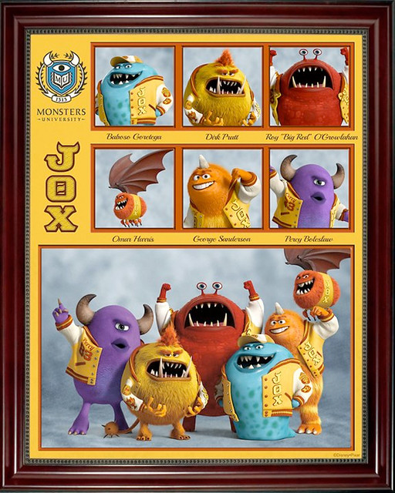
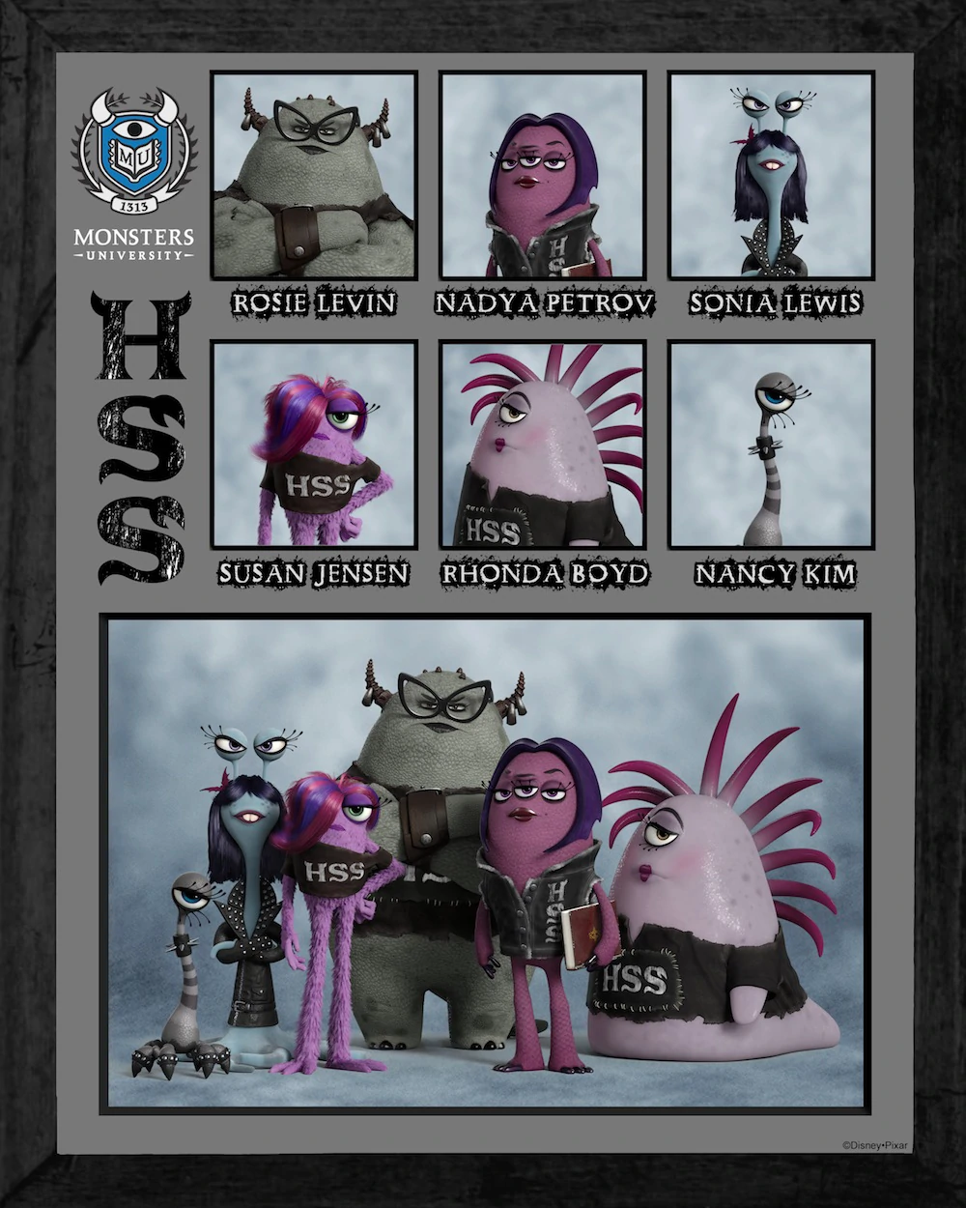
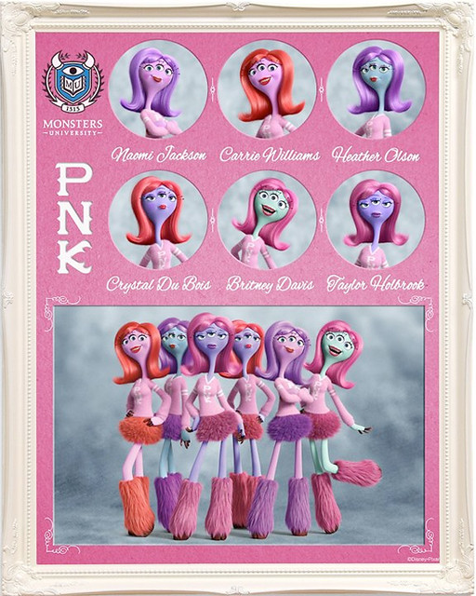
Notes:
Discussion question: just by looking at their team photos, which team do you think will win the 驚嚇全運會?
Answers from students: they immediately eliminated the pink and purple team because they reckon they don’t look scary at all.

Slide 10
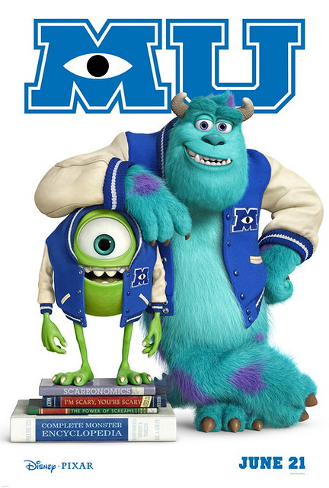
🎬電影時間
Notes:
Video Clip: 1st game
Instructions for students: pay attention to Mike and Sulley’s interactions
Summary
1st game: The first game of the “Scare Games” competition where teams were asked to dodge poisonous sea urchin and race to the finishing line. In this game, both Mike and Sulley were busy competing against each other that they completely forgot about the rest of their team. The two of them managed to reach the finishing line very quickly but the rest of their misfit teammates were the last to finish the race. Their team was declared to have finished last in this round but were saved from elimination after another team is disqualified for cheating.
Purpose: introduction the concept of being in a team.

Slide 11
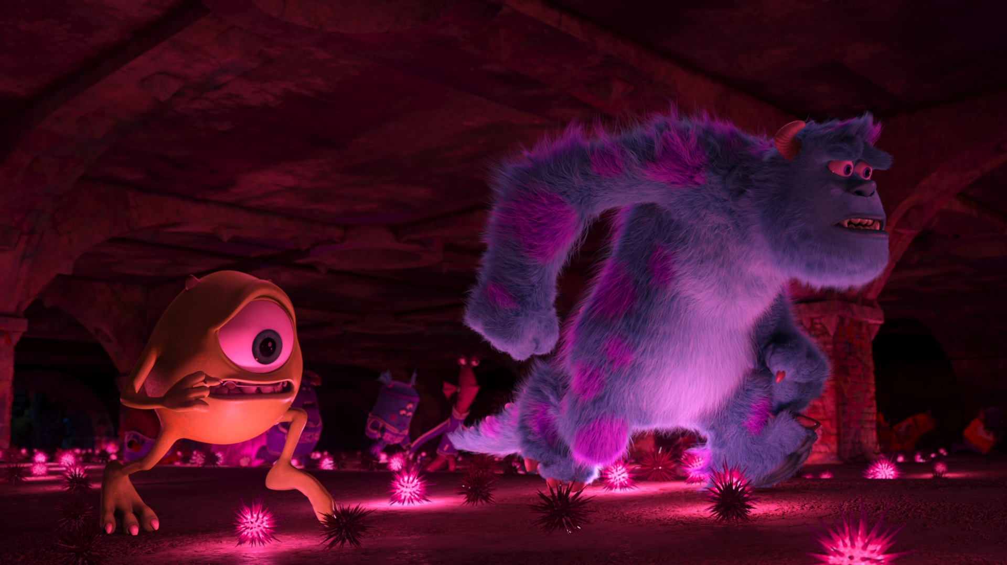
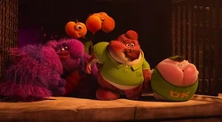
為什麼OK組會輸了第一場比賽呢？
Notes:
Comments: Students were able to recall what they have seen in the movie and why the OK team has lost the first race but their answer was very factual and they needed more guiding to generalize it to themselves.

Slide 12
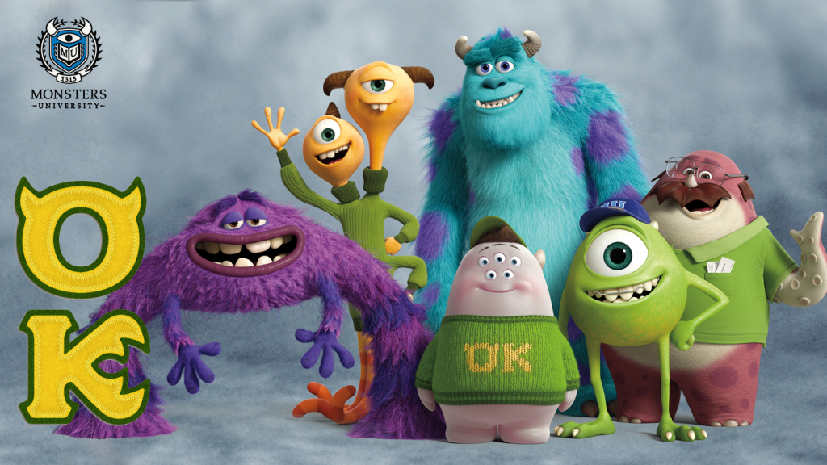
你認為OK組可以贏得比賽嗎？如果要贏得比賽，他們需要做出什麼改變呢？
Notes:
Comments: Students were able to raise some constructive suggestions such as Mikey and Sulley should wait for their teammates and make sure they all finish the competition together. They should also work as a team instead of as individual players to win the competition. Students needed more suggestions to think outside the box such as figuring out each other’s strengths and weaknesses and assessing how they should allocate the team efforts to improve their team strategies.

Slide 13
🎬電影時間2
Notes:
Video Clip: library game + training and competition
Instructions for students: pay attention to the changes in their team dynamics
Summary
Library game: The second game of the “Scare Games” competition where teams were asked to get flags from a high ground in their school library without causing a commotion and being caught by the librarian. Sulley almost ruined the competition as he did not want to listen to and follow through Mike’s directions when others were incredibly compliant. The others immediately acted upon Sulley’s mess and was able to use illusions and tricks to avoid being caught by the librarian and retrieved the flag.
Training and Competition: In order for the team to build momentum and motivation, Mike brought the team members to the Monsters, Inc. They sneaked into a high window to peep into the scarers an their assistants working in the company. They were found out by the security guard and with team effort, they managed to escape the company as well as regain confidence. They then started training with Mike as their leader and they managed to win the next 2 rounds of the competition.
Purpose: furthering on the topic of teamwork. Students were once again asked why the OK team almost lost in the second competition and they were able to answer because of Sulley and his inability to work as a team with the others. In the ’Training and Competition’ clip, students had a glimpse of how the team became one and were able to cooperate with each others and excel in the following rounds of the competition.

Slide 14
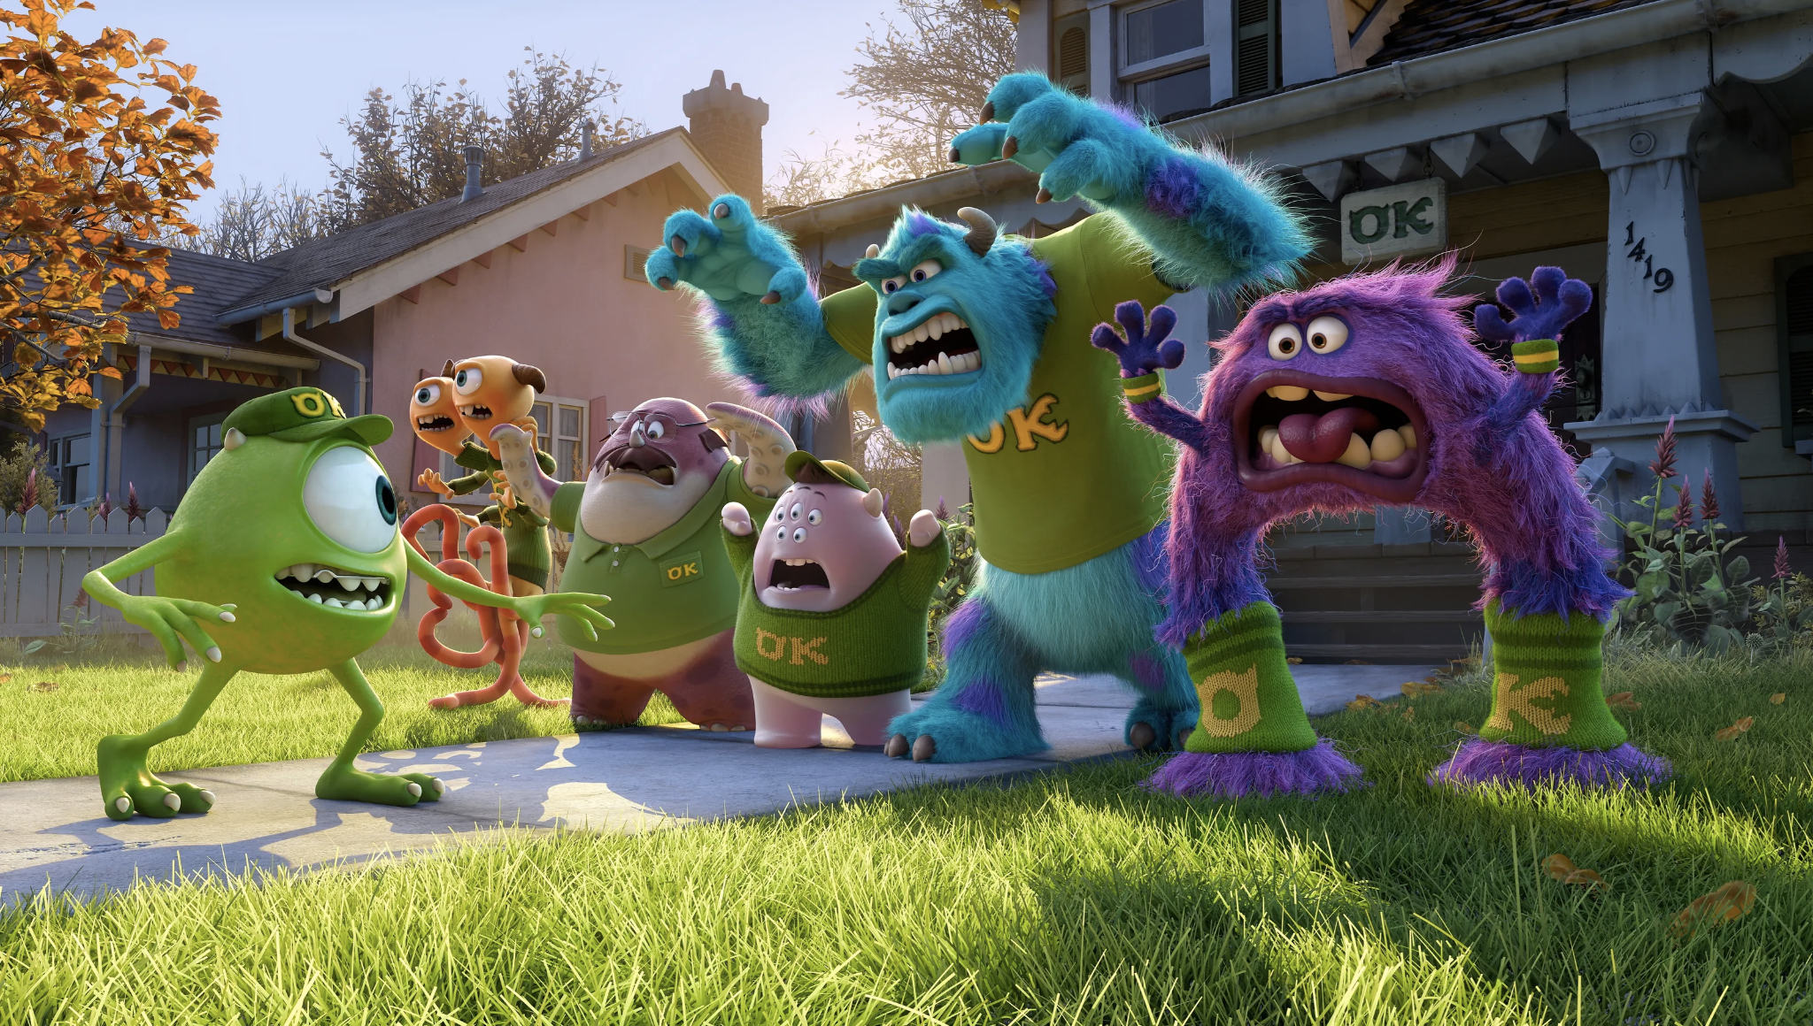
Notes:
Students were then asked compete in their own competition where they need to practice and exercise the teamwork they saw in the OK team.

Slide 15
遊戲：團體賽
10 minutes 35 seconds
英文
數學
推論
謎語
反應
Notes:
Students were given 5 different parts of a competition where they have to work together to move on to the next topic. The different parts included
English
Inferencing
Response and Attention shifting
Maths
Riddles
In order to make the game more fun for the students as well as help them practice their teamwork skills, we have told the students that the previous record other student groups managed to achieve wwas completing the competition in 10 minutes and 35 seconds. If they would like to be better, they just needed to use less time than that. This helped give students a goal to work towards to.
In the ends, students were able to complete the competition in 10 minutes and 32 seconds.

Slide 16
Math
English
Which of the following is a similar word to “listen”?
hear | quiet | play | whisper

Slide 17
Math
English
Which of the following is the verb? “Michelle hurt her elbow while playing.”
hurt | elbow | while | playing
Notes:
hurt

Slide 18
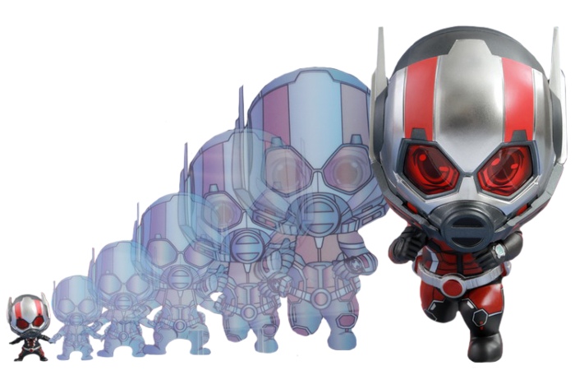
Math
English
Which of the following is a similar word to “small”?
few | tiny | calm | lot
Notes:
tiny

Slide 19
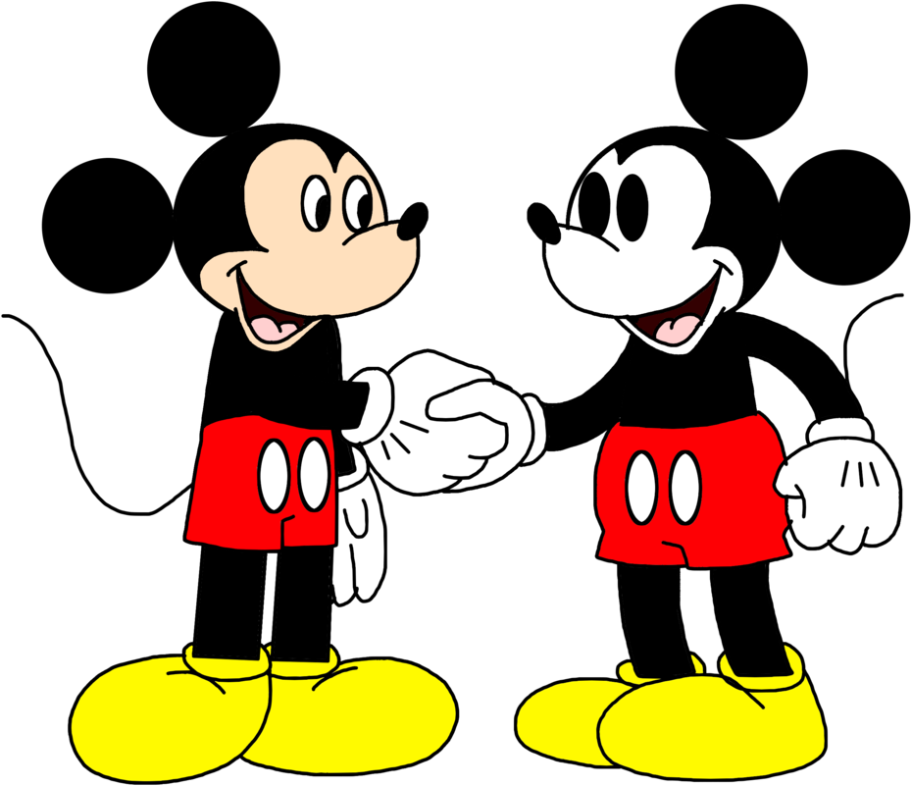
Math
English
Which of the following is the opposite of “polite”?
crazy | rude | angry | irritable
Notes:
rude

Slide 20
Math
English
Which of the following is the opposite of “defend”?
play | attack | walk | jump
Notes:
attack

Slide 21
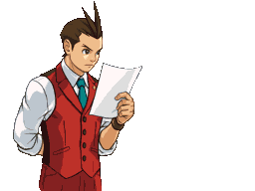
角色：
2. 偵探 x5
只能問“是/否”問題
每輪必須移除一名嫌疑人
可以而且應該解釋刪除誰

Slide 22
Objective (目的):
你必須互相合作，找到正確的罪犯。

Slide 23
Storyline
在怪獸大學的驚嚇全運會發生了一件偷盜案件，你們是5位偵探，而Miss K 和Miss M是兩個人證，可以幫助你們查出小偷的身分。
你們可以問我們5條問題，找出誰是小偷!
記住Miss K 和Miss M只會回答是/不是!

Slide 24
推論題：誰是兇手
Notes:
Comments: Student spent a lot of time fighting against what question to ask and also they needed some help with changing their question to a yes/no one.

Slide 25
反應題：
A
Notes:
Students were asked to read this as fast and as accurately as possible
Comments: for this part of the competition, the 5 students had a hard time fighting for who to do what. We ended up resolving the issue by coordinating and allocating 5 positions for the students to all be able to take part (i.e. A – read by one student, B – read the word by one student, B- read the colour by one student, C – read the word by one student, C ready the colour by one student). With 5 positions, the students were split the tasks among themselves peacefully and complete it together.

Slide 26
反應題：
B

Slide 27
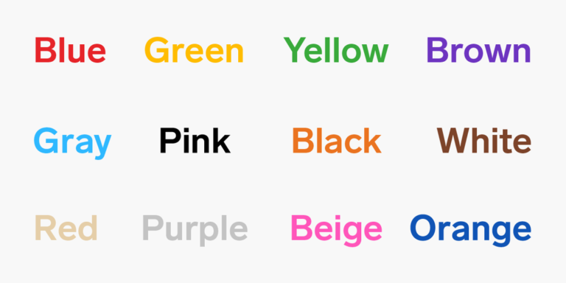
C

Slide 28
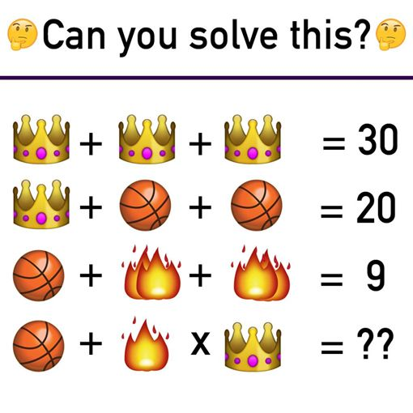
數學題：
25

Slide 29
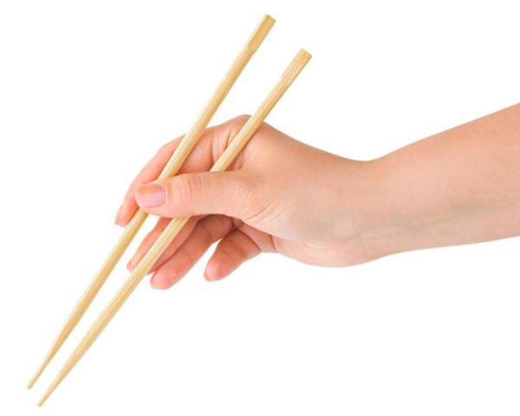
謎語題：
身體細長，
兄弟成雙，
光愛吃菜，
不愛喝湯。
(猜一種餐具)
答案：筷子🥢

Slide 30
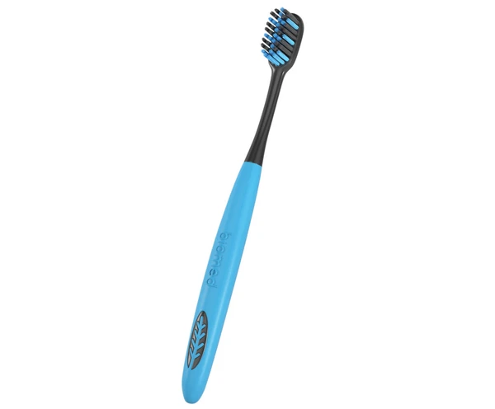
謎語題：
我的身體細又長，
頭長白毛身上光。
從來就愛講衛生，
天天嘴裏走兩趟。
(猜一種用具)
答案：牙刷

Slide 31
討論時間：
當你聽到同學評價自己的個人能力、長處及短處，你會有甚麼感受呢？
當你聽到同學分享對你的意見及看法時，你又會有甚麼感受呢？
今天有同學提出了你個人不足之處，你會怎樣處理呢？（接納及積極改善）
面對別人的不足之處，你會如何去幫助他們呢？
綜觀各人的長處，你會選擇那一項去發展呢？如何發展呢？

Slide 32
🎬分享心得

Slide 33
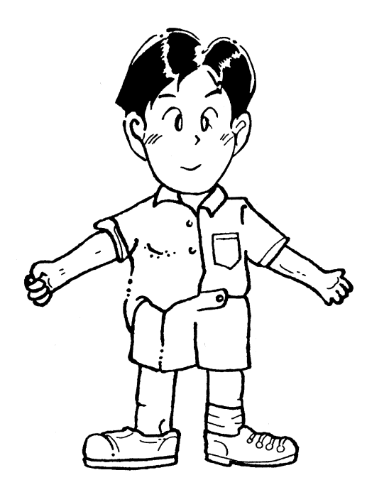
強項
長處
弱項
短處
Notes:
Discussion: we invited students to write down 2-3 of their own strengths and weaknesses and share with the group

Slide 34
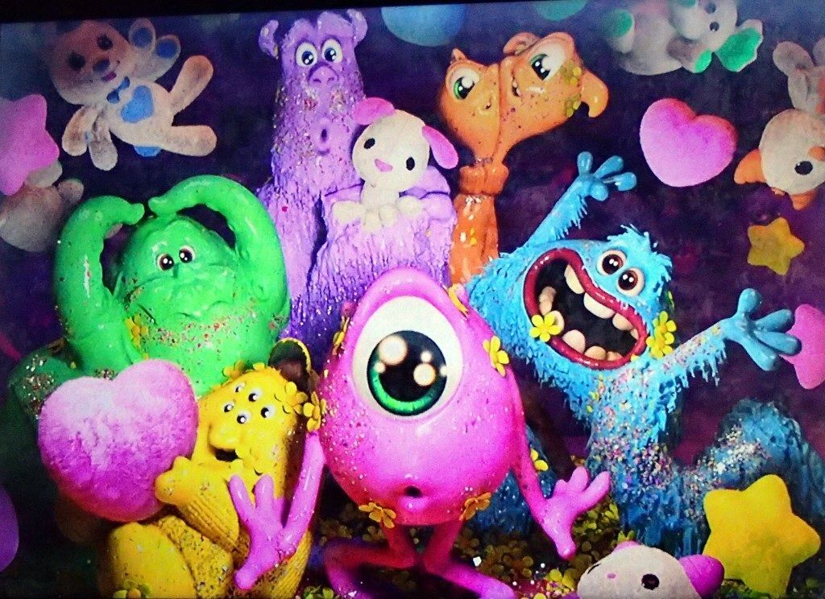
5分鐘小休時間
Break Time!

Slide 35
🎬電影時間3
Notes:
Video Clip: final game
Instructions for students: pay attention to the changes in their team dynamics
Summary
Final game: A clip of the final “Scare Games” competition with OK team competing against ROR team. “Every one of your skills will be put to the test. The Scare Simulator will prove who's the best.” This round involves each and every member of the team to scare a simulated doll and earn accumulative energy from the robot’s screams. One by one, team members go head to head in Scare Simulators, set to the very highest difficulty level. In this round, OK team won the competition and were deemed champions.
Purpose: furthering on the topic of teamwork. Students were able to compare the teamwork and effort of OK team members from the beginning of the movie to the end and see how they succeeded in coming first in the “Scare Games” competition.

Slide 36
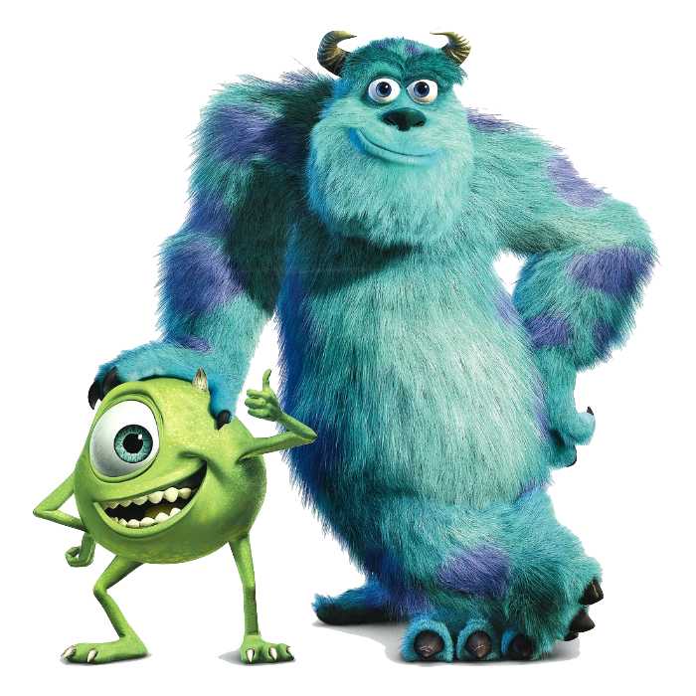
今日學什麼
怪獸大學強調自我肯定和朋友的重要：
毛毛認清自己雖然有做驚嚇專員的天賦，但是不能單靠天資而不努力。他的OK隊組員和米高令他明白到團體合作和每個人都有自己的才華。
雖然所有人都看不起米高，但是他沒有放棄，用他的勤力和聰明才智帶領隊員 打敗所有隊伍，拿下驚嚇大賽的冠軍。

Slide 37
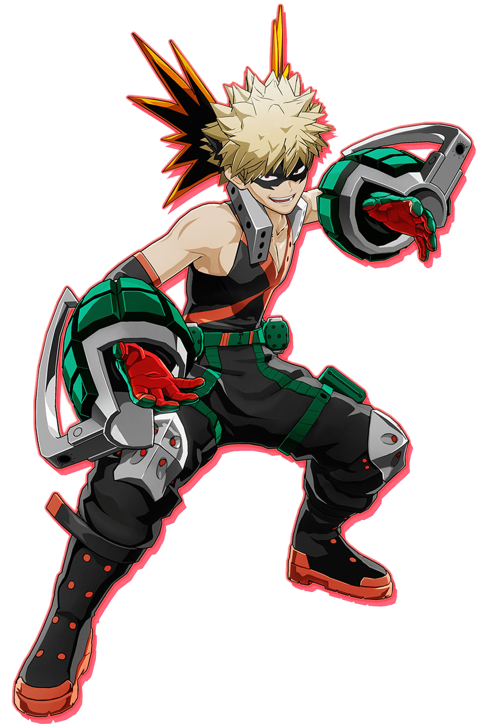
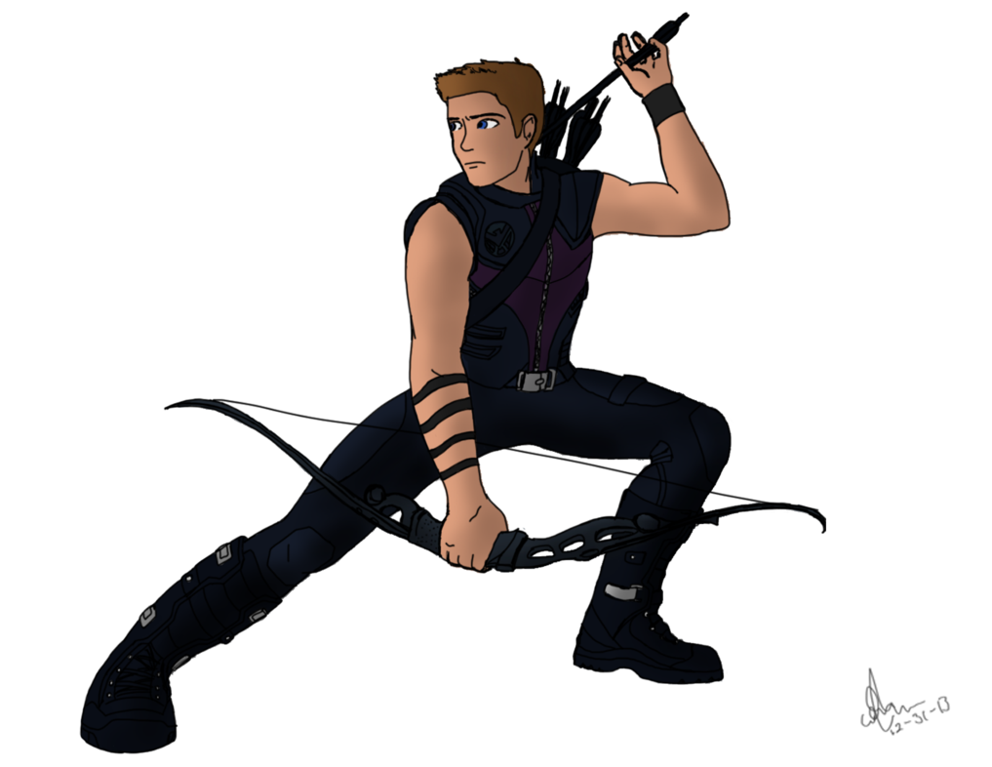
What makes a Hero?
Listen (聽話)
Attentive (留心)
Organised (組織能力)
Creative (創作力)
Flexible (思維靈活)
In control (掌控)
Communicate (溝通)

Slide 38
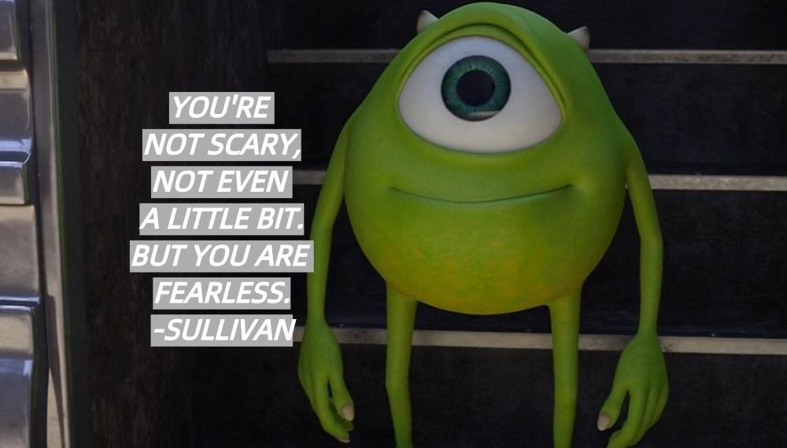
你一點也不可怕，但是你無所畏懼。
解讀：別讓別人否定你的與眾不同！

Slide 39
🎬總結時間
大家都有優點和缺點，差別在於我們能不能接受並學習改善自己和欣賞他人。朋友之間要懂得互相扶持、互相幫助，每個人都在發揮自己的長處。
Notes:
我們也應該珍惜友情、相信自己、努力發光發熱的樂觀傾向

Slide 40
請填妥選擇題，並於答案☑️
Notes:
Post-questionnaire

Slide 41
下星期六 10:00am 見

