Slide 1
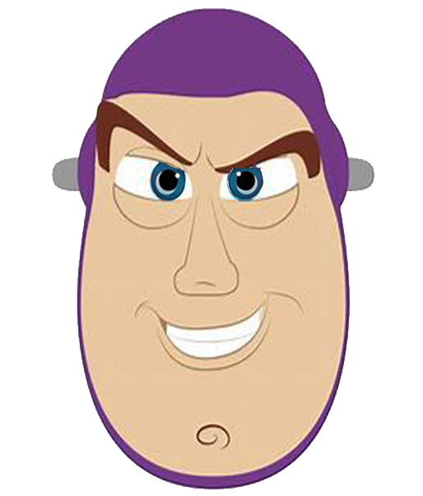
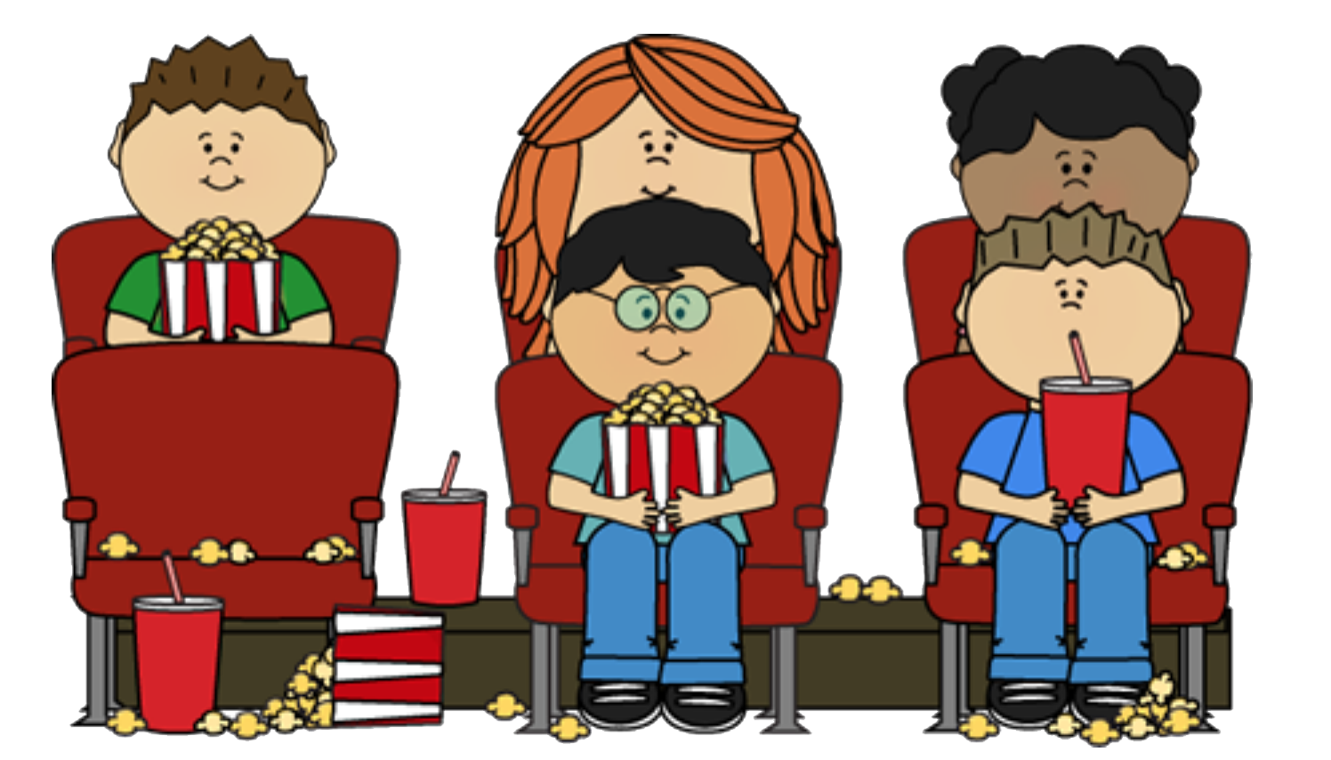
成長電影院
第一節

Slide 2
齊想想： 小組小規則
互相尊重
準時出席
用心觀看
專心聆聽
遵守秩序
積極參與
每節帶備此手冊及完成小任務
Notes:
狐狸物語：人人都有獨特才能
我們都有優點，每個人都是獨特而珍貴的，連玩具角色都是。《反斗奇兵3》展示所有存在都有價值，牛仔胡迪是領袖，但領袖也有盲點和錯誤決定的。每個角色都有自己的想法和決定，遇上危難時，個個都能發揮所長幫助團隊。

Slide 3
今日活動內容
主題 ： 互相認識既認識自己和他人
🎬播放 ：反斗奇兵
電影心得分享
周哈里窗🪟🪟：認識自己和他人總部控制中心
總結 ， 課外小任務

Slide 4
首先...
讓我們互相認識一下吧！

Slide 5
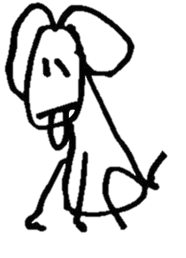
遊戲 1: 認識大家
你喜歡別人叫你什麼
Miss K
你最喜歡的電影
你的嗜好
歷史
中文
神奇隨意門
如果你能獲得一種
超能力或工具，
你會選擇哪一種？
你最喜歡和討厭的科目

Slide 6
遊戲 1: 認識大家
請想想你最想成為邊個電影人物，將他寫或畫在紙上。

Slide 7
將紙摺成一隻紙飛機，等Miss K數1、2、3，一齊將紙飛機飛到課室的另外一面！
猜猜這是誰？
Notes:
Ice Breaking Activity:
Students will have a paper each to draw the movie character they would like to become
Students will fold the paper into an airplane
Miss K will count to 3 and students will then be asked to fly their airplane to the other side of the classroom
Students will then pick up an airplane from the floor (make sure it’s not theirs)
Students will unfold the paper airplane and one by one, share with the class what the character they’ve picked up is
Students will then guess who the paper airplane belongs to and why the student chose that character

Slide 8
Notes:
Explained each of the ideas of the window (squares)
開放我：人前展現的一面，我和他人都知道的自己 (例如：性別，外觀)
盲目我： 他人看得出來的特質，但自己沒有察覺(例如：小習慣)
隱藏我：只有自己才知道，別人不知道或看不出來(例如：我的小秘密，特殊習慣，過去)
未知我：我和他人都還未發現，實際發生才知道(例如：未來)
Comments: the abstract idea of Johari Window was probably too complex for students to bring the awareness to themselves
Suggestions: Focus on 1 or 2 of the boxes at a time and practice knowing more and observing themselves more

Slide 9
🎬電影時間
Notes:
Video Clip: Woody + Woody 2
Instructions for students: pay attention to Woody and Buzz’s interactions with others and their characters
Summary
Woody: Woody’s interactions with other toys and leading them to find out what presents Andy has received for his birthday
Woody 2: Woody’s first interactions with Buzz, Buzz’s interactions with other toys and how Buzz replaced Woody in both positions as Andy’s favourite toy and other’s best toy friend
Purpose: introduction of Woody and Buzz to students and for them to analyze and look into Woody’s character

Slide 10
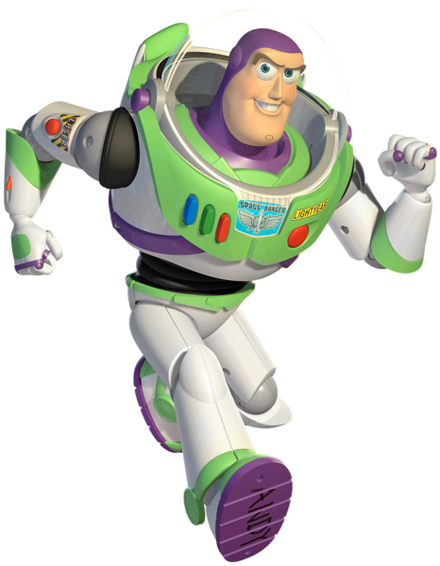
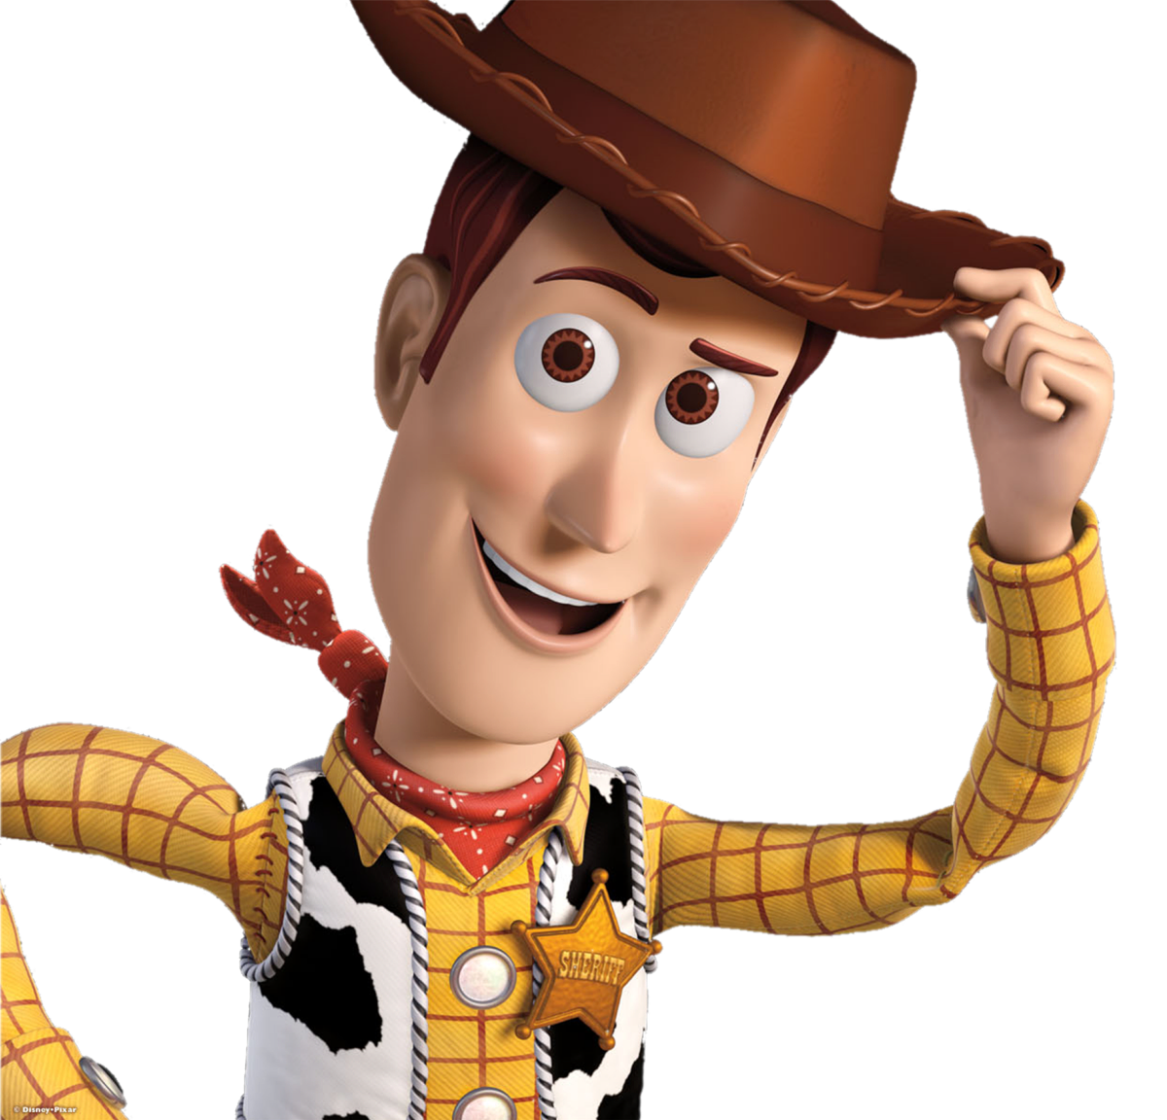
跟腦朋友 SAY HI
仔細留意胡迪和其他人的互動

Slide 11
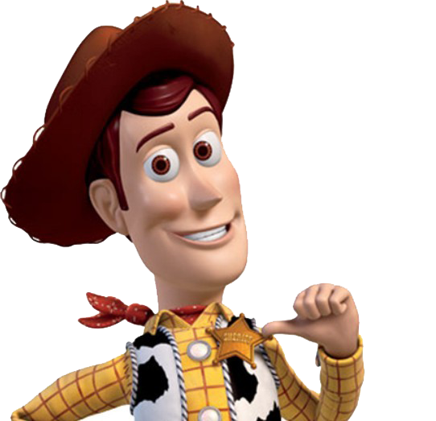
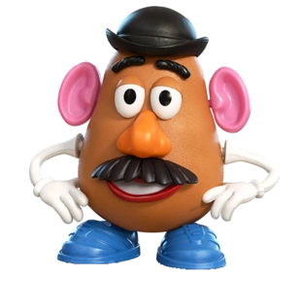
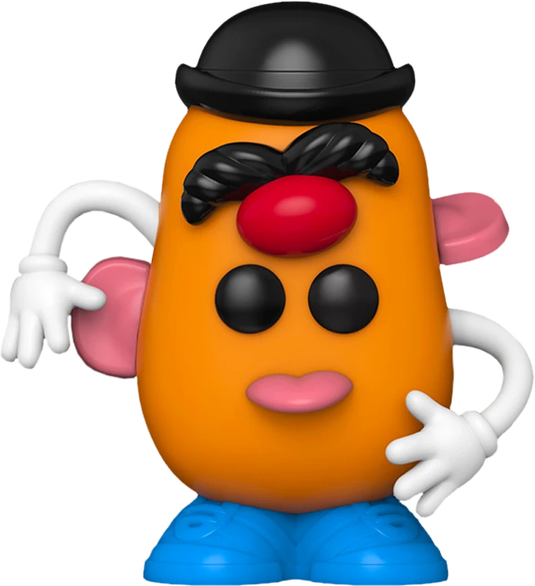
請留意
張開眼睛 =
胡迪知道的
閉上眼睛 =
胡迪不知道的
張開眼睛 =
其他人知道的
沒有眼睛 =
其他人不知道的

Slide 12
開放我：別人和胡迪都了解的部分
盲目我：胡迪自己蒙蔽看不見的部分
有自信
有領導才華
是一個牛仔
過分自信
沒禮貌
隱藏我：胡迪知道但其他人不知道的部分
未知我：胡迪自己和他人都不知道的備份
巴斯根本不是宇宙太空戰士，而是一件玩具
?？
Notes:
Open area – 開放我
Blind spot – 盲目我
Hidden area or façade – 隱藏我
Unknown – 未知我

Slide 13
🎬電影時間2
Notes:
Video Clip: Sid’s house
Instructions for students: pay attention to Woody and Buzz’s interactions with others and their characters
Summary
Sid’s house: Woody and Buzz were brought to Sid’s house. They observed how torturous Sid was to his toys and tried to escape. In the process, Buzz accidentally found out about his identity as a toy and not the Space Ranger superhero he thought he was. He got really depressed and the end scene was Buzz trying to fly to prove himself as the superhero, but he fell and broke one of his arm.
Purpose: in this scene, students were introduced to Buzz’s feelings and thoughts of finding out he was a toy. It also set the scene for the third movie watching parts.

Slide 14
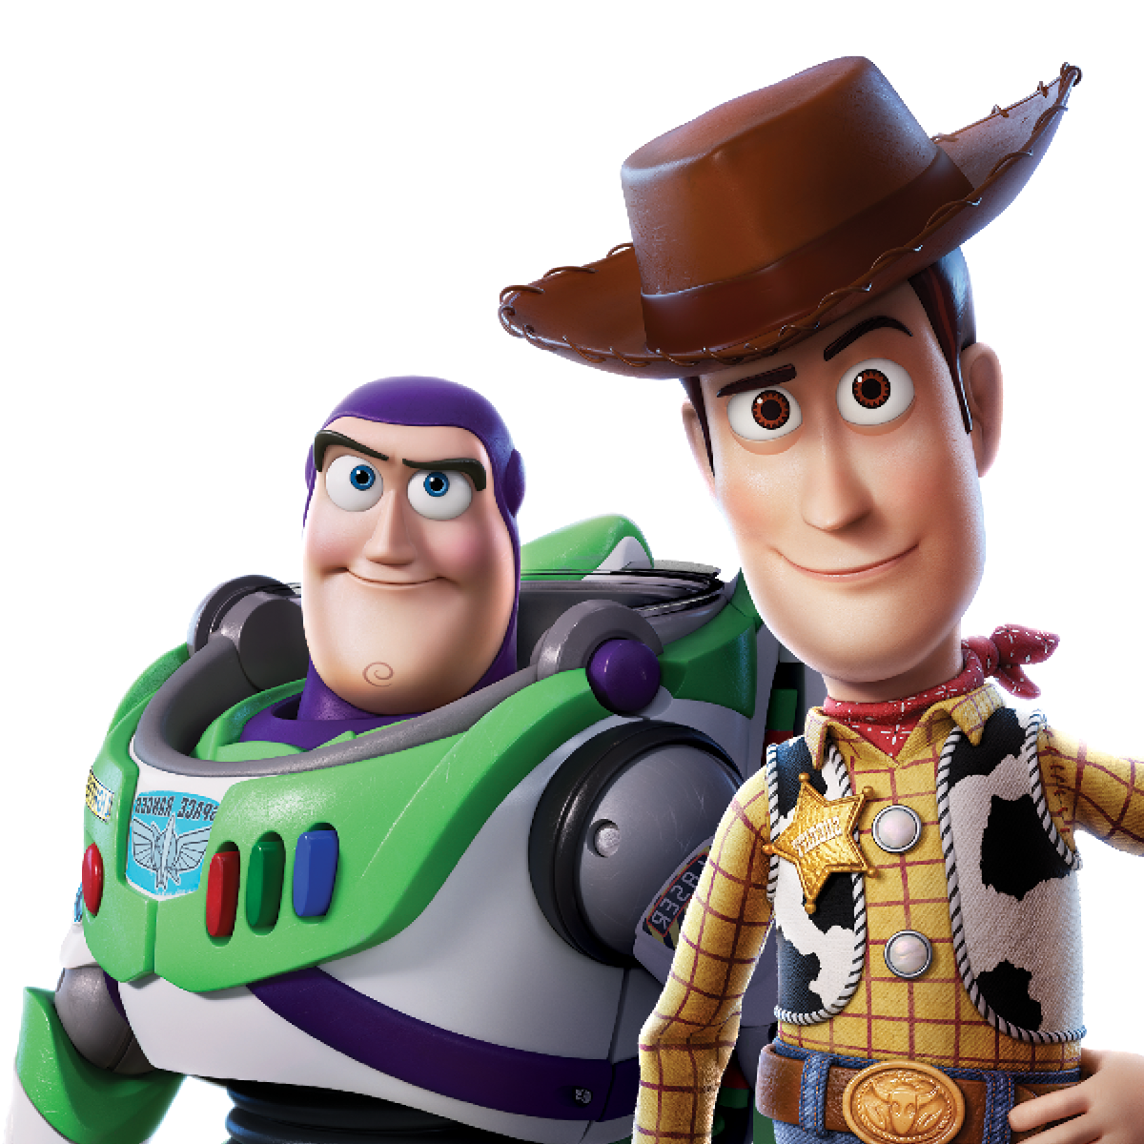
討論時間
你認為玩具們比較喜歡聽從胡迪或巴斯的性格呢？
如果你要選擇，你會想跟胡迪或巴斯做朋友呢？
為什麼？
Notes:
Discussion:
意行：Buzz Lightyear, 因為他的性格很隨和，而 Woody 過分自信和很克人憎
加佑：Buzz Lightyear, 因為他很有型
家亨：Both, 因為 Woody 很有領導才華，而 Buzz 很友善
迪浩：Woody, 因為我喜歡他的自信
宇軒：Buzz Lightyear, 因為他很有型，而且和其他玩具相處很好
Whether you’re dealing with a toxic friendship, some codependency or just need friends, these films will show you what friendship is, and what it’s not. When Andy chose Buzz over Woody, Woody was heartbroken. In Toy Story, Woody obviously handles it poorly at first, but then figures it out. You can go it alone for a while until you figure out what kind of friend you want and need. Friendship is a main theme in many Disney films so you will not be short of potential solutions to any friend problem.
孩子們在看的過程中感受到了各種努力的真誠，充滿歡笑之餘體會到了團隊協作的意義。雖然生活中難免遇到坎坷，但是通過大家的娭，一定可以克服困難。整部動畫片充滿了智慧，定義了真正的朋友不在於物質的虛榮，讓劇情更有沉澱感，讓孩子感受到成功。對於一個孩子來說，一個富於勇敢正直的靈魂遠比物質更寶貴。

Slide 15
vs

Slide 16
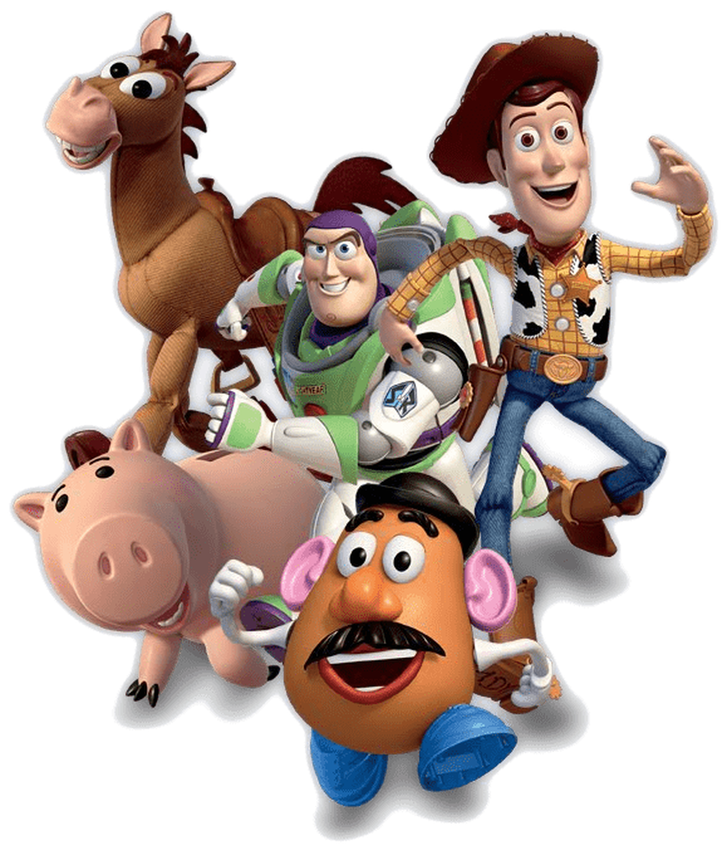
🎬分享心得

Slide 17
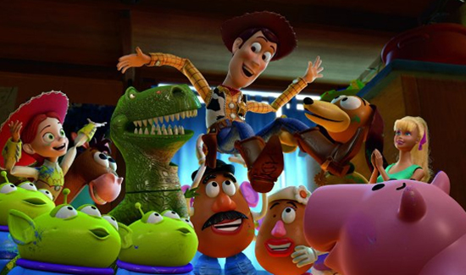
5分鐘小休時間
Break Time!

Slide 18
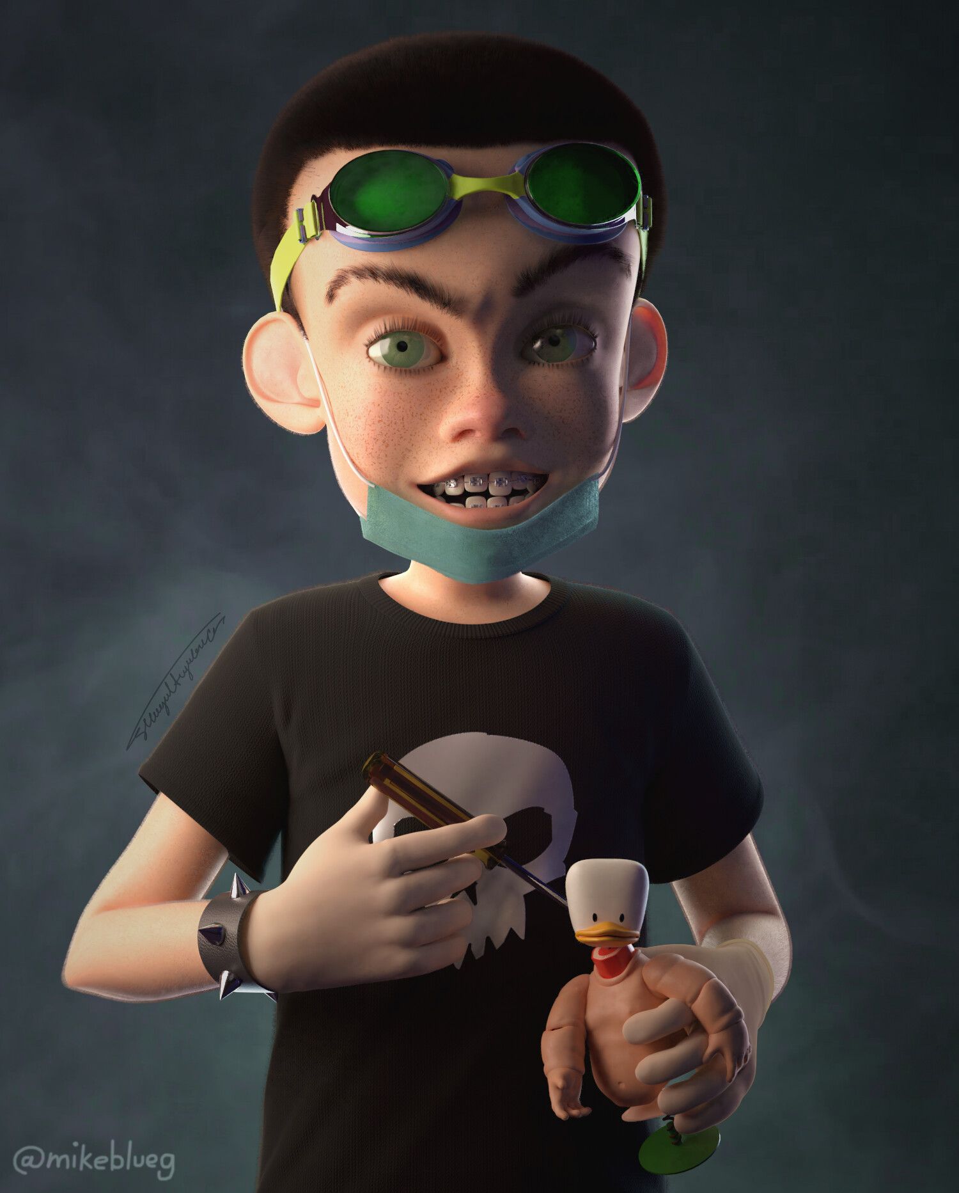
🎬電影時間3
Notes:
Video Clip: Woody and Toys Save Buzz
Instructions for students: pay attention to Woody and Buzz’s interactions with others and their characters
Summary
Woody and Toys Save Buzz: Woody cheered Buzz up and confessed to Buzz that he felt he was not enough. Sid tied Buzz onto a rocket and planned to blow him up but Woody asked Sid’s scary-looking toys for help to save Buzz and scare Sid for hurting them.
Purpose: This scene had a lot of learning opportunities. Firstly, students could learn from Woody who was able to let go of his ego and confess to Buzz about his weaknesses and negative thoughts. Secondly, students could see a change in Woody’s impression on Sid’s toys as he initially thought they were evil and violent simply because of their appearances; but upon knowing the toys, he realized they were all kind-hearted toys who were just tortured and disfigured by their owner. He then let go of his prejudice and asked them for help. He also used his amazing leadership skills to formulate a brilliant plan to revenge on Sid and save his best friend Buzz Lightyear.

Slide 19
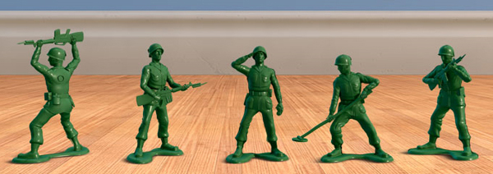
在影片裏，你有看到團隊合作的部分嗎？他們怎麼分工呢？
Notes:
Discussion: There were multiple scenes of teamwork. This question was used to introduce students to the concept of teamwork and cooperation.
人人都有獨特才能
我們都有優點，每個人都是獨特而珍貴的，連玩具角色都是。《反斗奇兵3》展示所有存在都有價值，牛仔胡迪是領袖，但領袖也有盲點和錯誤決定的。每個角色都有自己的想法和決定，遇上危難時，個個都能發揮所長幫助團隊。

Slide 20
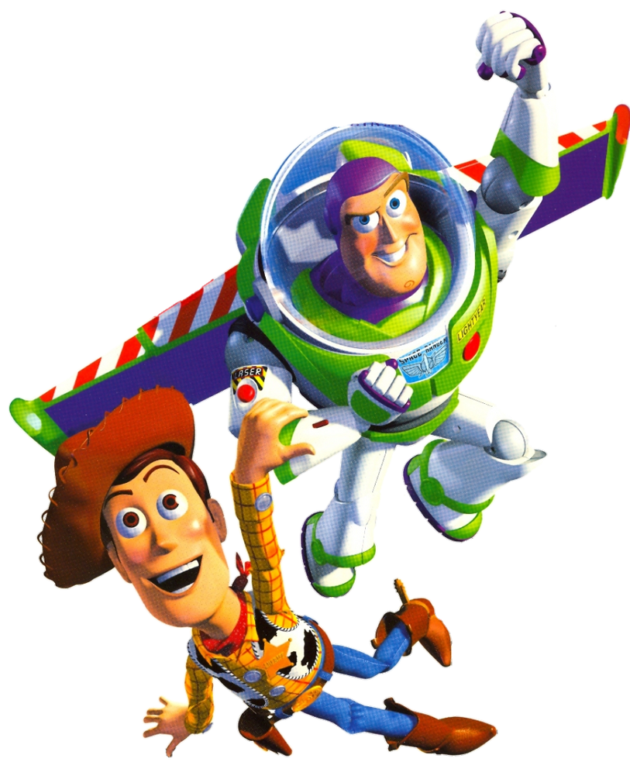
今日學什麼
反斗奇兵強調自我價值的重要：
巴斯光年得到胡迪的鼓勵和支持，認清自己作為一件玩具的價值，自信令他可以真正的「一飛沖天」
胡迪要拋開被取代的嫉妒與加強自信，承認自己比不上巴斯，並真誠地邀請其他玩具拯救巴斯一齊回到安仔身邊
Notes:
在最低潮的時期，巴斯最需要的就是朋友和家人的鼓勵和支持。當他聽到胡迪的真情傾訴後記起了自己作為一件玩具的價值，就是在鞋底寫的「ANDY」- 一個真心欣賞他愛護他的人。
因為新玩具巴斯光年加入後受到冷落，當新加入者擁有超人般令人稱羨的能力，而自己只是個衣裳破舊的牛仔時，胡迪更加失落。一個人為求爭回以往的重視，很容易失去自我，做出一些自己都不理解的損人利己行為，被身邊的人討厭。胡迪直到為喚醒巴斯共同努力逃出阿薜的家，他才第一次真正勇敢的面對自己，誠實地承認自己比不上巴斯光年，但他真心希望可以和巴斯一起回到安仔身邊去。沒有一種光輝可以永恆，認清自己的定位，接受自己，每個人都是獨一無二，心胸廣闊、珍惜朋友和懂得欣賞他人，這才是討人喜歡和可親的人。

Slide 21
🎬總結時間
很多時候， 我們總是去挑剔、找出及放大不夠完美的地方，但其實我們也該要把多點時間，學會欣賞和發掘自己的價值 ！
學習欣賞自己和他人的優點
Notes:
我們也應該珍惜友情、相信自己、努力發光發熱的樂觀傾向

Slide 22
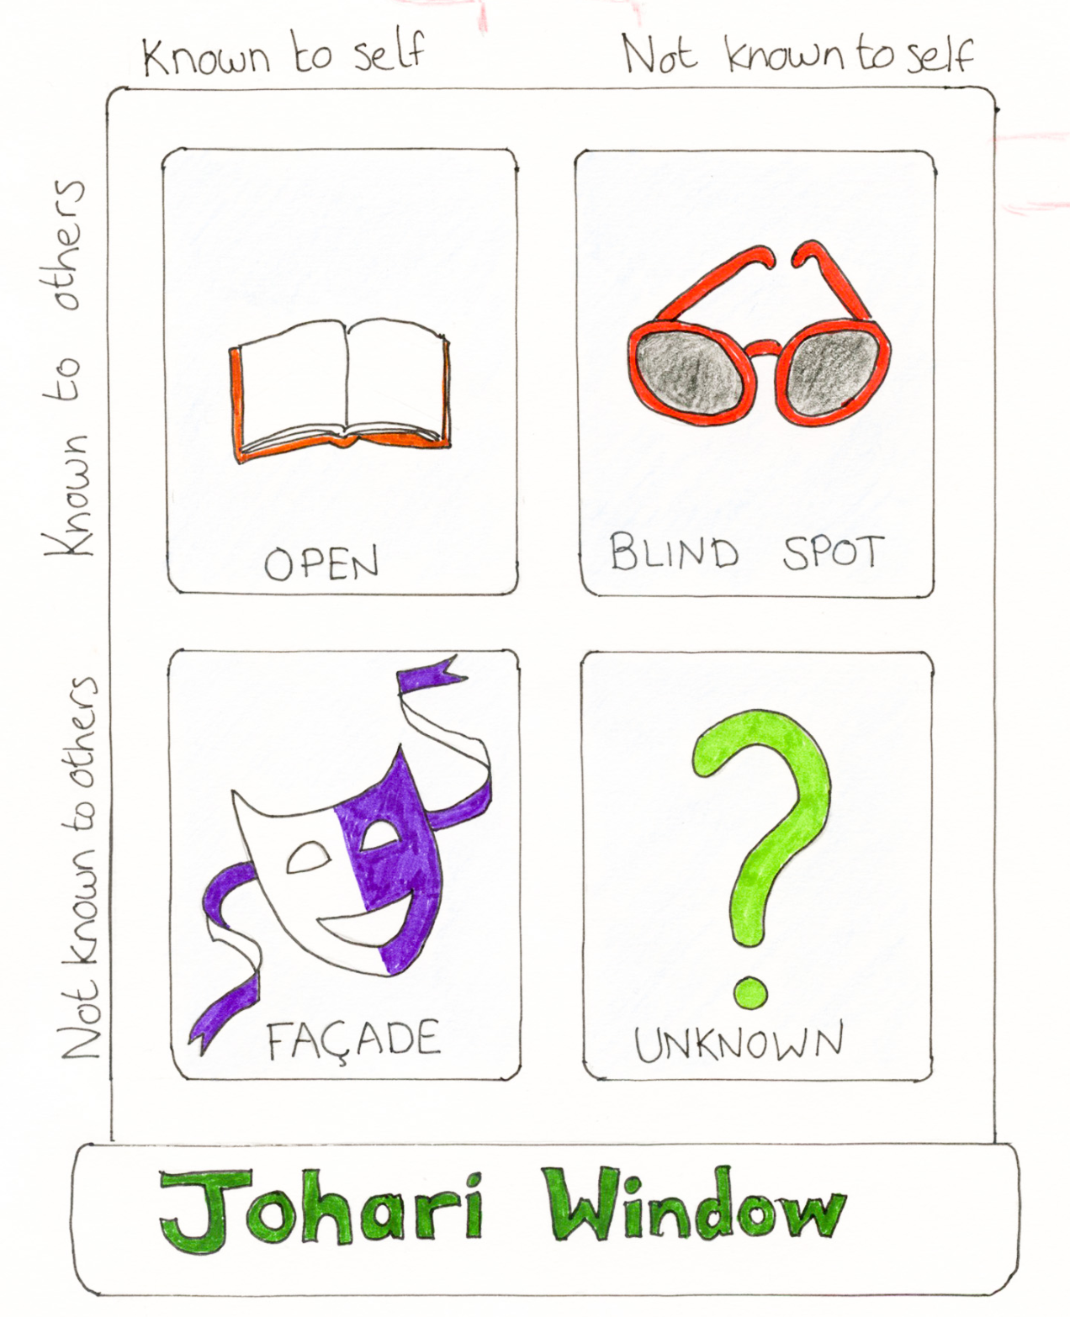
發揮想像力 ：
創做你們獨一無二的
總部控制中心
有沒有聽過別人這樣形容你呢？
「你認為我是個怎樣的人呢？」
有什麼你的秘密是沒有人知道的呢？
開放我
盲目我
隱藏我
未知我
周哈里窗🪟🪟
Notes:
Comment: 小組當天我們沒有時間做這個活動，但是如果可以花多點時間解釋周哈里窗，可以讓學生自己創造他們獨一無二的 Johari Window 和幫他們更了解並認識自己

Slide 23
下星期六 10:00am 見

