Slide 1

成長電影院 🎬
第五節
X月X日 XX:XX - XX:XX
Miss K, Miss M

Slide 2
小組小規則
準時出席
尊重他人
安靜坐好
用心觀看
專心聆聽
積極參與
帶手冊及完成小任務

Slide 3

OUR GROUPMATES 我們的小組組員
XX XXX
XX XXX
XX XXX
XX XXX
XX XXX
XX XXX
WE ARE FRIENDS

Slide 4
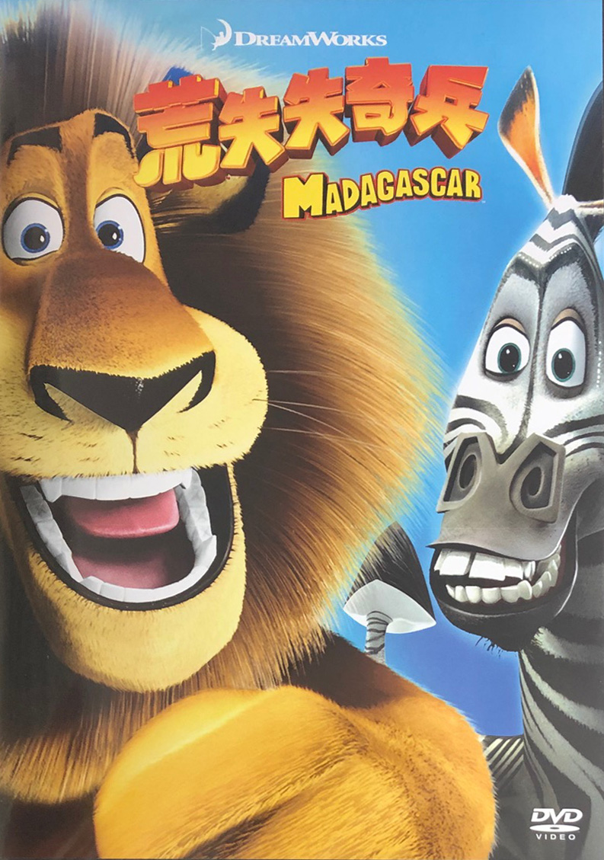
記得我們上星期看了什麼電影嗎？
馬達加斯加 Madagascar

Slide 5
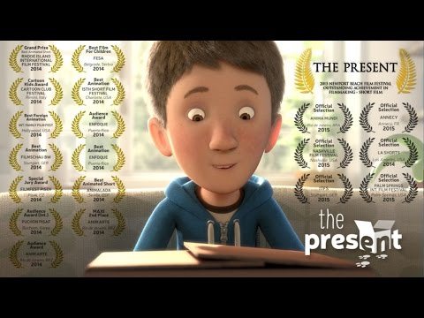
A short story on - kindness must see
Notes:
<The Present>
Plot:
A 12-year-old boy plays a shooter video game in a darkened living room behind blinds, but is surprised when his mother arrives with a box, saying it contains a present for him. She then goes upstairs to answer a phone call. The boy opens the box, revealing an energetic young puppy. The boy's delight turns to disgust however, as he sees the puppy is missing most of his left front leg. He tosses the puppy away and continues playing his game. Unperturbed, the puppy finds a red rubber ball under a cabinet and walks up to the boy, carrying the rubber ball and inviting him to play. The boy does his best to ignore the puppy but is soon won over by his determination and spirit, in spite of himself. The boy shuts off the video game and decides to go outside to play fetch with his dog, where it is revealed that he walks with crutches, as his left leg has been amputated below the knee.

Slide 6
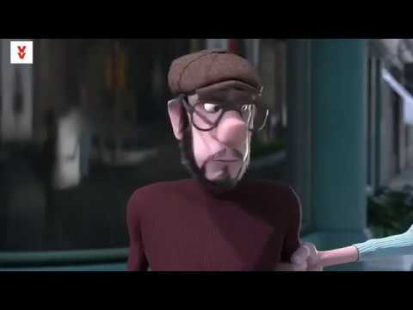
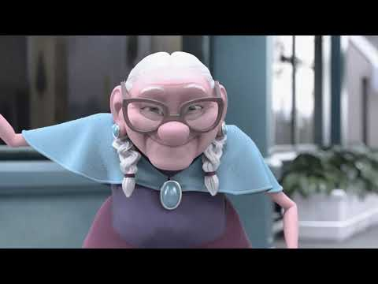
Notes:
<#Strangers> 2:28
Plot: Short video revolving around a grumpy man who wasn’t mindful of other people or helpful. He met an old lady by accident while waiting to cross the road and understood the beauty of helping people and being nice. Look at the changes in his life after this transformational encounter!

Slide 7
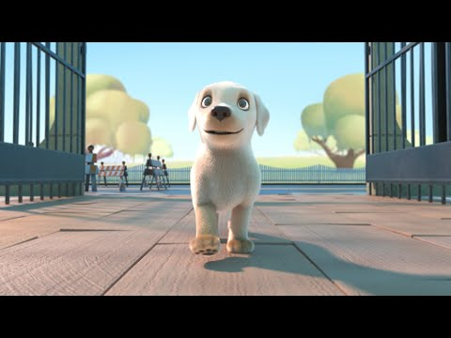
Notes:
<PIP> 4:05
Plot:
“Pip” animated short film presented by Southeastern Guide Dogs -- A heartwarming tale for underdogs everywhere, Pip is the story of a small dog with a big dream—to become a Southeastern Guide Dog. Does she have what it takes?

Slide 8


Slide 9
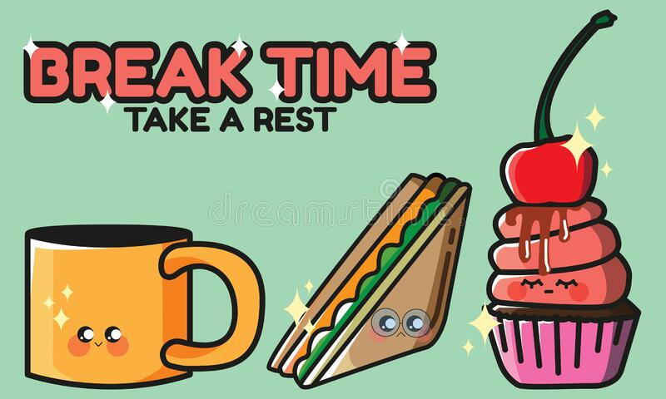
10 分鐘

Slide 10
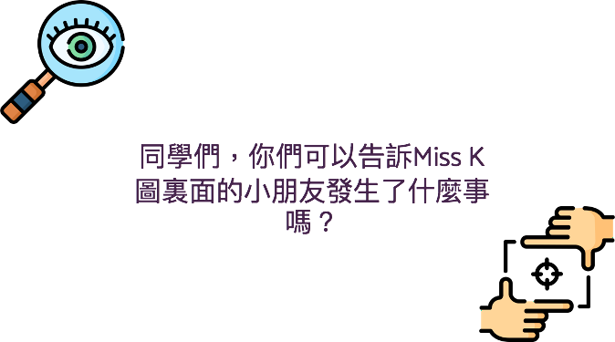

Slide 11
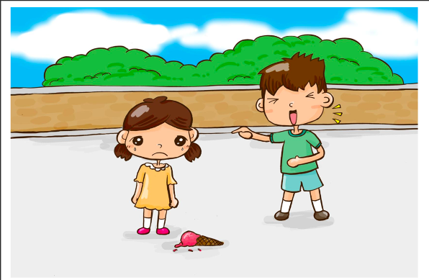

Slide 12
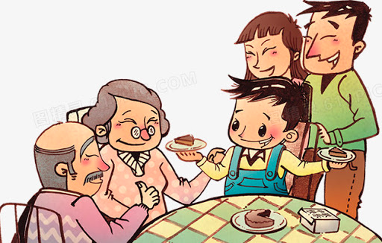

Slide 13
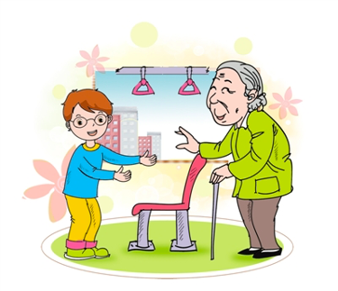

Slide 14
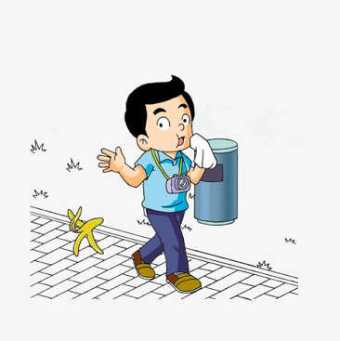

Slide 15
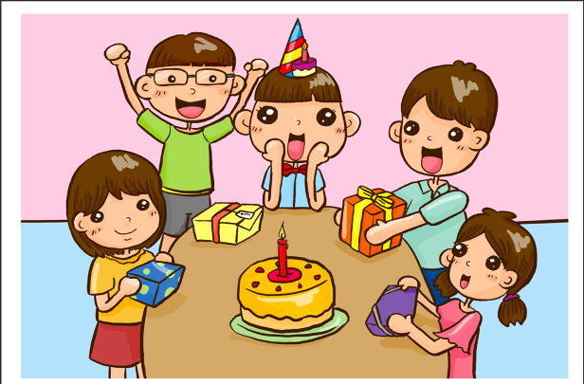

Slide 16
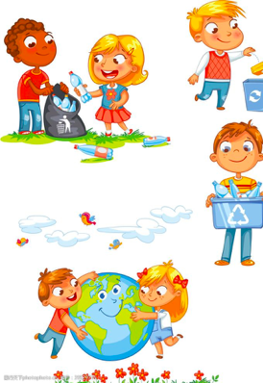

Slide 17
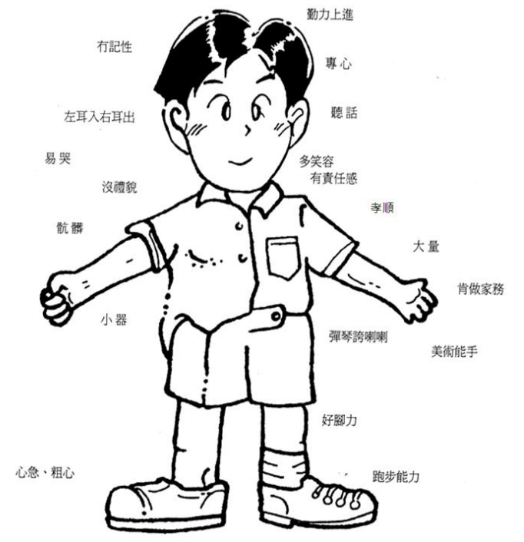
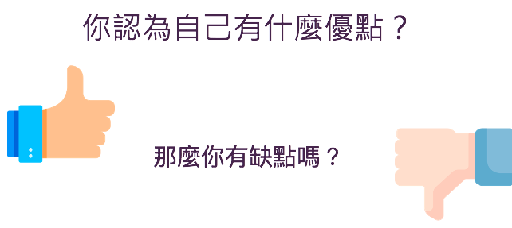

Slide 18
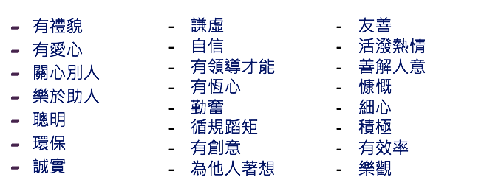

Slide 19
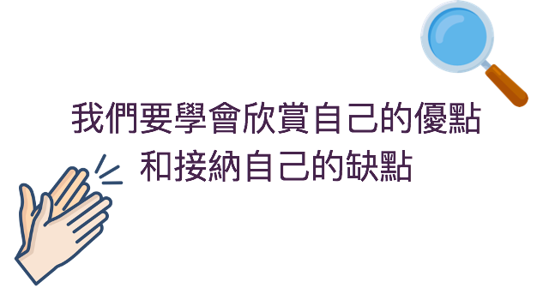

Slide 20


欣賞自己小任務：

Slide 21
下一節
xx月xx日
xx:xx - xx:xx
記得完成小任務！

