Slide 1

成長電影院 🎬
第四節
X月X日 XX:XX - XX:XX
Miss K, Miss M

Slide 2
小組小規則
準時出席
尊重他人
安靜坐好
用心觀看
專心聆聽
積極參與
帶手冊及完成小任務

Slide 3

OUR GROUPMATES 我們的小組組員
XX XXX
XX XXX
XX XXX
XX XXX
XX XXX
XX XXX
WE ARE FRIENDS

Slide 4
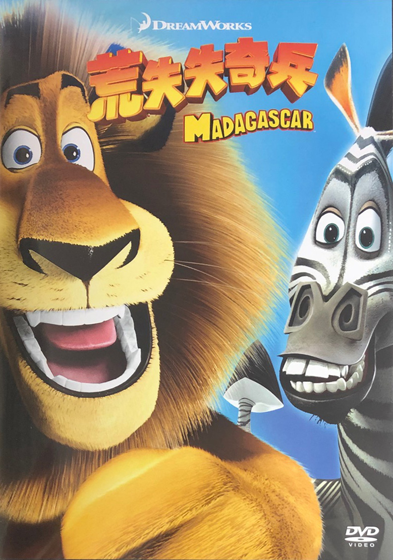
記得我們上星期看了什麼電影嗎？
馬達加斯加 Madagascar

Slide 5
55:31-1:19:36
Notes:
Alex faces one of the toughest challenge as he is desperate to indulge his carnivorous cravings and is longing for his favorite steak. Alex recovers and is very upset at himself for attacking Marty. He's worried what might happen, so he runs off. He falls into a river and ends up floating to another part of the island, the place where the fossa live. Marty, Gloria and Melman hurry to the beach as they see the same ship that they'd been on earlier. Marty has run off to go find Alex. Alex talks to Marty for a little bit, but he was so hungry so he goes deeper into the rocks to hide. Marty and tells Alex he isn't going anywhere without him. Then the fossa attack Marty. Melman, Gloria, and the penguins arrive to bring Marty back. Alex then shows up and save them all. Marty tells his friends that he's ok with just staying on Madagascar, or going back to New York, just as long as he can be with his friends. They decide to go back to New York.

Slide 6

10 分鐘

Slide 7


Slide 8
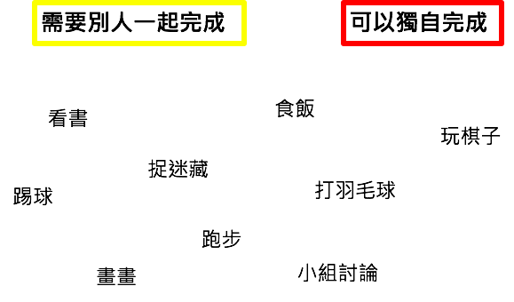

Slide 9
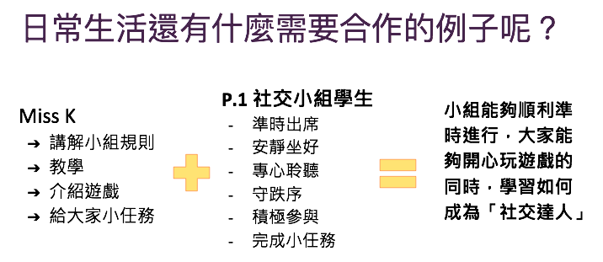

Slide 10
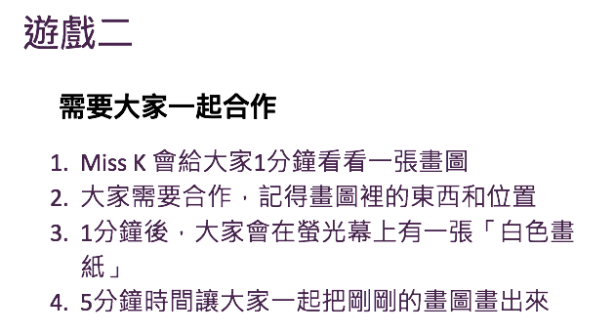

Slide 11
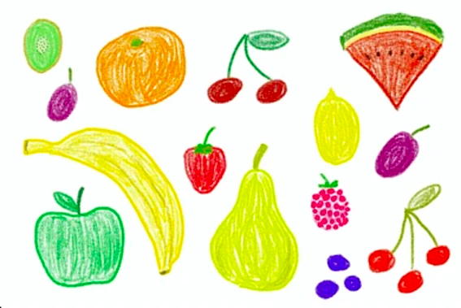

Slide 12
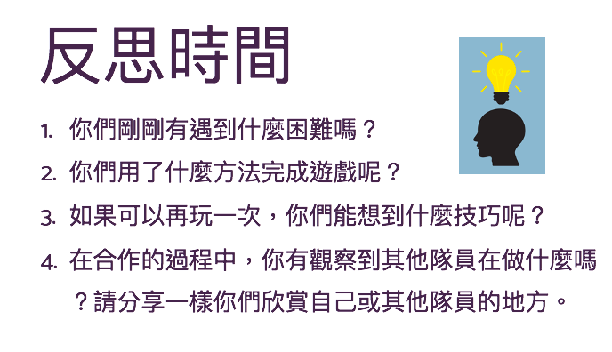

Slide 13
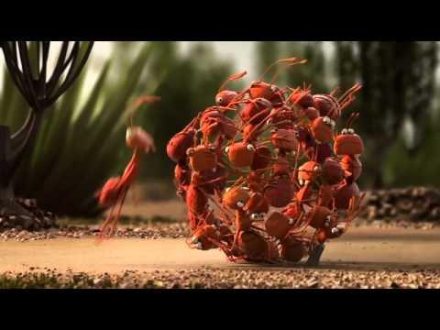

Slide 14
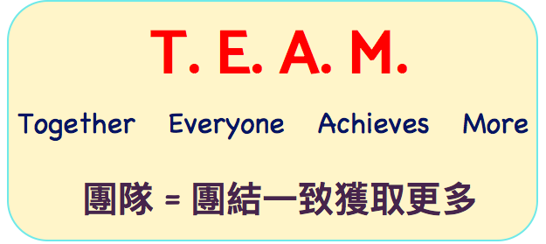

Slide 15


合作小任務：
- 你邀請了誰跟你合作呢？
- 你怎樣邀請她/他跟你合作呢？

Slide 16
下一節
xx月xx日
xx:xx - xx:xx
記得完成小任務！

